Slide 1
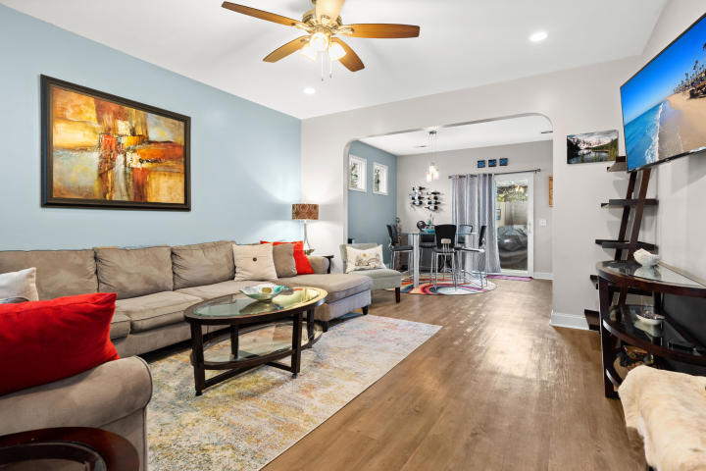
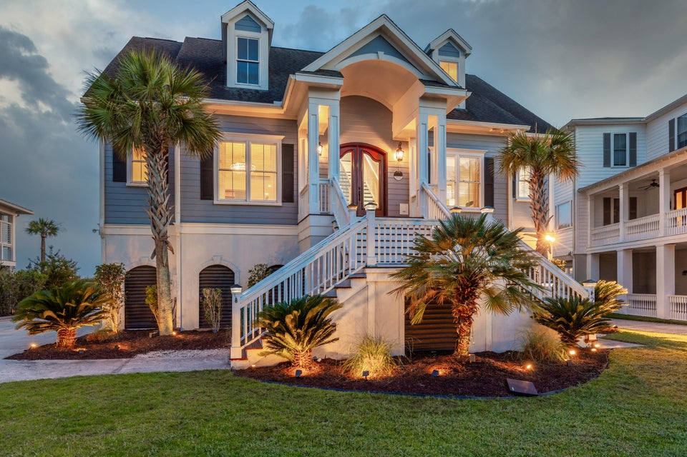
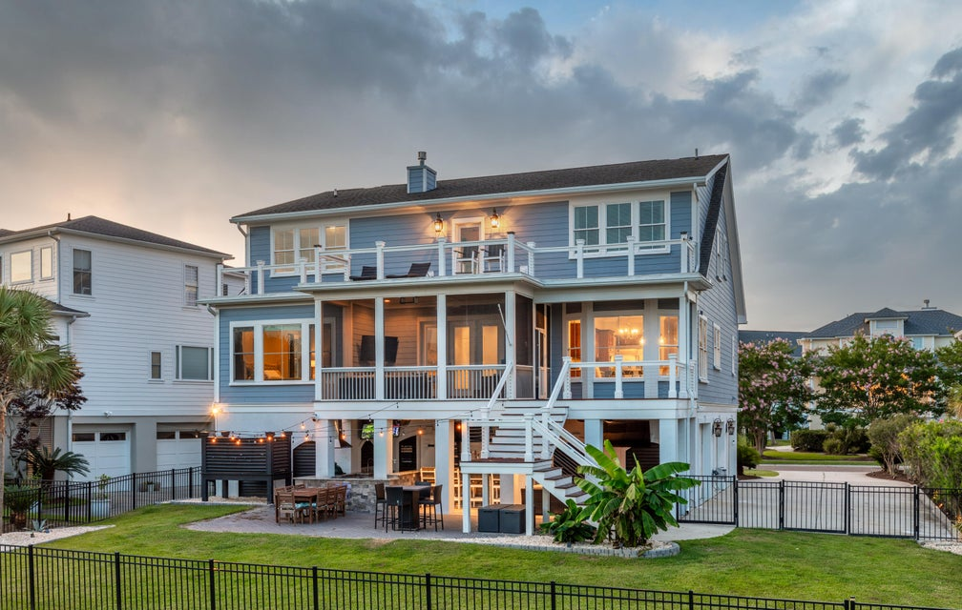
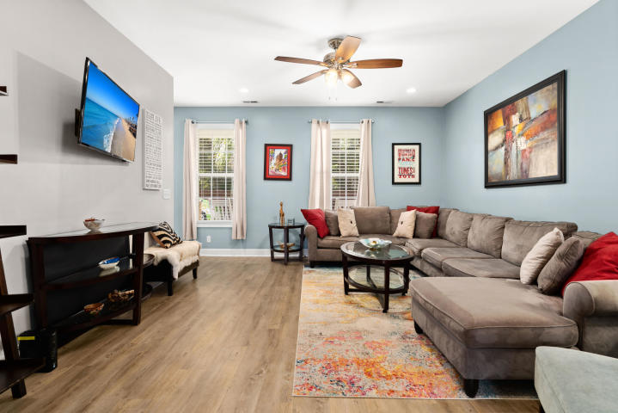
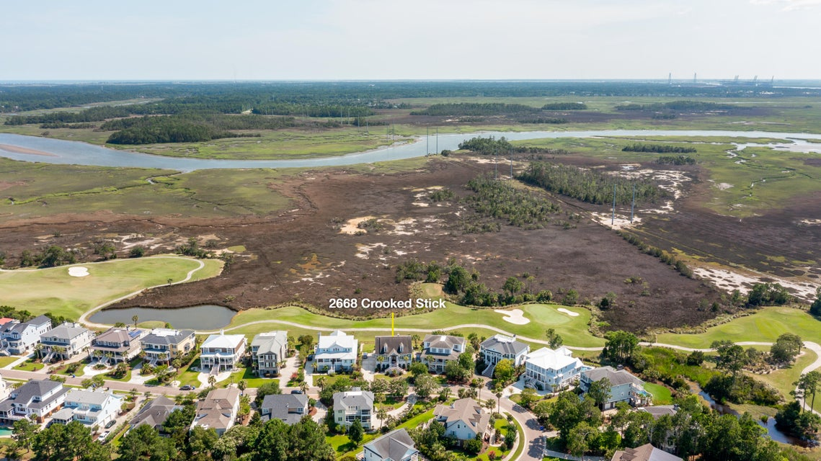
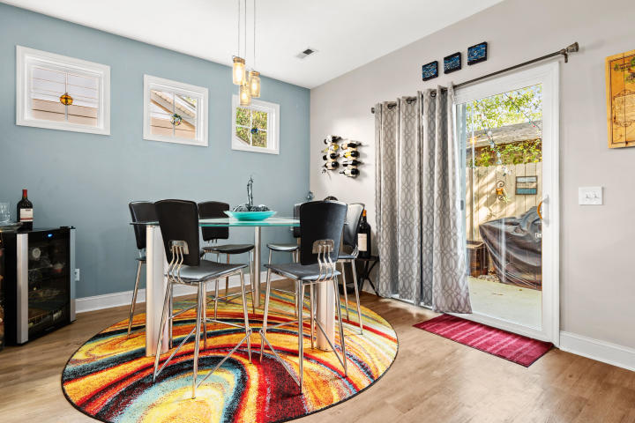
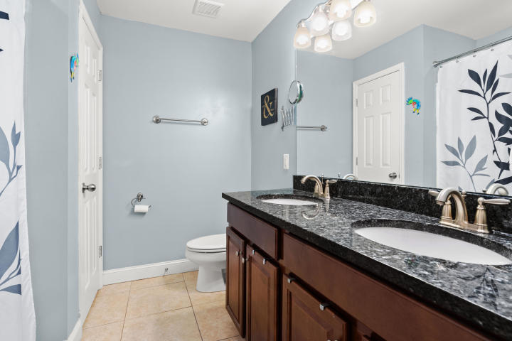
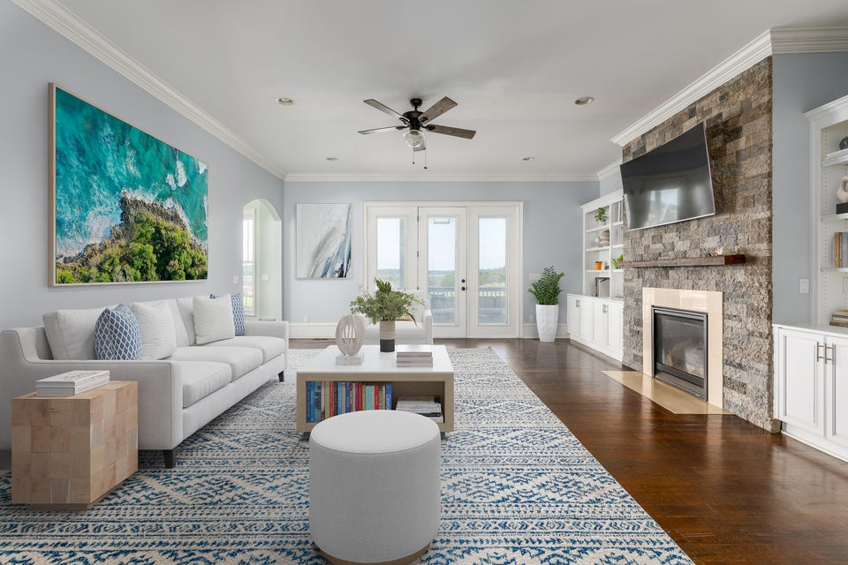
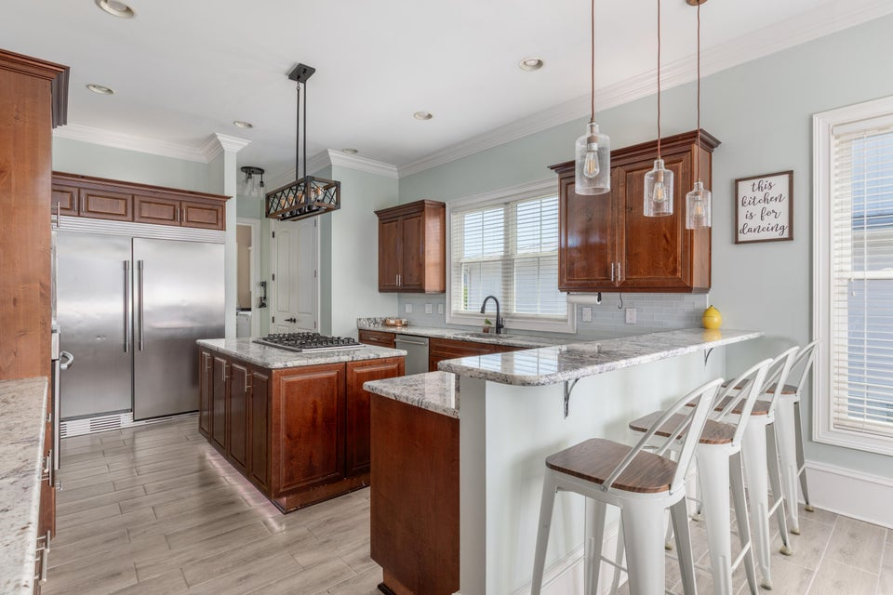
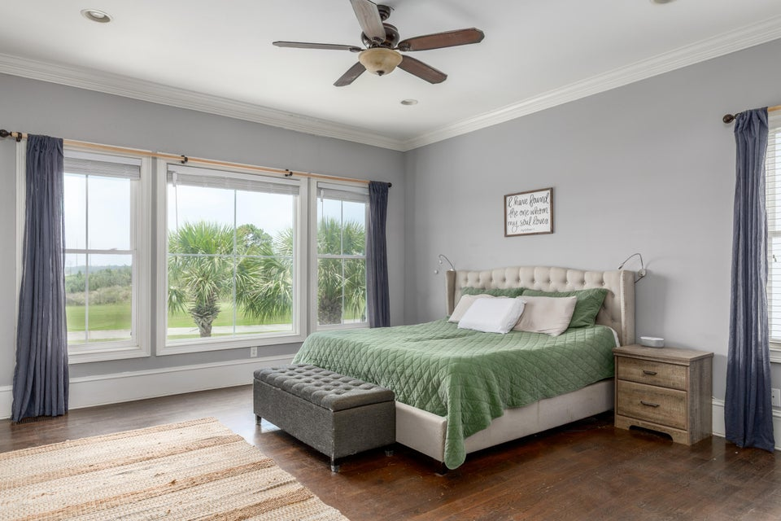
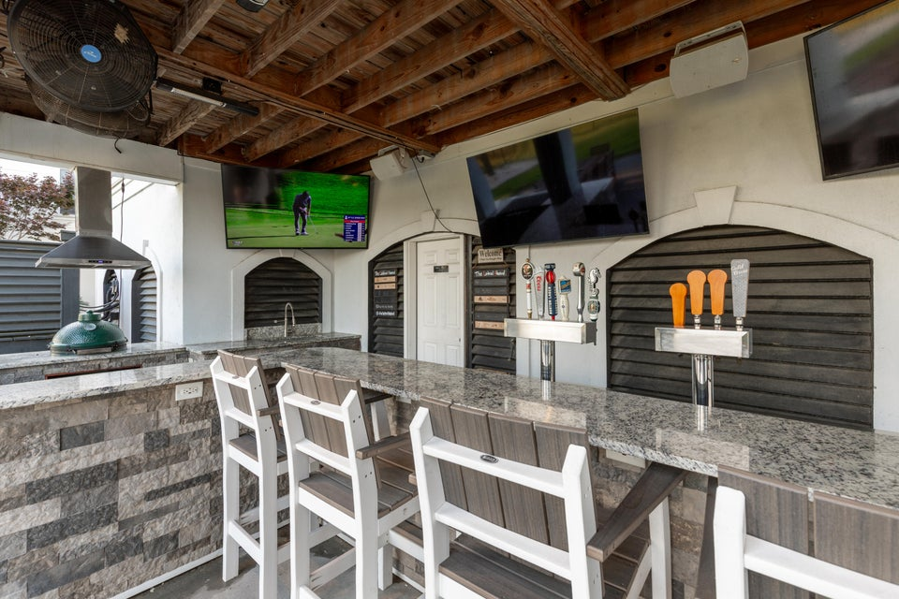

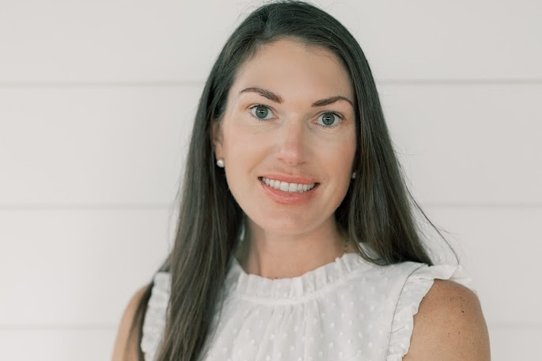
Under 1.3M on Golf Course W/ Marsh Views
2668 Crooked Stick Lane
Rivertowne Country Club · Mount Pleasant, SC 29466 · MLS# 25017953 · $1,299,000
Welcome to your Lowcountry home! Perfectly positioned on the 9th hole of Rivertowne Country Club, this elevated custom-built residence offers sweeping marsh views for miles with front-row seats to colorful sunsets, golf course activity, and even holiday fireworks shows. This spacious 5-bedroom, 4-bath home features smart home technology thoughtfully integrated throughout—giving you effortless control over lighting, climate, and more for modern, comfortable living. The main floor offers easy, everyday living with a private primary suite, a well-appointed guest bedroom, a dedicated laundry room, and a formal dining room perfect for hosting family dinners and special occasions. The large family room features custom built-ins and a cozy fireplace - ideal for gathering with family and friends. The kitchen is designed for both function and style, offering abundant cabinet and counter space, new flooring, and recently installed backsplash, perfect for everything from casual meals to larger gatherings.
Upstairs, you'll find three additional bedrooms, a large bonus room currently set up as a theater or playroom, and a flex space that makes the perfect home office/gym/homework nook. Step outside to your screened porch and soak in the coastal breezes and breathtaking marsh views - an ideal spot for morning coffee or enjoying spectacular sunsets. Downstairs, the fun continues with a fully equipped outdoor kitchen and bar area complete with multiple TVs - perfect for hosting guests and making the most of Lowcountry living all year long. Additional highlights include an oversized 3-car garage with plenty of storage for vehicles, golf carts, and outdoor gear, plus an elevator shaft already in place for future installation. Whether you're a golfer, nature lover, or simply enjoy peaceful evenings with unforgettable views, this home offers the perfect blend of charm, space, and modern convenience in one of Mount Pleasant's most desirable communities.
Schedule your showing today!
Keller Williams Realty Charleston West Ashley
1180 Sam Rittenberg Ste 300
Charleston, SC 29407
Deanna Stinnett
843-708-3234
deanna.steedley@kw.com
deannasteedley.kw.com

