Slide 1
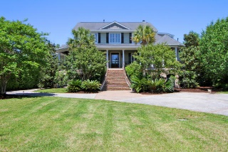
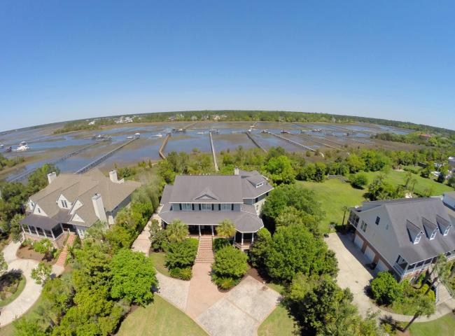
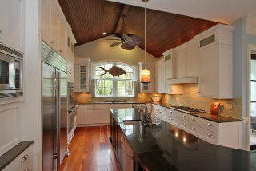
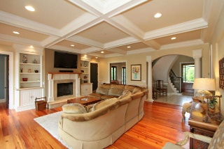
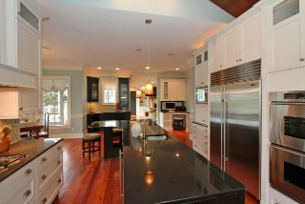
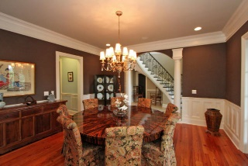
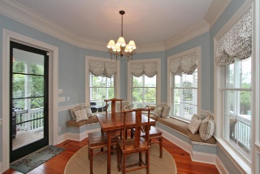
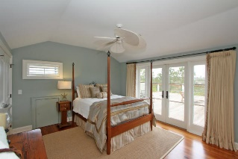
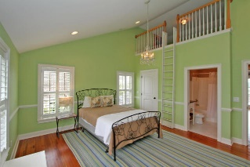
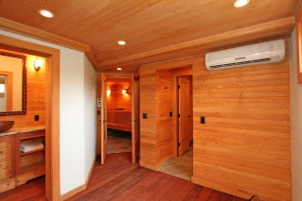
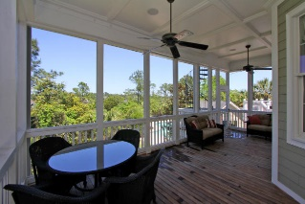
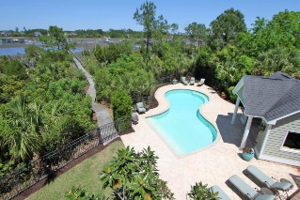


2678 Egrets Landing Court
Brickyard Plantation :: Mount Pleasant :: MLS# 15011355 :: $2,099,000
Lowcountry Living At Its Finest
Deepwater Dock On Horlbeck Creek
This home is the epitome of gracious lowcountry living! Salvaged heart of pine hardwood floors throughout the first floor and part of second floor. A beautiful curved staircase greets guests in the foyer. French doors connect the indoor and outdoor living spaces in the dining room and living room. This home is wired for surround sound and is perfect for entertaining. Screened-in porch, deck, pool and dock have panoramic views of the marsh and Horlbeck Creek. Relax and enjoy the beautiful sunsets! Stunning dining room has 300+ bottle wine chiller. Magnificent kitchen with glass tile backsplash and granite countertops boasts large island with lots of seating, custom cabinets, subzero refrigerator, Dacor 5-burner stove, double ovens, warming tray and double dishwashers. Bar area next to breakfast nook is a perfect serving station for get-togethers and parties. Sit down to breakfast and enjoy the views! Beautiful living room has coffered ceiling and custom cabinetry plus a gas fireplace with limestone surround. A hidden spiral staircase leads from the living room to the entertainment room upstairs. The master bedroom on the first floor has its own private deck with a hot tub. The walk-in master closet has his and hers space with organizers. The master bath has a large tiled walk-in shower with dual shower heads, a jetted bath tub, and dual vanities with granite countertops and built-in storage. First-floor study can be used for a home office or a music room. Spectacular second bedroom has an expansive deck with beautiful views and a spiral staircase to the first-floor screened-in porch. Two other private bedrooms are upstairs with private baths and lofts that make a great reading/play time. There is another large den upstairs currently used as an office. It would be another great den or reading room. The media room has a small balcony and is great for family movies. There is also a full bath off the media room. The large craft room/play room would be perfect as an art studio with panoramic views from all windows. This is truly a luxury estate. Brickyard community has swimming team, swimming pool, play park, tennis courts and boat ramp. Community is close proximity to schools, beaches, shopping, hospitals.
Kimberly Ritter
ABR, CRS, REALTOR
Office - (843) 216-2356
Fax - (843) 202-2923
Mobile - (843) 693-8802
kritter@carolinaone.com
www.SearchForCharlestonHomes.com
Carolina One Real Estate
628 Long Point Rd
Mt Pleasant, SC 29464

