Slide 1
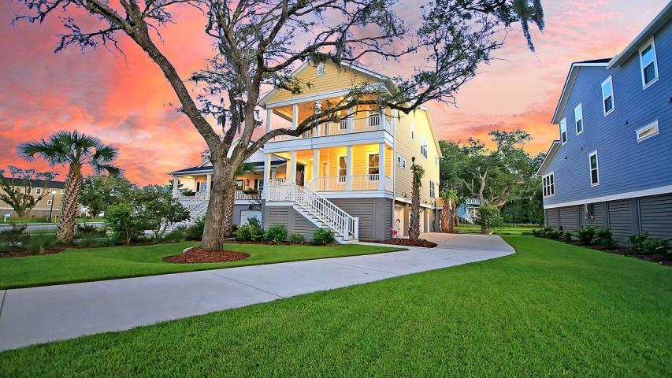



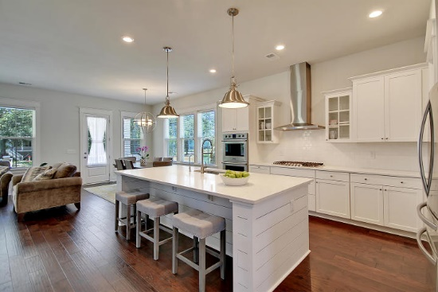
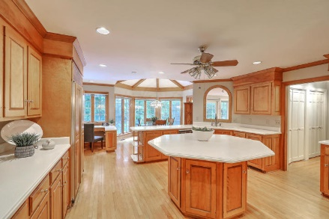
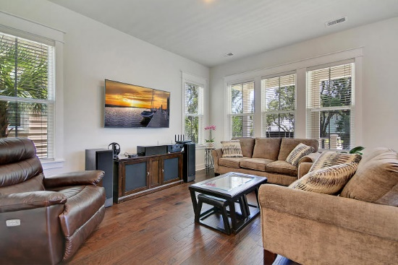



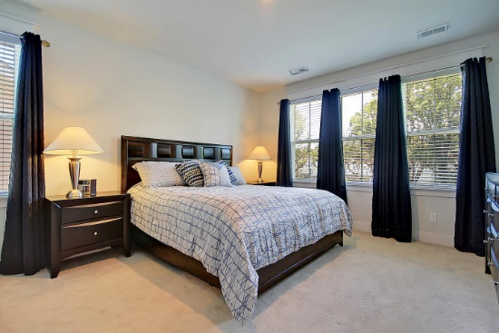

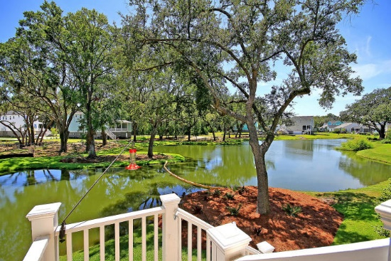
Parkshore Marshfront
Recently Reduced!
2679 Colonel Harrison Drive
Stonoview ~ Johns Island, SC 29455 ~ MLS# 19021996 ~ $510,000
Located in the gorgeous community of Stonoview on Johns Island, this elevated home has incredible views of the Stono River AND Ravenel Bridge from the front porch and balcony. As if the view from the front wasn't amazing enough, what makes this location even better is the peaceful pond that the home backs up to. This home is shows like model and is well appointed with a center island, Carrera Marble tops, subway tile backsplash, SS appliances, craftsman trim package, high ceilings and a luxurious, subway tile walk-in rainfall shower in the master en-suite bath. There is a loft on the second floor and the open concept on the main level leads out to a full back porch that looks out over the water. The community boasts a dock on the Stono, walking trails and a pool/clubhouse coming soon!
Additional features include:
Master bedroom has views of the pond, huge walk-in closet and en-suite bath with dual vanity
Drive under 3 car garage and great storage
Lawn irrigation
Close to shopping, dining, area beaches, and Downtown Charleston
Book your showing today!
Christopher Smith christopher@mattoneillteam.com 843-267-0735

