Slide 1
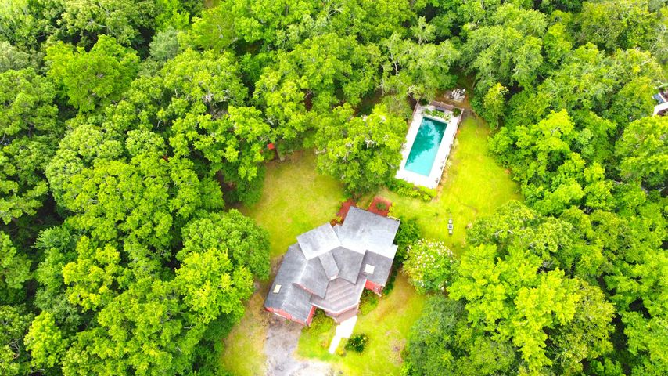
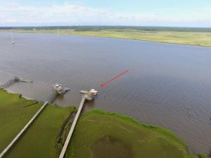
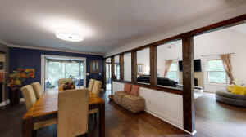
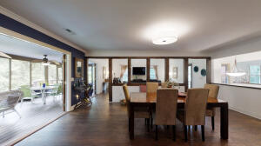
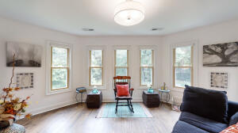

OPEN HOUSE
Agents & Public
2679 COQUINA DR. JOHNS ISLAND
THURSDAY AUGUST 5TH
11:00 TO 1:00
Catered by Hambys
2679 COQUINA DR.
JOHNS ISLAND, SC 29455
4 Bedrooms
3.5 Baths
3500 Square Feet
2 acres of seclusion
Custom Pool w/Waterfall
Neighborhood Deepwater Dock
Potential for bottom floor Mother in law & private quarters access
15 minutes to downtown
Extra workout space/office
Lennie Woods
Capstone Realty
843-864-6760

