Slide 1
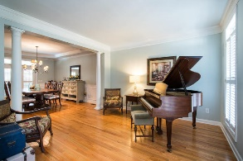
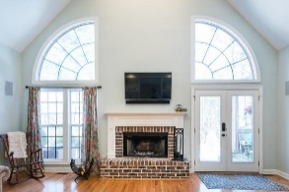
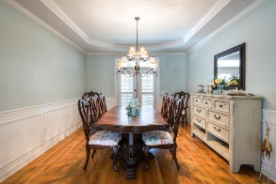
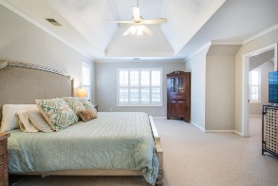
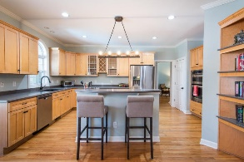
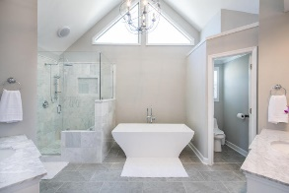
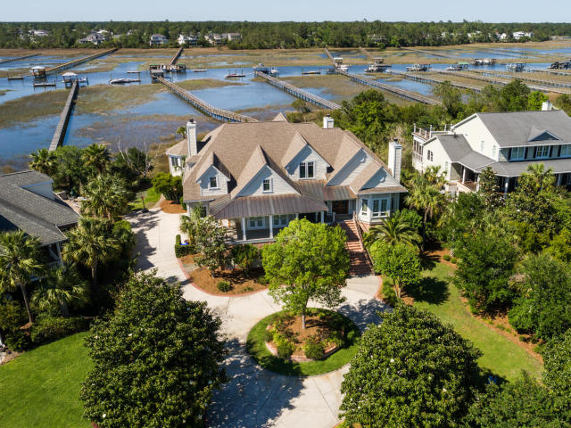
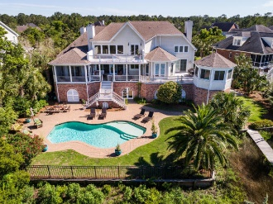
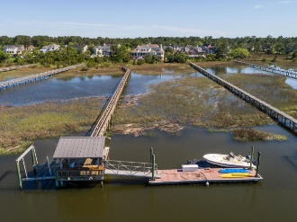
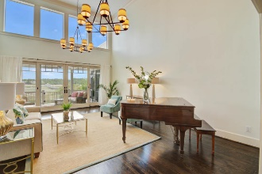
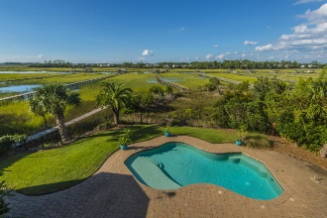
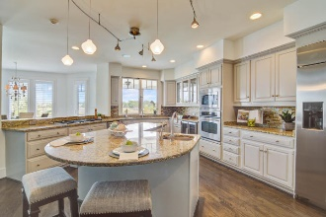
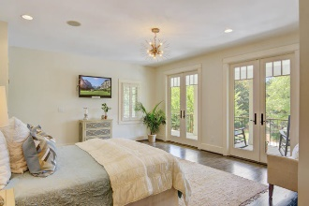
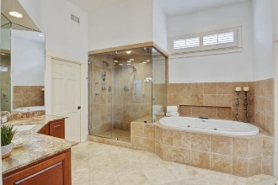
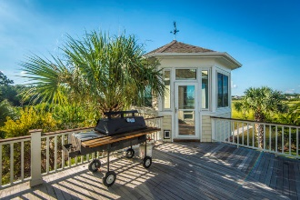

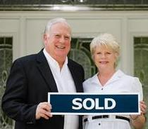
2682 Egrets Landing Court Brickyard Plantation ~ Mount Pleasant ~ MLS# 18025548 PRICED AT $2,189,000 OVER $50,000 IN UP GRADES AND OVER $200,000 IN PRICE REDUCTION
LOW COUNTRY LIVING AT ITS FINEST!!!
REALTORS OPEN HOUSE SUNDAY 1-4PM
$550,000
Rare Opportunity to own a Custom 5/6 BR, 4.5 BA home located on a cul de sac street with its own in ground pool and its own deep water dock with water and marsh views and sunsets like no others. The curb appeal is Impressive with circular drive and massive landscaping and raised low country design. Drive under home parking for 4 or more vehicles. and lots of storage. This property affords a lifestyle that everyone would die for but only a few can afford.
OWNER HAS PROVIDED MAJOR UPGRADES IN PAINTING, LIGHT FIXTURES AND STAGING TO DEMONSTRATE WHAT POTENTIAL THIS EXECUTIVE PROPERTY TRULY HAS.
Tommy Lovett Tommy - (843) 442-1276
tlovett@carolinaone.com www.tommylovettrealestate.com
Carolina One Real Estate
628 Long Point Rd.
Mt Pleasant, SC 29464-3032

