Slide 1
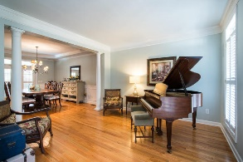
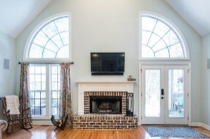
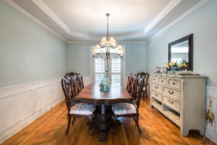
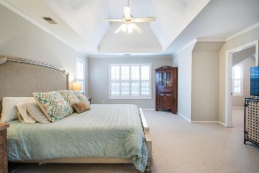
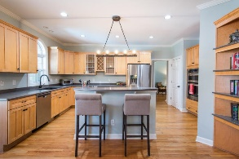
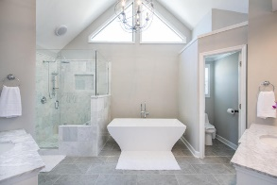
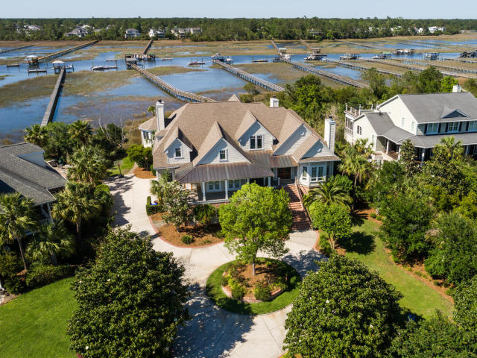
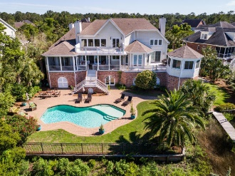
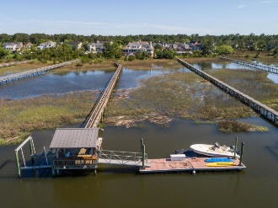
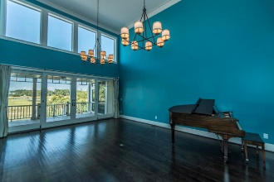
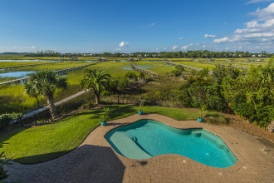
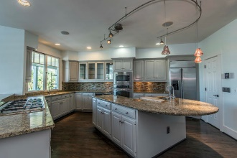
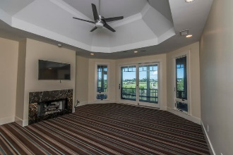
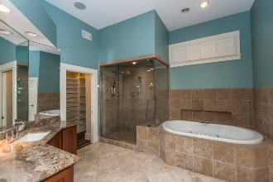
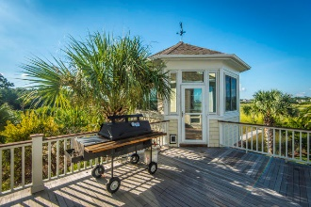


2682 Egrets Landing Court
Brickyard Plantation ~ Mount Pleasant ~ MLS# 18025548
ON THE MARKET AT $2,395,000
Open House Sunday Oct 21st from 1-4 ~ First Open Preview!
LOW COUNTRY LIVING AT ITS FINEST!!!
$550,000
Rare Opportunity to own a luxurious 6 BR, 4.5 BA custom built home located on a cul de sac street with its own pool and its own deep water dock on 2.5 acres with water and marsh views and sunsets like no others. Impressive circular drive and massive landscaping. Drive under home parking for 4 or more vehicles. This property affords a lifestyle that everyone would die for but only a few will ever have. The list of extras include an elevator, 3 fireplaces , front and rear porches (open and screened) with decking and gazebo/cooking station. NOTE: Survey/Plat shows 2.50 ACRES OF WHICH .47 Acre is HIGHLAND and 1.97 MARSH W/162 FT ON HORLBECK CREEK
Tommy Lovett
Tommy - (843) 442-1276
tlovett@carolinaone.com
www.tommylovettrealestate.com
Carolina One Real Estate
628 Long Point Rd.
Mt Pleasant, SC 29464-3032

