Slide 1
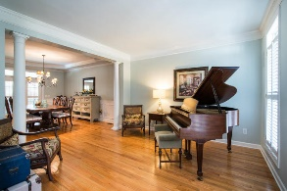
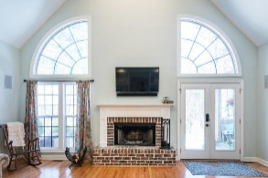
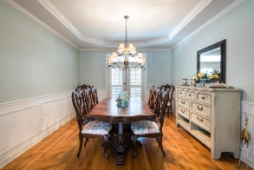
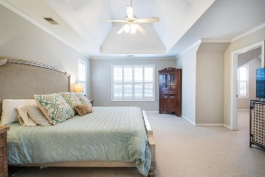
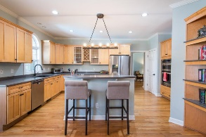
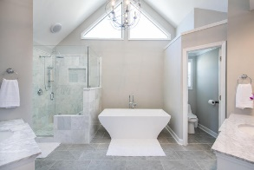
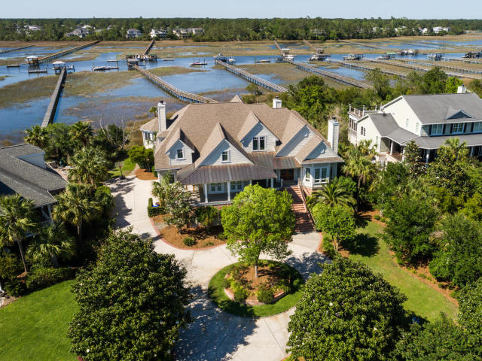
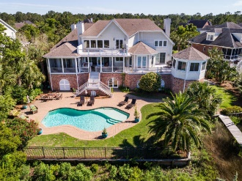
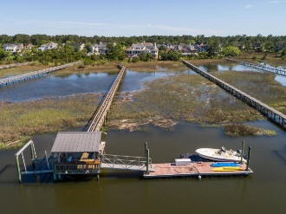
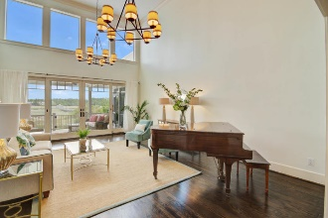
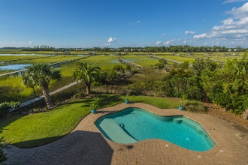
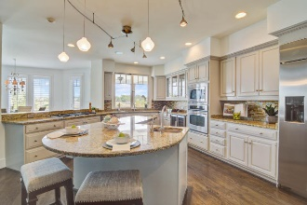
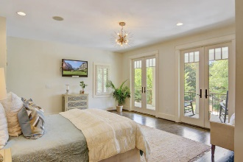
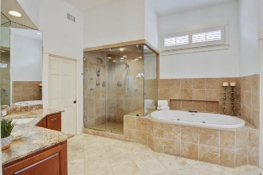
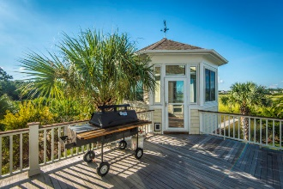


2682 Egrets Landing Court
Brickyard Plantation ~ Mount Pleasant ~ MLS# 18025548
NOW PRICED AT $1,895,000
ShowHomes of Charleston staged home to demonstrate potential of this low country estate
Best Deep Water Value In Mt Pleasant
$550,000
RARE OPPORTUNITY TO OWN THREE LEVEL, 5/6 BR, 5.5 BA, CUSTOM HOME WITH ELEVATOR AND IT'S OWN IN GROUND POOL, OWN PRIVATE DEEP WATER DOCK AND SUNSETS LIKE NO OTHERS. THE CURB APPEAL IS MOST IMPRESSIVE WITH IT'S CIRCULAR DRIVE AND PROFESSIONAL LANDSCAPING AND LOW COUNTRY DESIGN. DRIVE UNDER STYLE PROVIDES PARKING FOR 3 OR MORE VEHICLES AND OTHER UTILITY SPORT VEHICLES AS WELL AS ROOM FOR HOBBYIST AND STORAGE. THE PROPERTY AFFORDS A LIFESTYLE THAT ONLY A FEW HAVE THE OPPORTUNITY TO TRULY ENJOY. CALL FOR APPOINTMENT.
OWNER HAS PROVIDED MAJOR UPGRADES IN PAINTING, LIGHT FIXTURES AND STAGING TO DEMONSTRATE WHAT POTENTIAL THIS EXECUTIVE PROPERTY TRULY HAS.
Tommy Lovett
Tommy - (843) 442-1276
tlovett@carolinaone.com
www.tommylovettrealestate.com
Carolina One Real Estate
628 Long Point Rd.
Mt Pleasant, SC 29464-3032

