Slide 1
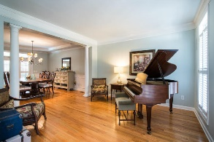
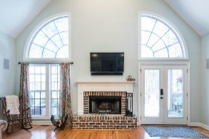
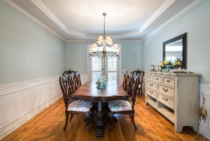
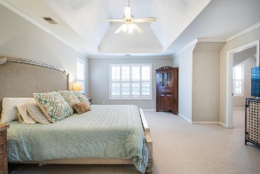
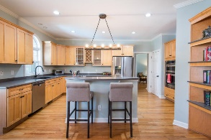
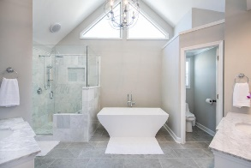
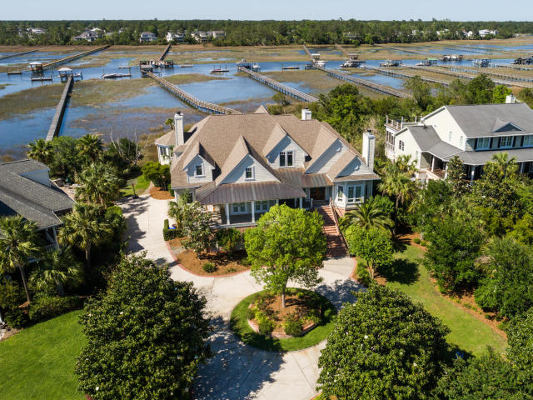
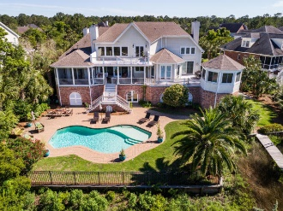
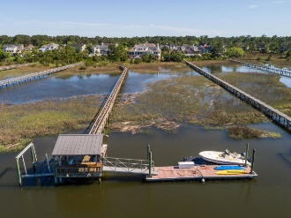
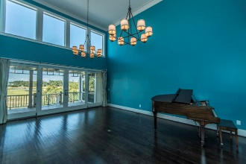
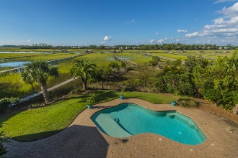
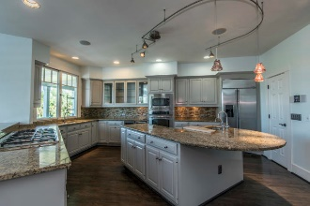
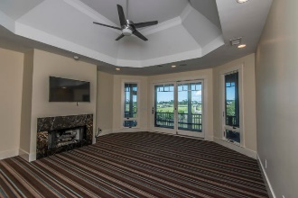
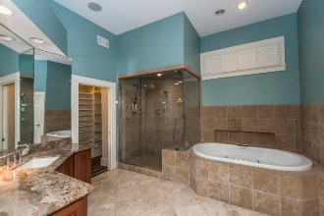
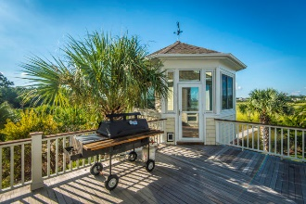

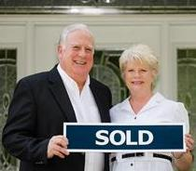
2682 Egrets Landing Court Brickyard Plantation ~ Mount Pleasant ~ MLS# 18025548 PRICED AT $2,289,750 PLUS $35,000 FOR BUYER'S CONCESSIONS AND/OR DECORATING ALLOWANCES
LOW COUNTRY LIVING AT ITS FINEST!!!
$550,000
Rare Opportunity to own a Custom 5/6 BR, 4.5 BA home located on a cul de sac street with its own in ground pool and its own deep water dock with water and marsh views and sunsets like no others. The curb appeal is Impressive with circular drive and massive landscaping and raised low country design. Drive under home parking for 4 or more vehicles. and lots of storage. This property affords a lifestyle that everyone would die for but only a few can afford. The list of extras include an elevator, 3 fireplaces , front and rear porches (open and screened) with decking and gazebo/cooking station. NOTE: Survey/Plat shows 2.50 ACRES OF WHICH .47 Acre is HIGHLAND and 1.97 MARSH W/162 FT ON HORLBECK CREEK
Tommy Lovett Tommy - (843) 442-1276
tlovett@carolinaone.com www.tommylovettrealestate.com
Carolina One Real Estate
628 Long Point Rd.
Mt Pleasant, SC 29464-3032

