Slide 1
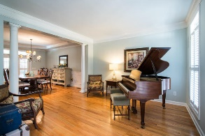
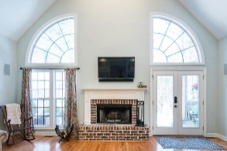
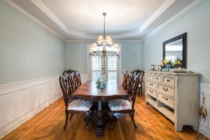
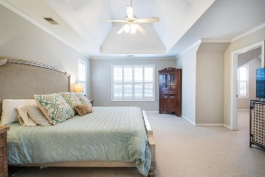
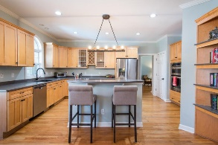
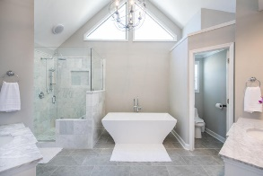
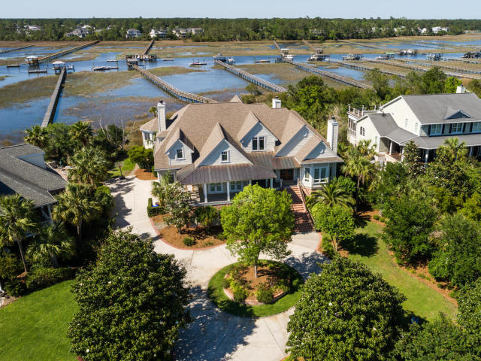
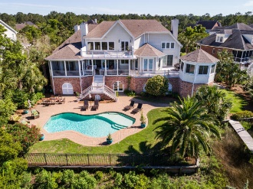
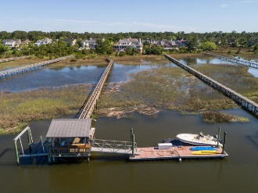
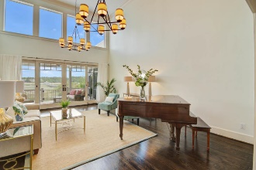
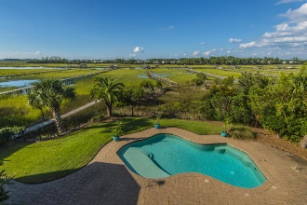
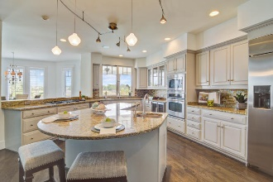
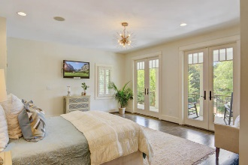
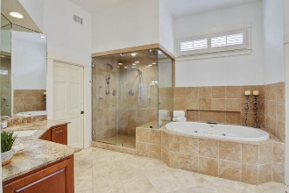
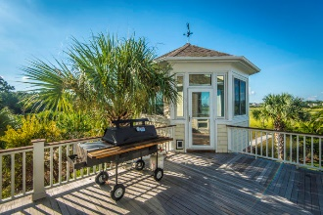


2682 Egrets Landing Court Brickyard Plantation ~ Mount Pleasant ~ MLS# 18025548 PRICED AT $2,189,000 OVER $50,000 IN UP GRADES AND OVER $200,000 IN PRICE REDUCTION
Deepwater Estate with Pool and Private Dock
$550,000
RARE OPPORTUNITY TO OWN THREE LEVEL 7900 SQFT , 5/6 BR, 5.5 BA, CUSTOM HOME WITH ELEVATOR AND IT'S OWN IN GROUND POOL, OWN PRIVATE DEEP WATER DOCK AND SUNSETS LIKE NO OTHERS. THE CURB APPEAL IS MOST IMPRESSIVE WITH IT'S CIRCULAR DRIVE AND PROFESSIONAL LANDSCAPING AND LOW COUNTRY DESIGN. DRIVE UNDER STYLE PROVIDES PARKING FOR 3 OR MORE VEHICLES AND OTHER UTILITY SPORT VEHICLES AS WELL AS ROOM FOR HOBBYIST AND STORAGE. THE PROPERTY AFFORDS A LIFESTYLE THAT ONLY A FEW HAVE THE OPPORTUNITY TO TRULY ENJOY. CALL FOR APPOINTMENT.
OWNER HAS PROVIDED MAJOR UPGRADES IN PAINTING, LIGHT FIXTURES AND STAGING TO DEMONSTRATE WHAT POTENTIAL THIS EXECUTIVE PROPERTY TRULY HAS.
Tommy Lovett Tommy - (843) 442-1276
tlovett@carolinaone.com www.tommylovettrealestate.com
Carolina One Real Estate
628 Long Point Rd.
Mt Pleasant, SC 29464-3032

