Slide 1
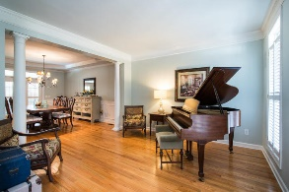
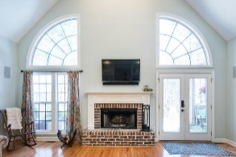
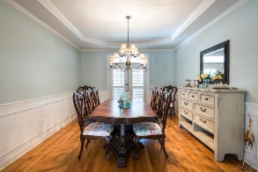
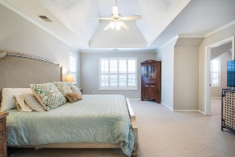
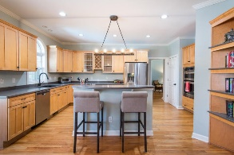
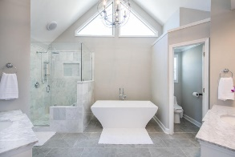
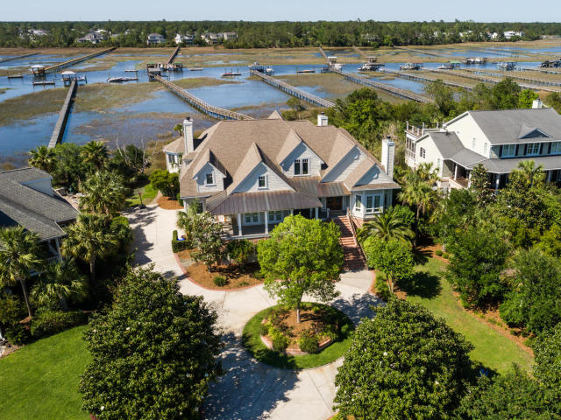
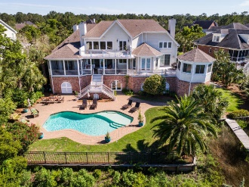
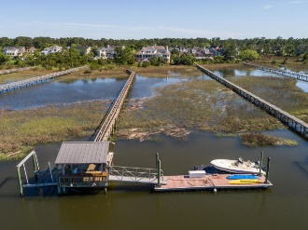
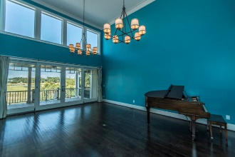
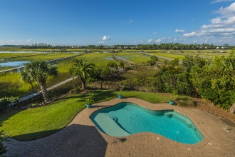
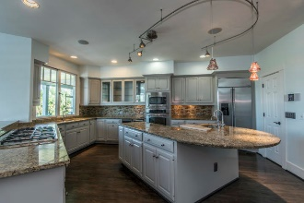
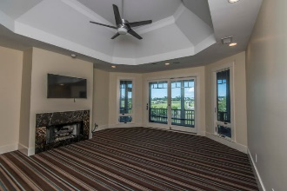
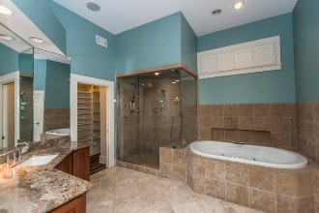
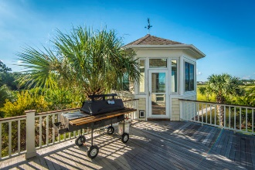


2682 Egrets Landing Court
Brickyard Plantation ~ Mount Pleasant ~ MLS# 18025548
PRICED AT $2,395,000
PLUS
$35,000 FOR BUYER'S CONCESSIONS AND/OR DECORATING ALLOWANCES
LOW COUNTRY LIVING AT ITS FINEST!!!
$550,000
Rare Opportunity to own a luxurious 6 BR, 4.5 BA custom built home located on a cul de sac street with its own pool and its own deep water dock on 2.5 acres with water and marsh views and sunsets like no others. Impressive circular drive and massive landscaping. Drive under home with parking for 3 vehicles and completely separate spacious area for workshop and storage. This property affords a lifestyle that everyone would die for but only a few will ever have. The list of extras include an elevator, 3 fireplaces , front and rear porches (open and screened) with decking and gazebo.
Tommy Lovett
Tommy - (843) 442-1276
tlovett@carolinaone.com
www.tommylovettrealestate.com
Carolina One Real Estate
628 Long Point Rd.
Mt Pleasant, SC 29464-3032

