Slide 1
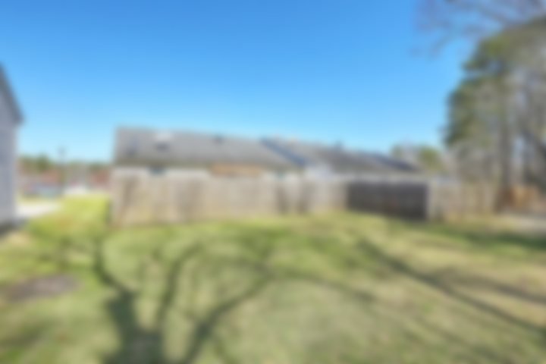
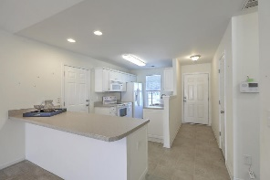
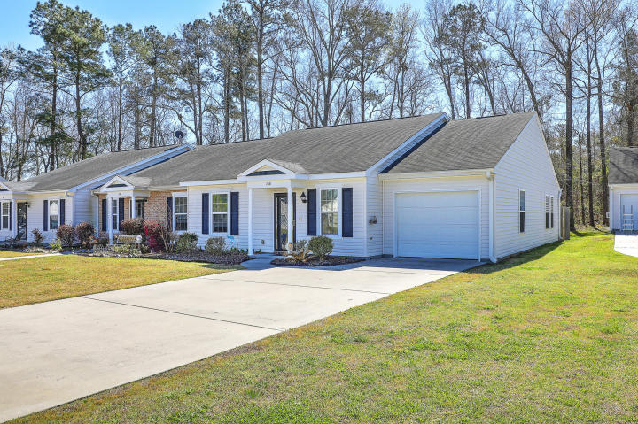

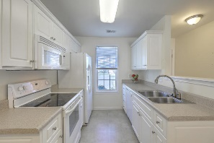
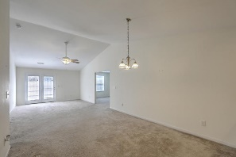
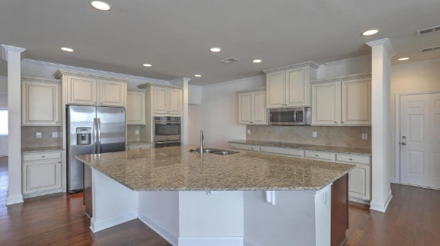
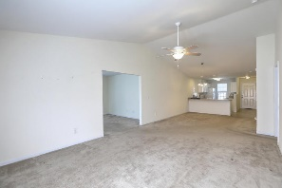
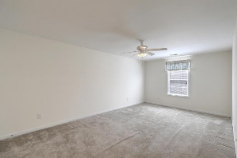
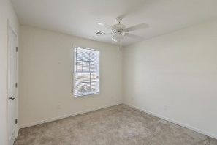
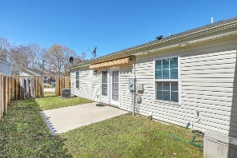
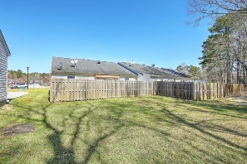


Join Us Saturday from 11a-3p Just Listed Spacious 1-story Townhome
268 Reagan Drive
Cedar Springs | Summerville, SC 29486
MLS# 18006360 | $149,975
This spacious, move-in ready, 1-story end unit townhome is low maintenance living at it's finest! Features include open floor plan w/vaulted ceiling and great natural light**Roomy master en suite with large walk-in closet, and oversized shower in bathroom**LARGE BONUS ROOM which can be easily converted into 3RD BEDROOM**Nicely sized kitchen w/ample storage and large breakfast bar with cabinets underneath**Large laundry room with extra storage**Relax or enjoy family gatherings in your privately situated, fenced backyard with patio and retractable awning**Attached 1-car garage with storage shelving. This conveniently located community is just minutes from the new Nexton development, I-26, Summerville & Goose Creek shopping, restaurants, medical and close to the new Volvo plant. Perfect for first-time home buyers or empty nesters - LOW HOA FEES!! Appraisal in hand!!
Desiree Maurer Office - (843) 416-2000
Mobile - (843) 327-9010 desiree.maurer1@gmail.com
www.yourcharlestonhousesearch.com
Keller Williams Realty 496 Bramson Ct Ste 200 Mt. Pleasant, SC 29464

