Slide 1

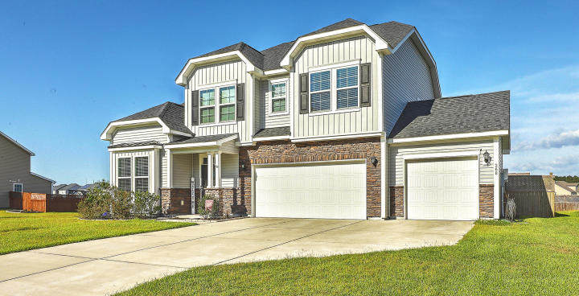
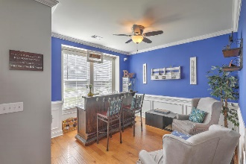
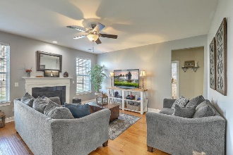
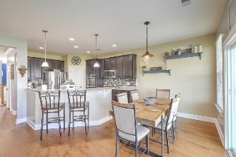
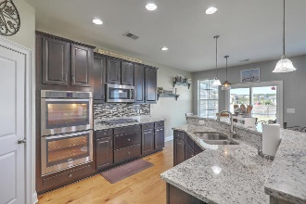
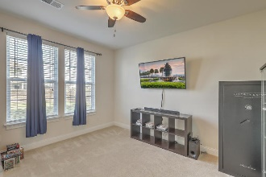
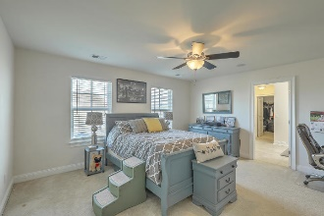
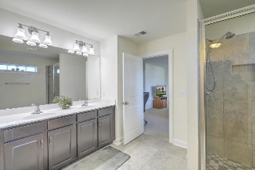
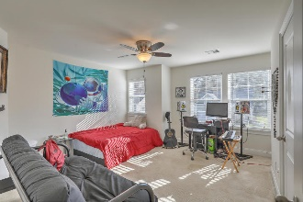
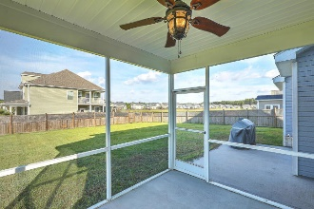
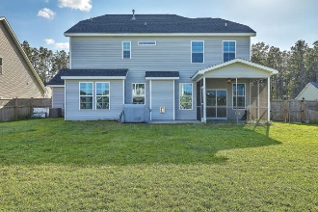

Cane Bay Plantation
Agent Luncheon
Thursday, December 12th 12-2pm
Come enjoy some Hamby’s sandwiches
Pam Bass Realtor
M 843-259-4926 | O 843-277-6677
pam@pambassproperties.com
www.pambassproperties.com
268 Spectrum Road | Summerville, SC 29486 | MLS# 19023503 | $322,000
OPEN HOUSE CANCELED
HOUSE JUST WENT
UNDER CONTRACT!
Beautiful move in ready 4 Bedroom home on corner lot with a 3 car garage and tons of upgrades. As you pull up to the house, the curb appeal offers a beautiful elevation and landscaping. The inside greets you with handscraped hardwood floors and tons of natural light. The gourmet kitchen offers double ovens, stainless steel appliances, granite counter tops and a gas cooktop. The kitchen has an eat in breakfast area and is open to the family room. There is also an office with a 1/2 bath downstairs. The master bedroom is very spacious and the owners suite features dual vanities, a 5ft tiled shower, huge walk in closet and surround sound. Three additional guest bedrooms and a guest bath, make for a great layout on the second story. Enjoy relaxing on the screened porch that overlooks the private fenced yard. When you're not relaxing at home, take a stroll through the miles of wooded walking trails, or swim in your beautiful community pool and visit the brand new Cane Bay YMCA! Don't miss this turn-key home located on a perfect lot overlooking the pond in Magnolia Plantation of Cane Bay.
Coldwell Banker Residential Brokerage | 4969 Centre Pointe Dr. Ste 203 | Charleston, SC 29418

