Slide 1
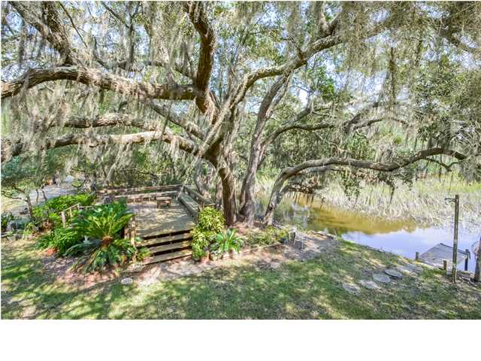
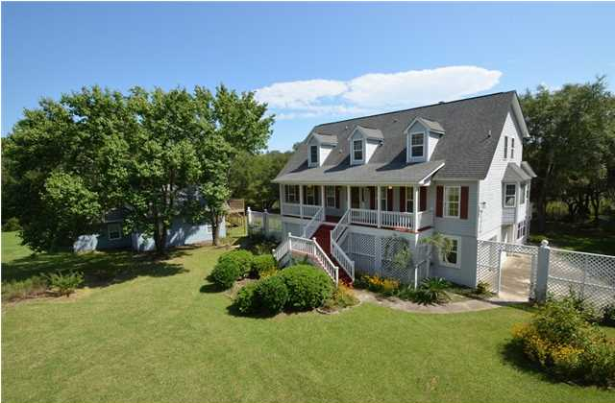
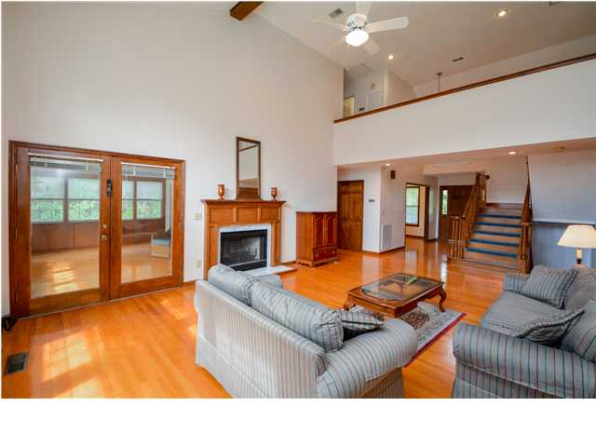
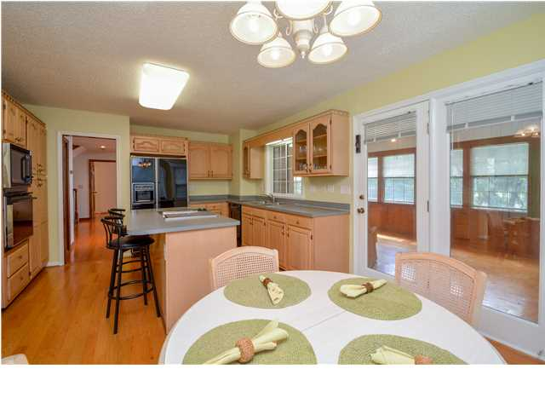
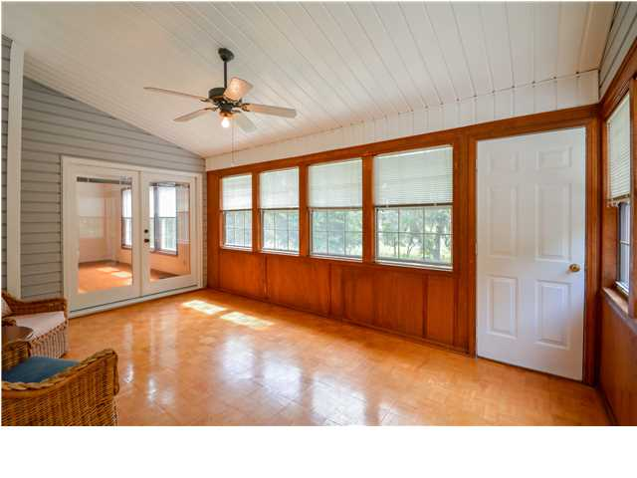
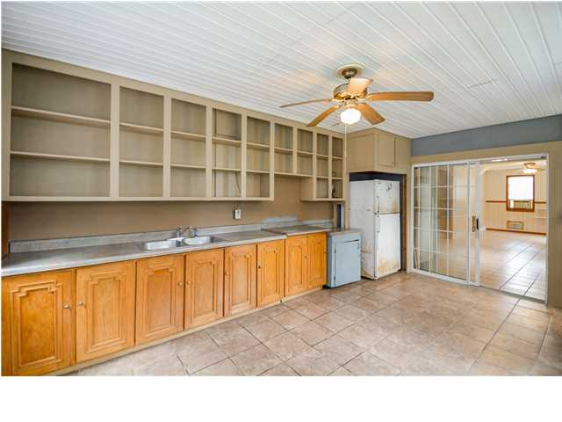
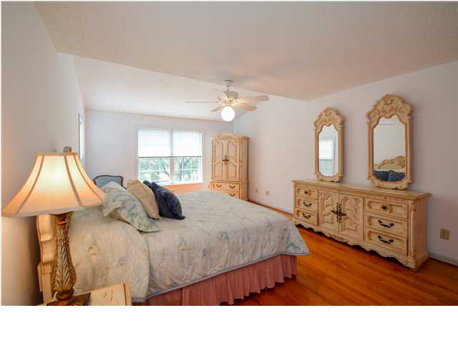
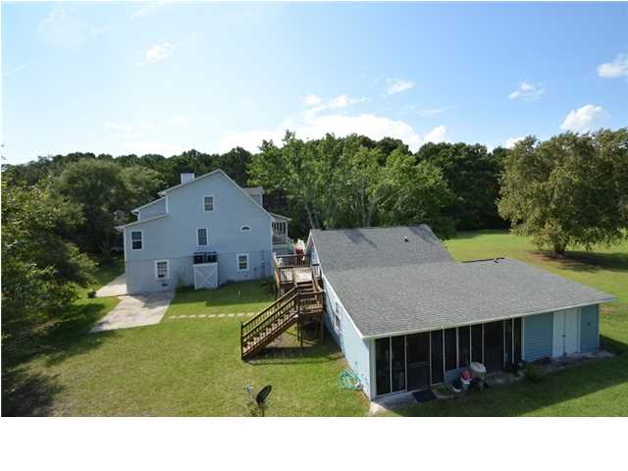
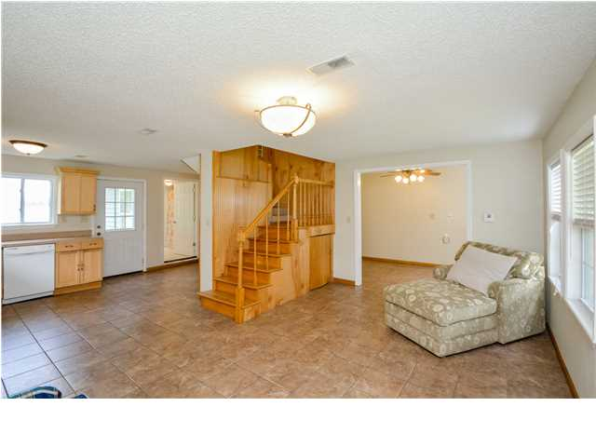
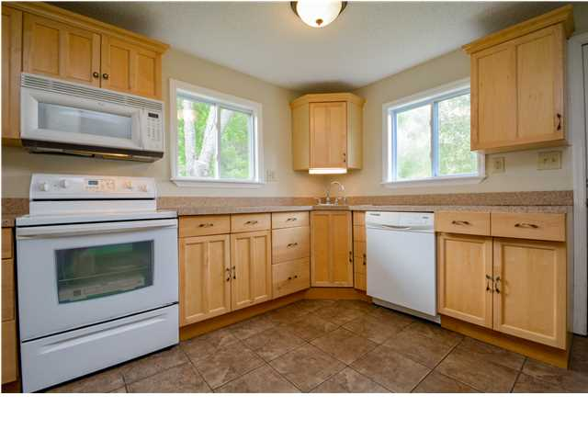

Price Reduced!
Serenity & Privacy Await…
2690 Cotton Gin Rd ~ Johns Island ~ MLS# 1424980 ~ $789,000
Serenity and privacy await you at this four bedroom-2 are masters, four full bath, one half bath home that sits on a five plus acre lot with marsh and tidal creek views. Situated on the Abbapoola Creek, stroll out onto the short dock to gaze out at the wildlife or take a small vessel out to explore the aquatic beauty that is known and loved at Johns Island. The main home boasts 2,426 square feet of living area with high ceilings, hardwood floors and tons of picture windows throughout the home to take in the views. With a spacious eat-in kitchen, formal dining room, great room and sunroom, there's plenty of space to entertain and for comfortable everyday living. One highlight that helps make this property so unique is the 2005 built guest house, with full kitchen (no refrigerator) that features one bedroom, one and a half baths and 1,200 square feet of living area, large screened porch/cookshed and added storage area. The outdoor living space on the guest house deck offers a great spot to feel the breeze from the mature live oaks scattered throughout the property. A large deck with built-in seating areas is nestled under a majestic live oak that sits alongside the tidal creek bank. Plenty of PRIVATE outdoor living and entertaining space for oyster roast, shrimp boil parties, gardening and/or just enjoying the beautiful views, this is a setting that must seen to be believed. Come be apart of the magic that is found at Johns Island, you'll love being conveniently located to the beach, downtown, shopping and dining. Owners had 60ft. dock permit that expired in July, easily renewable.
Call or email for details: (843) 654-7777 or Monique@MattOneillTeam.com

