Slide 1

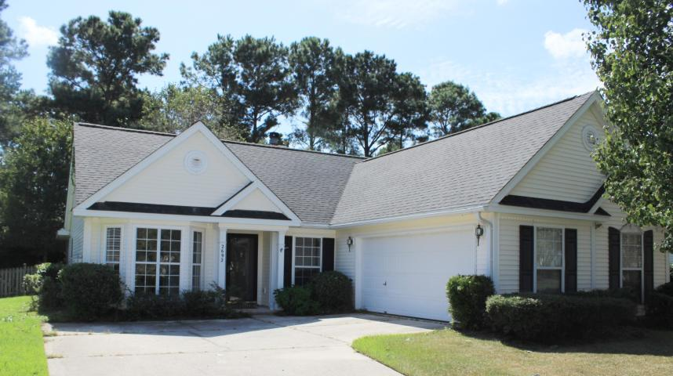
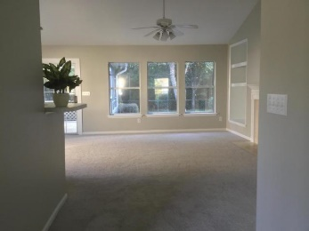
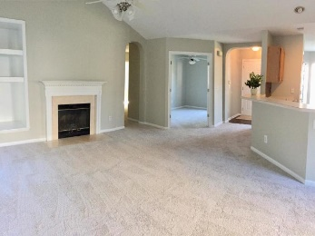
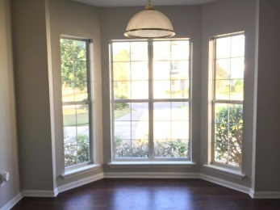
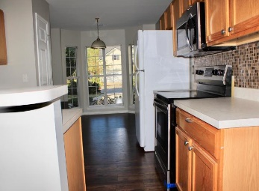
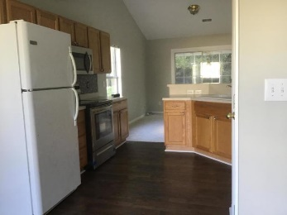
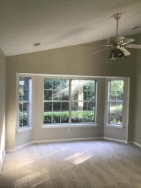
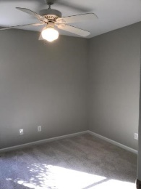
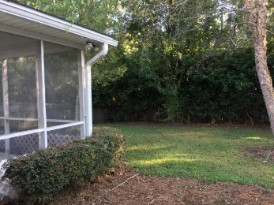
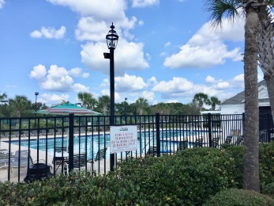


Dunes West Open House
Sunday 1/27 2pm-4pm
Debbie Himebaugh
(843) 324-6959
dhimebaugh@century21properties.com
debbiehimebaugh.c21.com
2692 Palmetto Hall Blvd | Mt Pleasant | MLS# 18027125 | $319,000
Brand New Flooring!
This charming, freshly painted, single family home features FLEX SPACE and all NEW FLOORING. The kitchen with NEW STAINLESS STEEL APPLIANCES has a large eating area, pantry and the new wood laminate floors just gleam. Look over the counter bar area into a beautiful natural lit great room with vaulted ceilings and a fireplace. Screened porch leads to a fenced backyard. The 2 large bedrooms and a nice size study with built in shelves makes this home the perfect fit. The master bedroom is large with lots of windows sports a master bath with his and her sinks, stall shower and a garden tub to top it all off a huge walk in closet. The second bedroom is also a good size with large closet. Located in Dunes West a desirable Mount Pleasant Country Club neighborhood with Semi-Private Golf club, Pool Club, recreational area ready for membership. This home is close to grocery stores, restaurants, great schools, and a county recreational area as well.
Century 21 Properties Plus
3301 Salterbeck Ct Suite 100
Mt. Pleasant, SC 29466

