Slide 1
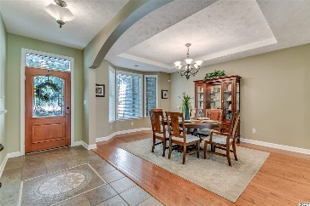
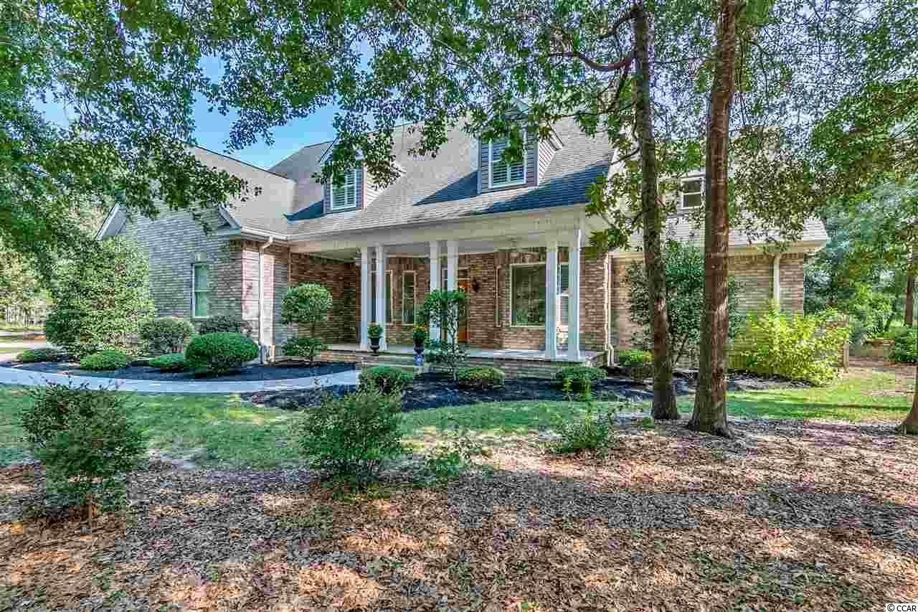
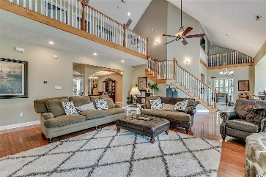
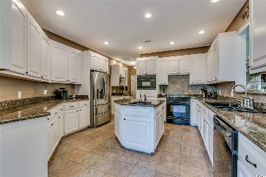
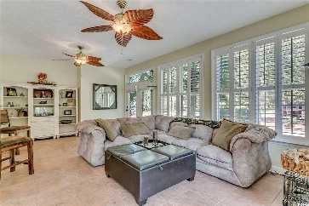
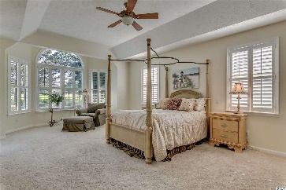
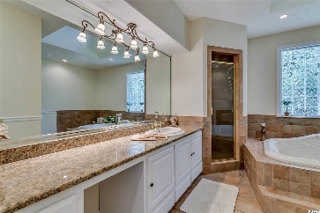
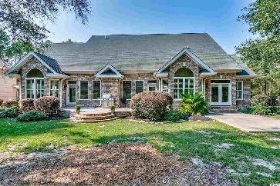
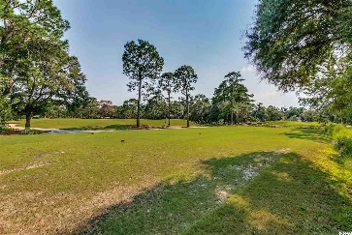


26 Deloach Trl
Pawleys Island, SC 29585
MLS# 1618591 ~ $532,000
You Have Found Your Dream Home!
$2,000 Buyer Agent Bonus
With Ratified Contract by 4/30/17
This home boasts a very spacious 4 bedrooms, 3 baths and a home office. You can relax by the fire in the living room, soak up some sunshine in the Carolina Room or wave to the golfers as they tee off on the beautiful Founders Golf Club. This home is situated on just over a half acre of land with plenty of space. This home features many upgrades including a 250 gallon in ground propane tank, pre-wired surround sound, pre-plumbed for central vac, instant hot water heater, security system, temp based fireplace, hurricane wrapped and much more! The community has a public boat landing on the Intercostal Waterway and no HOA. Best of all for the visionaries or people just needing more space there are 3 rooms that could be finished off to make this a 3 story 7 bedroom home. Book your showing today and don’t miss out on this great opportunity!
Justin Kirkman | justin@justinkirkman.realtor | 843-455-4771
Wilkinson ERA Real Estate, 9652 North Kings Hwy, Suite D-1, Myrtle Beach, SC 29572

