Slide 1
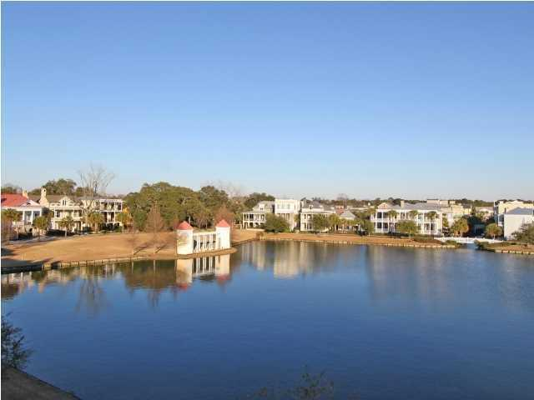
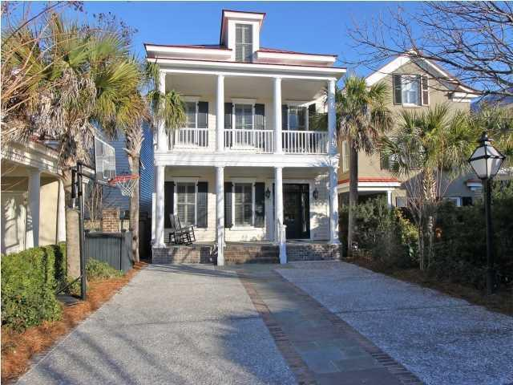
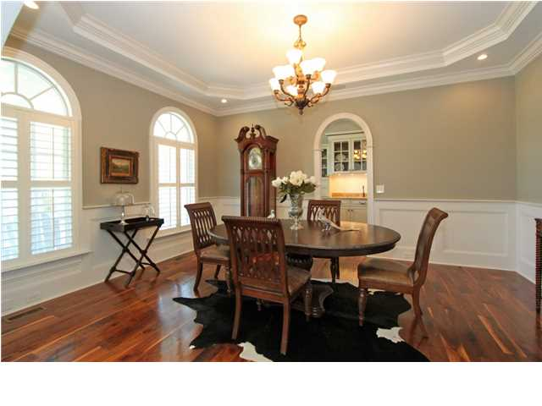
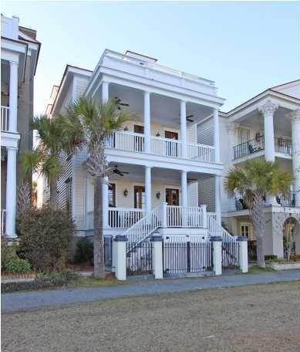
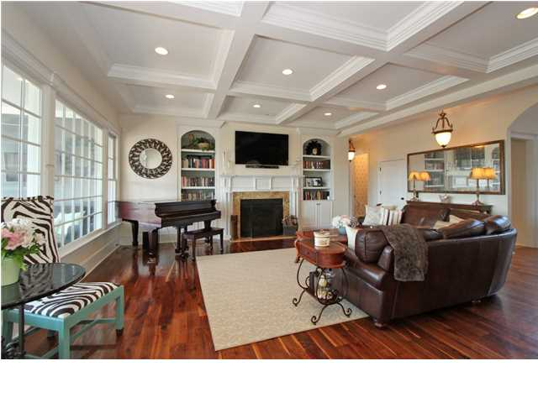
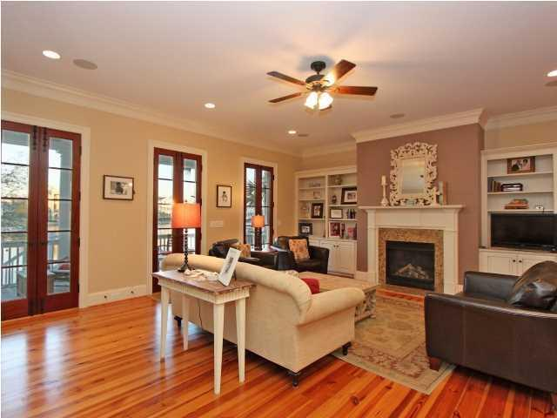
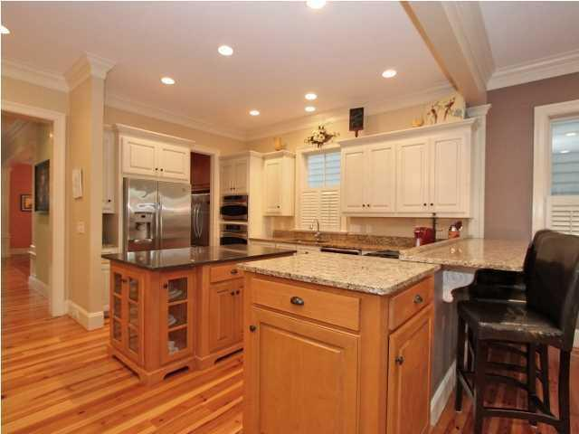
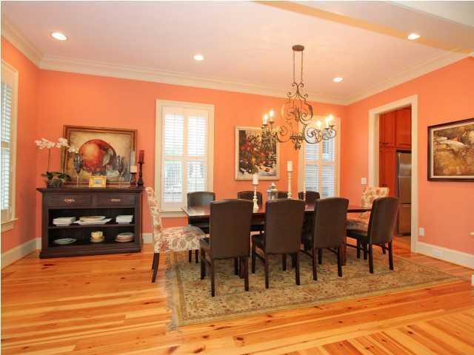
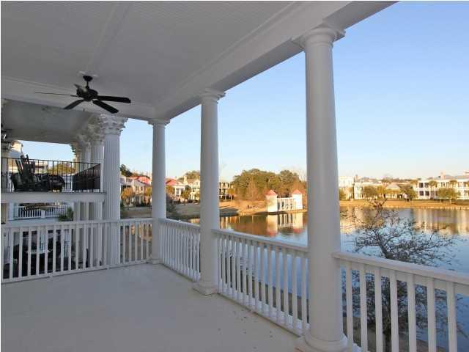
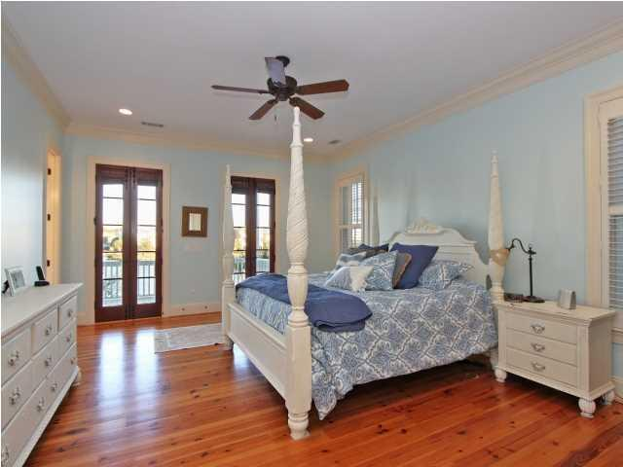
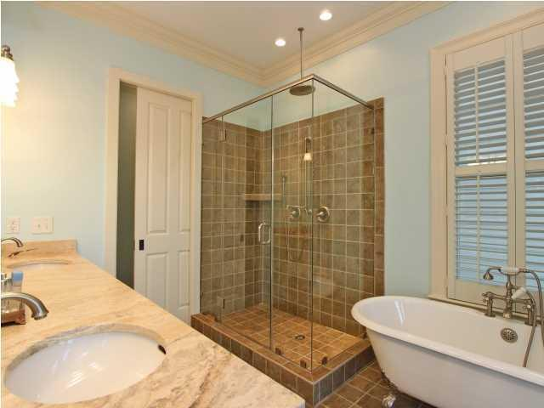
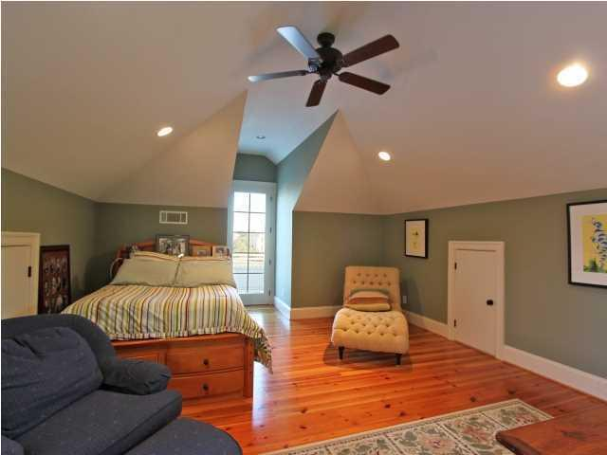
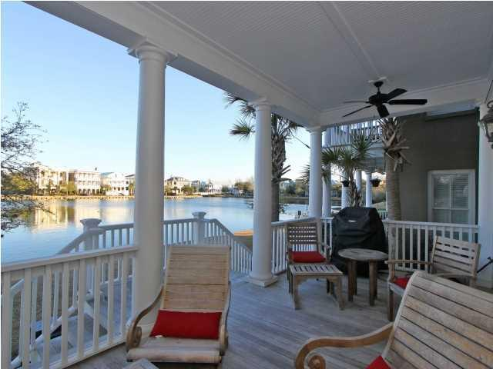


26 Fernandina St
I’On
Mount Pleasant
MLS# 1403689
$1,250,000
Seller is offering a $50,000 credit toward garage/carport with full price offer
Beautiful home on Westlake with spectacular views on all three floors . From the minute you walk in the front door, you are greeted with indoor and outdoor beauty. The main level is great for entertaining with a large formal dining room and adjacent large butler's pantry area. The oversized kitchen and great room flow seamlessly into the shaded porch overlooking the lake. All your casual and relaxing time is filled with the stunning yet private views of water. The kitchen boasts of two oversized refrigerators/freezers, huge walk in pantry, gas range, double oven/advantium micro combo, large kitchen island perfect for a buffet party, large eat in area adjacent to kitchen, gorgeous gas fireplace with decorative mantle. The beautiful master bedroom on the second floor oozes romance as the night time light sparkles off the lake! Cozy yet completely private with his and hers walk in closets. Large walk-in shower, and clawed foot bathtub round off this private sanctuary. With three other bedrooms and two additional bathrooms on this floor, it becomes a wonderful set up for a growing family. The third floor boasts of a large game room/media room with lots natural light filled windows and storage. In addition, a private hallway leads to the perfect au pair suite/college student room! This space has its own porch overlooking the lake, huge room with space for bed and sitting area, lots of closet/storage as well as an oversized bathroom with walk in shower. All rooms have custom plantation shutters. There is storage space under the back decks to keep your outdoor equipment etc. If you want the best water view available in I'on this is your home. This is the side of the lake where the three porches face the east, allowing for the perfect late afternoon shade for gatherings on the lake and the nearly constant breeze off the water for your cook outs over the lake!
Clay Cunningham
Office - (843) 886-8110
Cell - (843) 345-4647
Fax - (843) 202-2921
clay@carolinaone.com
Carolina One Real Estate
1400-E Palm Boulevard
Isle of Palms, SC 29451

