Slide 1
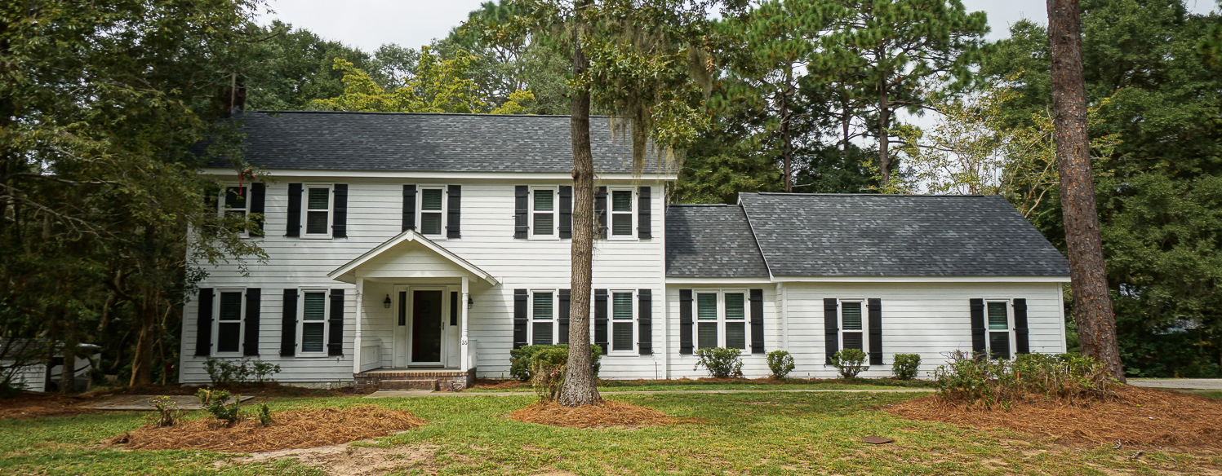
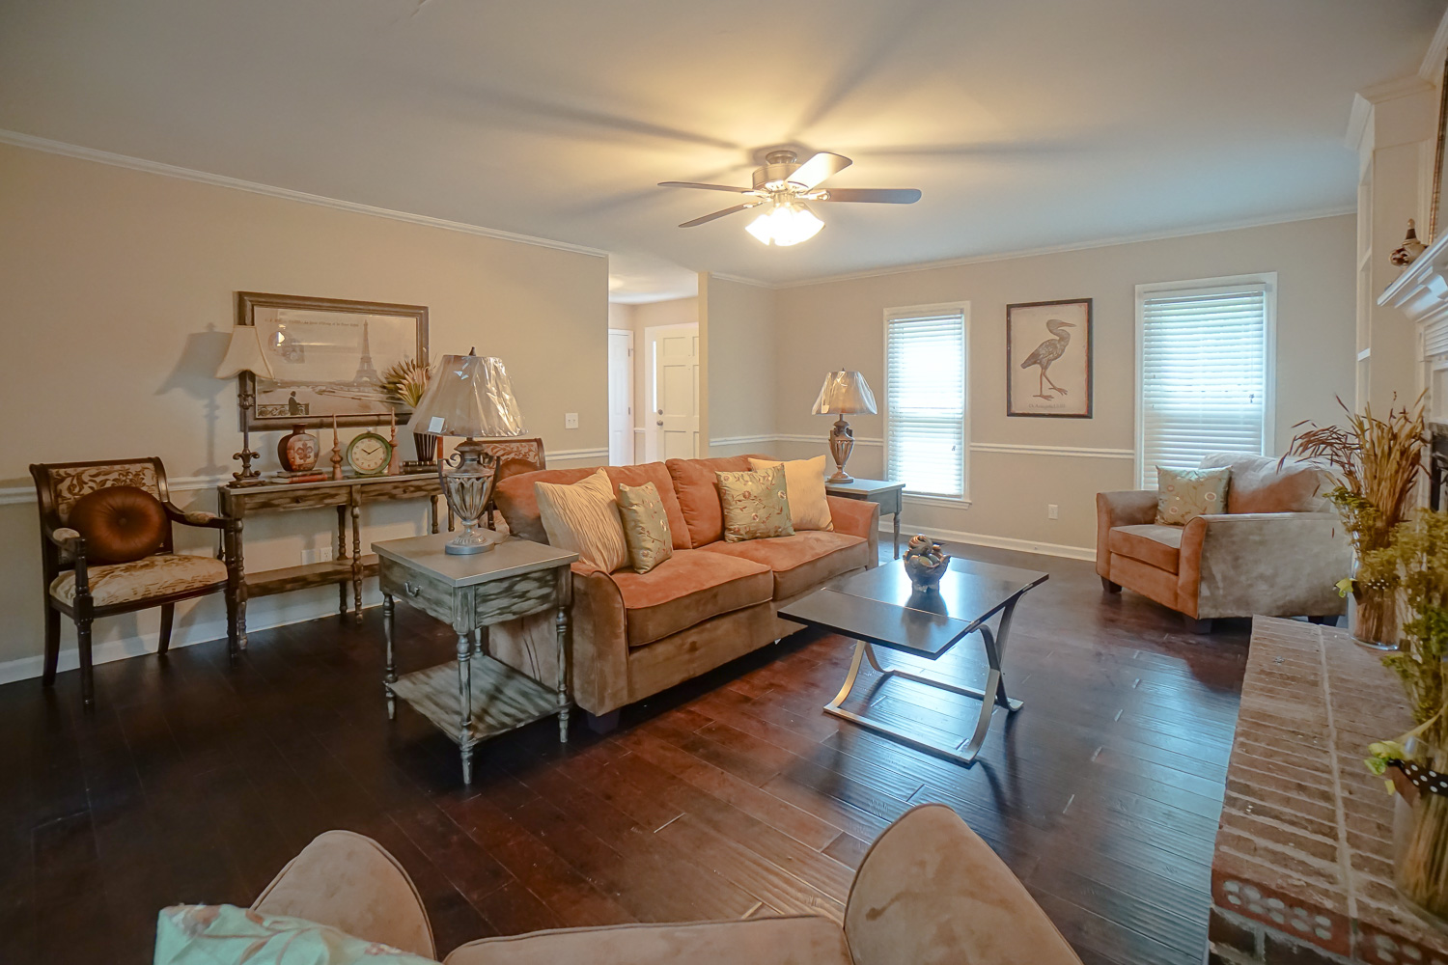
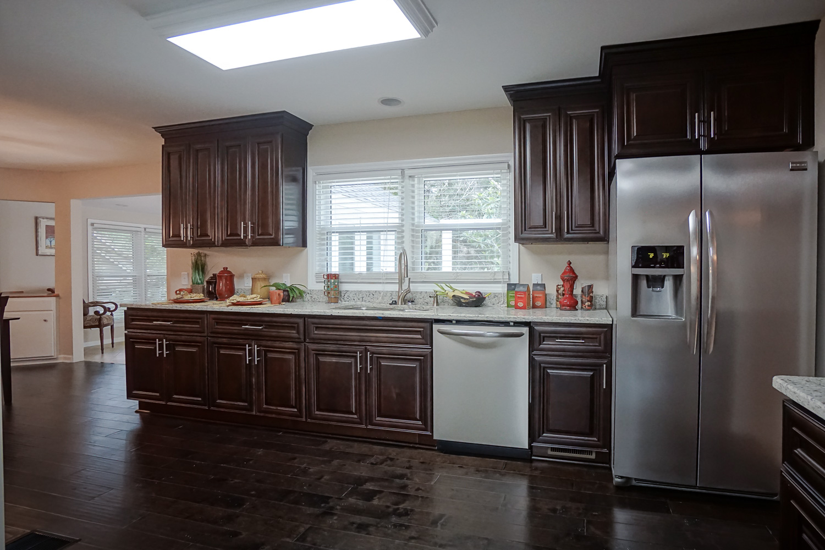
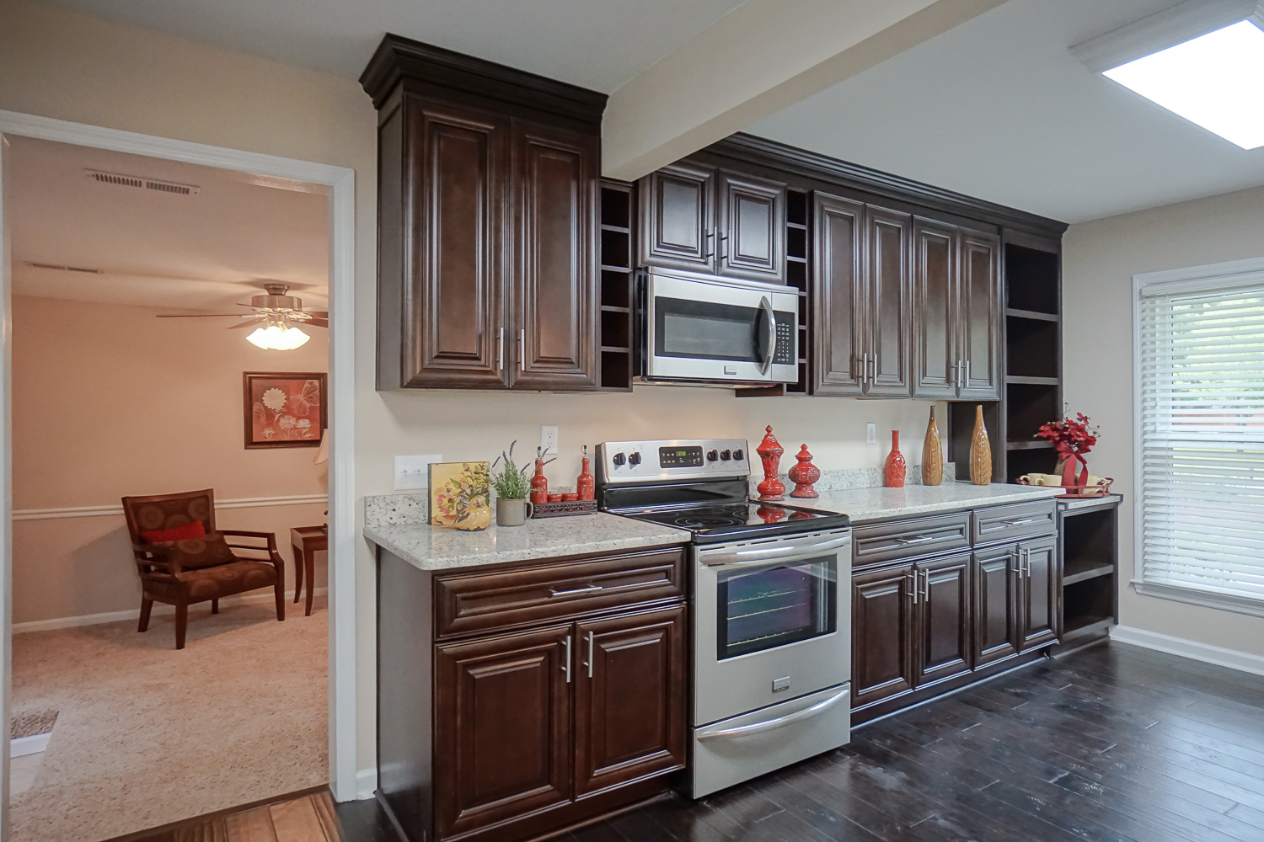
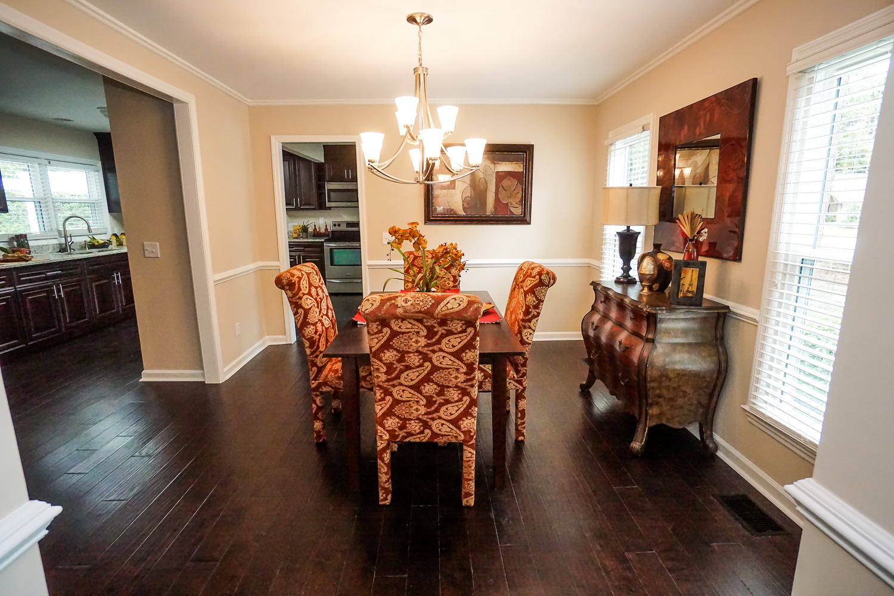
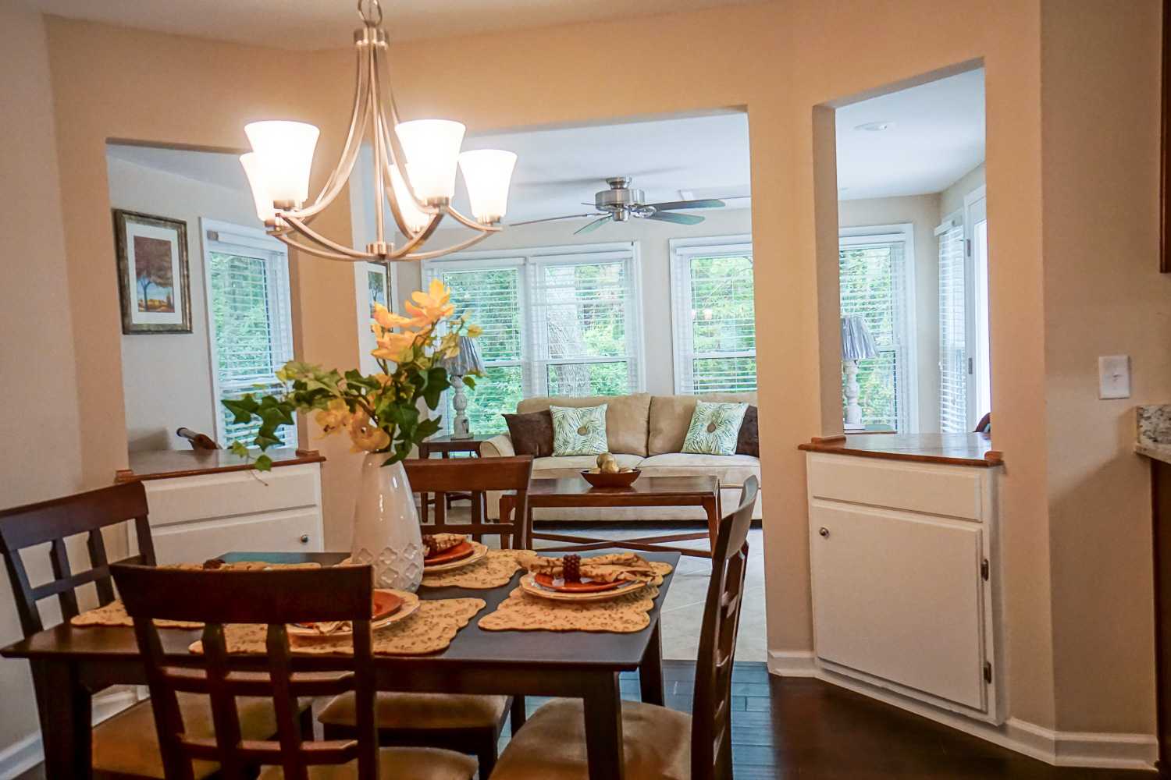
26 Planters Circle ~ Lady’s Island
$329,900
Priced to sell at under $118/ Sq Ft! Completely Renovated 4 BR/3.5 BA Executive home! The entire Int/Ext just painted! New Architectural Roof! New HVAC system! New windows! New premium hand-scraped wood floors downstairs, New tile & New frieze pad/carpet. Luxury kitchen w/ new cabinets, new granite tops with all new stainless steel appliances. Living room with Fireplace, a back Den, a multi-purpose room and a separate FROG! Separate Breakfast Room & Formal Dining Room. Master Bath w/ double vanity & new tile tub/shower. Mother-in-Law Suite w/ full bath. Oversized 2-car garage. Big 3/4 acre yard.
Bedrooms:
Bathrooms:
Fireplace:
Garage:
Lot Size:
Home Sq. Ft:
4-5
3.5
YES
2-Car Detached
0.76 Acres
2805
Year Built:
New Roof:
New Central Air:
New Heat:
Type of Floors:
1986
2015
2015
2015
Wood, Ceramic Tile, Carpet
Greg Cook
Anchor One Realty, LLC
843-343-3030
gcook@anchorpropertiesofsc.com

