Slide 1

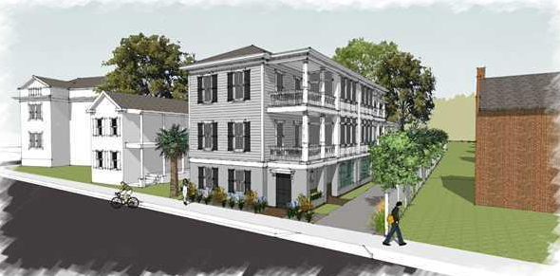
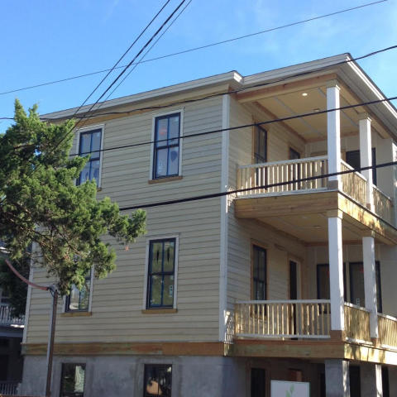
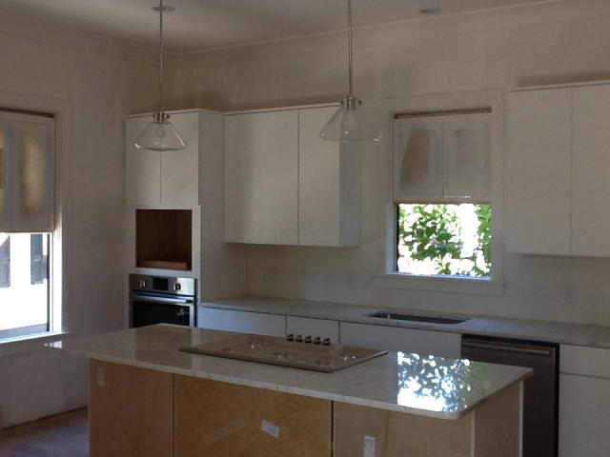
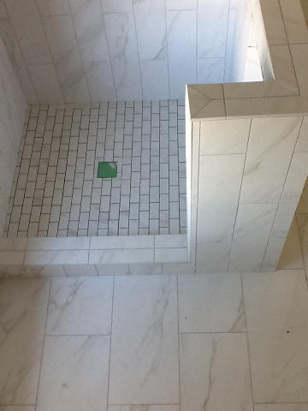
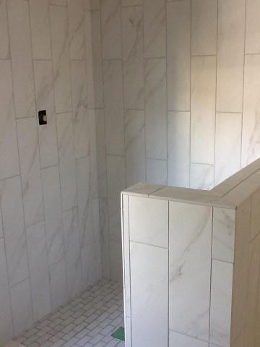
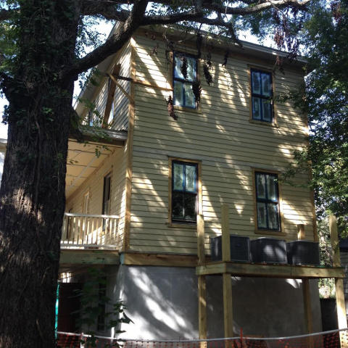


Agent Open House Lunch to be served · 10/23/14 11-1:30
26 Smith St - Harleston Village - MLS# 1413234
Oak hardwood floors, crown molding, and 9 foot ceilings throughout this entire unit with open floor plan. The bottom floor access acts as a basement or storage space. Unit A features two covered front porches with access from the second floor family room and the third floor master bedroom. The Kitchen has granite counters with an island appointed with a stainless gas range. There will be an under mount sink with subway tile back splash. The appliance package will be Bosch Stainless. The second floor also has a large pantry/storage room, a separate laundry room and a half bath as well as the Kitchen/Dining room and Family Room. The third floor has three bedrooms and two baths including the master that has its own bathroom as well as access to the deck. Granite and tile in all baths. Plumbing fixtures for bath and kitchen will be Moen. All bedrooms have ceiling fans as does the family room. Two panel solid core doors throughout interior. Two spaces for off street parking are allocated for each unit.
Edmund Major
843-343-6666 C edmund@flywaysc.com
www.flywaysc.com
Flyway Real Estate, LLC
1630 Meeting St. Bldg 1
Ste 302
Charleston, SC 29405

