Slide 1
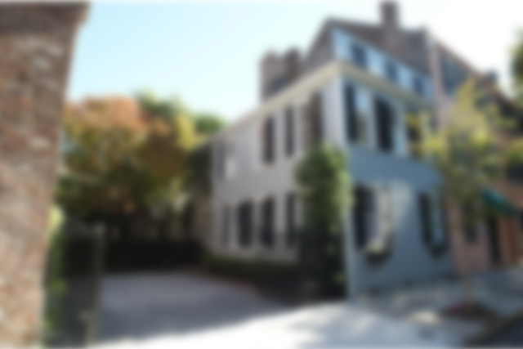



Be sure to check-out the YouTube video to see more!
26 State Street ~ French Quarter ~ MLS# 18010626 ~ $1,895,000
The bustling Charleston docks were just a block away on "Bay Street" when an English ship's captain built himself this two-story home with a third level façade in 1840. It was part of the old walled city, known as the French Quarter. On a large lot, it is one of only 2 wooden structures on Historic State Street and balances a 19th century elegance with up to date touches. Brickwork, original Heart Pine floors and beams are throughout! This home has it all for those who want to be in the middle of everything, shops, museums, galleries and restaurants. A block from beautiful Waterfront Park, one can stroll along the Charleston Harbor. The parking court can accommodate up to 4 cars. Behind the Philip Simmons designed wrought iron gates, its focal point is a cascading water fountain.
Enter through the wooden gate and now enter an Oasis, designed using the concept of garden rooms. Enclosed on all 3 sides by the time-worn brick walls, the alfresco "dining room" is surrounded by Palmetto trees, Chinese Palms, and a 130 year old Japanese Maple. Very Private. Very Charleston. The home was featured in the 2018 Historic Charleston Foundation's Festival of Houses and Gardens. It has been a location in the filming of "NORTH & SOUTH", "SCARLETT" and "COLD MOUNTAIN".
Handsome Properties, Inc 53 Broad St Charleston, SC 29401
Ellen Leigh Murray
843 813-2006
chaspremierprop@bellsouth.net

