Slide 1
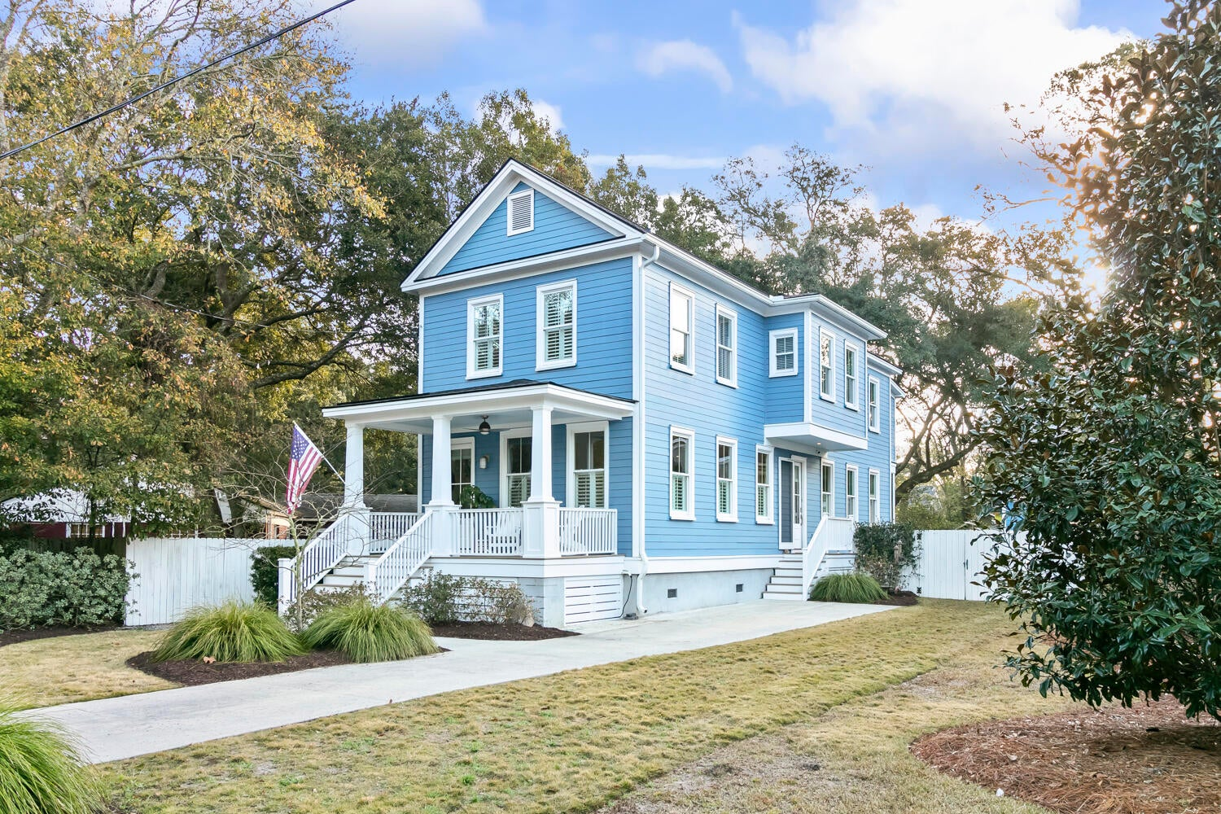
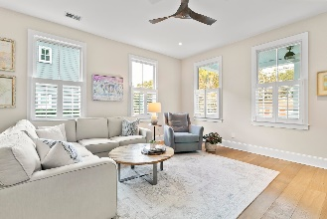
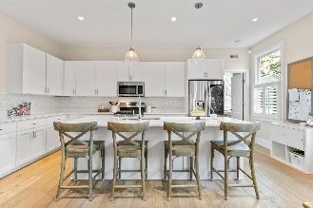
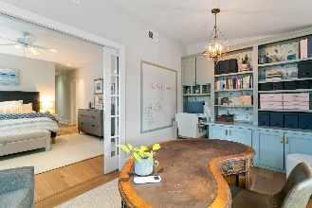
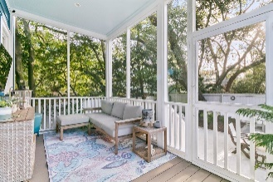
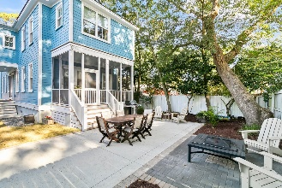

Agent Open House ~ Friday 11am-2pm
Hosted by Kathy Ware | 843-830-3804 | kathy.ware@carolinaone.com
26 Pearl Avenue
Brookgreen Meadows | Mount Pleasant | MLS# 24001156 | $1,368,000
Gorgeous inside and the perfect location, this special property is a hidden gem, in one of the most sought-after walkable neighborhoods where homes are rarely for sale. This gleaming, four bedroom, three-and-half bath custom home has high ceilings, a fully-fenced yard and wonderful outdoor space for your pets, friends, and family. Zoned for excellent schools, with friendly neighbors, it's an easy walk to restaurants, shops, Shem Creek, Pitt Street, Starbucks and more. As you open the front door you are greeted by natural light, hardwood floors, and custom shades and shutters. Enjoy the open floor plan with a spacious family room, dining area, custom kitchen with extended height upper cabinets, quartz countertops, stainless appliances, gas stove.
There's a pantry off the kitchen, large walk-in coat closet and a powder room. The home features dual primary bedrooms, each with an en-suite bath. The downstairs primary features a custom built-in Murphy bed and couch (which will convey!) making it easy for using as a flex space and bedroom when needed. Upstairs, the second primary bedroom features two walk-in closets, and a flex space with custom built-ins for an office/den/exercise area. Two additional generously sized bedrooms feature custom closets and a full bathroom for the two bedrooms to share. Other key features include hardwood floors in the entire home, tankless gas water heater, tiled floors in bathrooms, custom stamped patio with brick detailing, lawn irrigation and screened-in porch with TV. Only ten minutes to the beach, downtown, and 526.
Carolina One Real Estate
195 W Coleman Blvd
Mt Pleasant, SC 29464-3495
Jennie Hood Emerson
(843) 327-0384
jennie@carolinaone.com
www.yourcharlestonhomes.com

