Slide 1
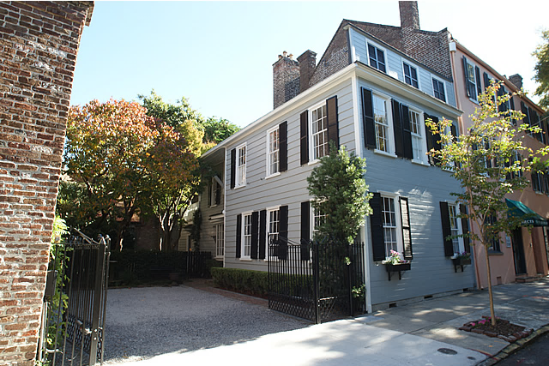

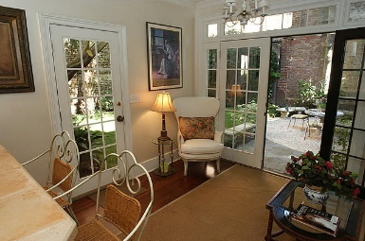
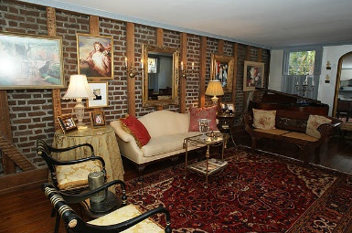
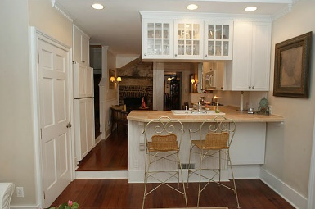
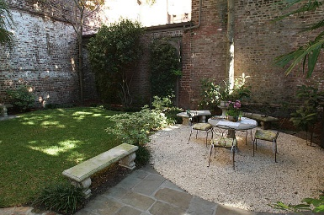


Be sure to check-out the YouTube video to see more!
26 State Street ~ French Quarter ~ MLS# 19030092 ~ $1,685,000
UNIQUE Jewel Box in the OLD WALLED CITY
Surrounded by world class ART GALLERIES and shops, this house has it all:
parking for up to 4 cars, private garden with mature landscaping, and so much more!
This pre-CIVIL WAR home was built by an English ship's captain with CYPRESS and HEARTPINE WOOD. Much exposed brick work and original features.
If you want a HISTORIC HOME WITH PARKING, PRIVACY, in the middle of everything, THIS IS IT!
Handsome Properties, Inc
53 Broad St
Charleston, SC 29401
Ellen Leigh Murray
843 813-2006
chaspremierprop@bellsouth.net

