Slide 1
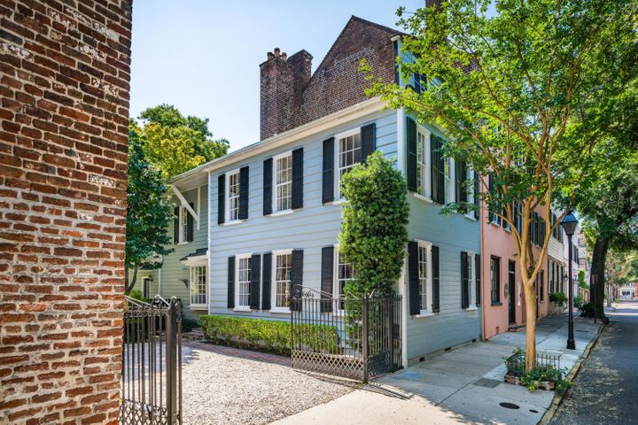
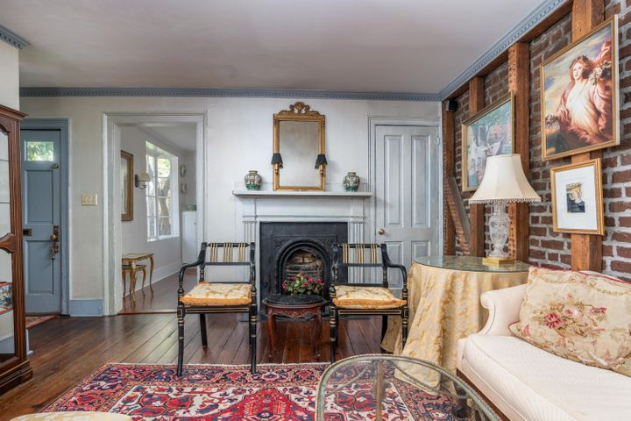
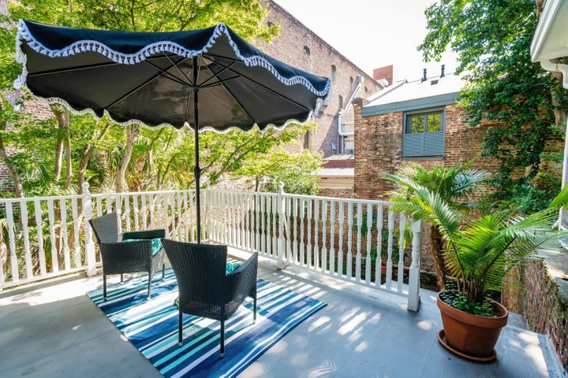

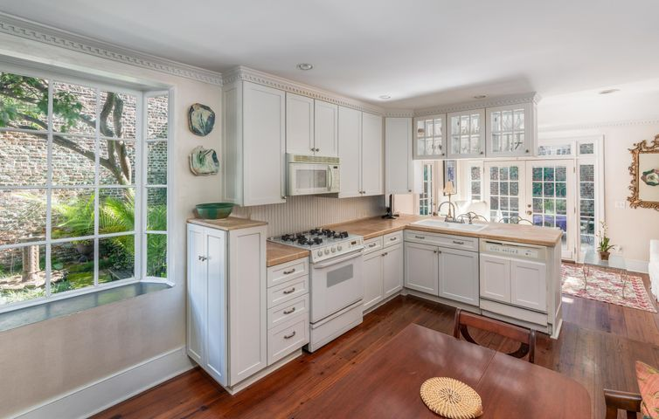
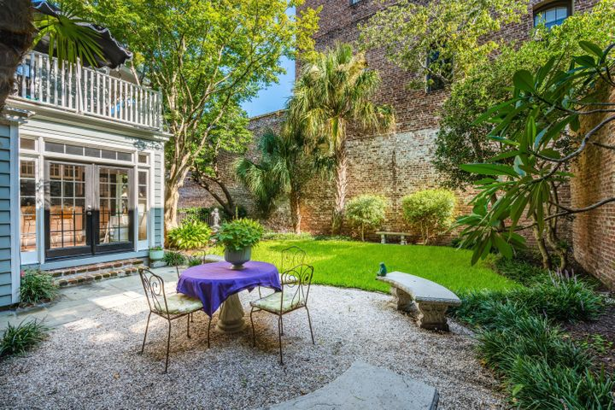


Be sure to watch the YouTube video to see more!
UNIQUE Jewel Box in the
OLD WALLED CITY
Open House
Sunday
April 25
1-3pm
Behind the Iron Gates in the HISTORIC FRENCH QUARTER, this serene retreat is a HOME that warms the heart and captivates the soul. Built in 1841, its key feature are its PRIVACY AND LOCATION. The interior is light and airy, awash with architectural details. Here one can enjoy total privacy on a double lot surrounded by trees and lush landscaping. A relaxing porch off the sun-drenched 2nd bedroom looks out over this bucolic setting, yet you are steps away from Waterfront Park and Charleston's restaurants and art galleries. Bike Everywhere! With a deck, grassy yard (plenty of room for a pool)and patio areas, this home is perfect for outdoor entertaining. PARKING for 4 cars is its coveted feature! This is a RARE GEM in the center of all that is CHARLESTON.
26 State Street
French Quarter | MLS# 21009550 | $1,599,000
2 Bedrooms | 2½ Baths | 1,850 sf
Handsome Properties, Inc 53 Broad St Charleston, SC 29401
Ellen Leigh Murray
843 813-2006
chaspremierprop@bellsouth.net

