Slide 1
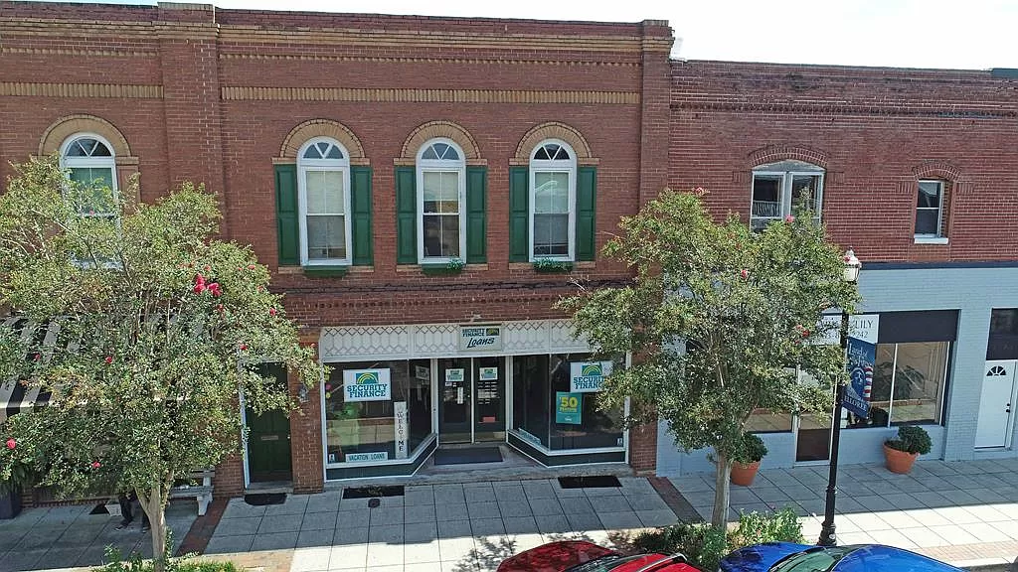
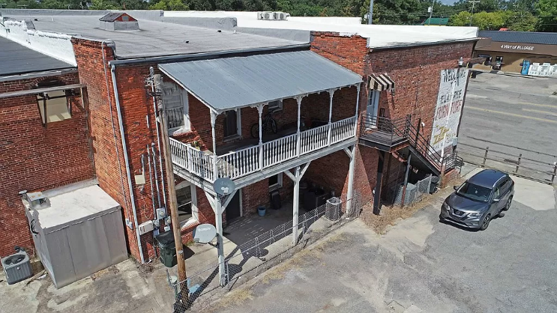
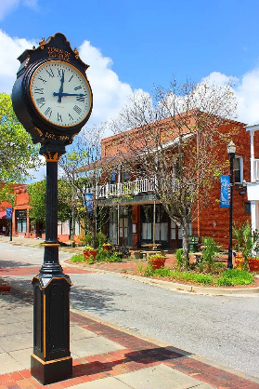
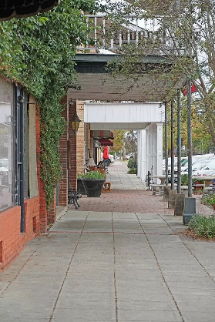
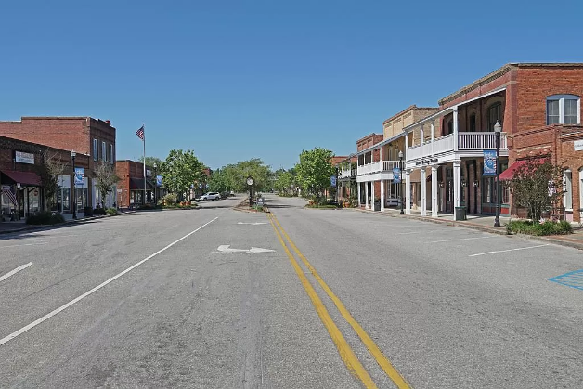

Investment Property
2703 Cleveland St
Elloree, SC 29047
MLS# 158094 ~ $275,000
Welcome to 2703 Cleveland St, Elloree, SC - an exciting investment opportunity in a charming southern town. This property presents an excellent chance to secure a piece of real estate with promising potential. Situated in the heart of Elloree, this Multi use building offers both a comfortable living space in 2 apartments and attractive Commercial space. Investors will appreciate the strong investment potential of this property. Elloree's real estate market has shown growth in recent years, and this property stands as a promising addition to your portfolio. With the potential for steady rental income (all 3 units are rented) this is a turn key investment.
Lake Homes Realty, LLC
Elloree, SC 29047
www.SCLakeLife.com
Kristie Anderson
(803) 387-9459
kristie@sclakelife.com

