Slide 1
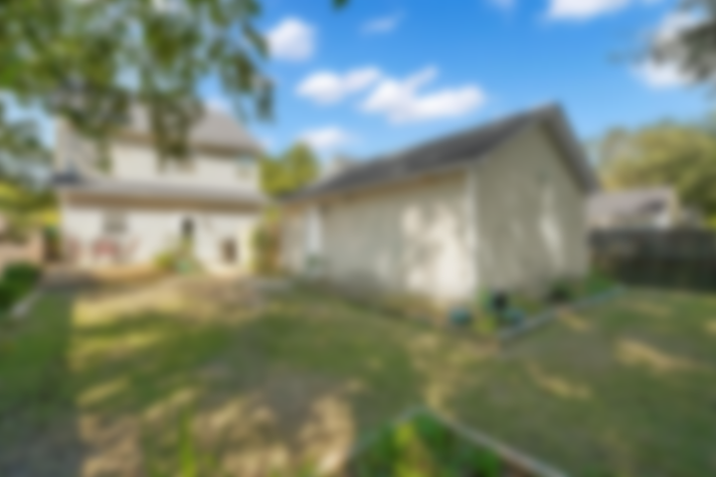
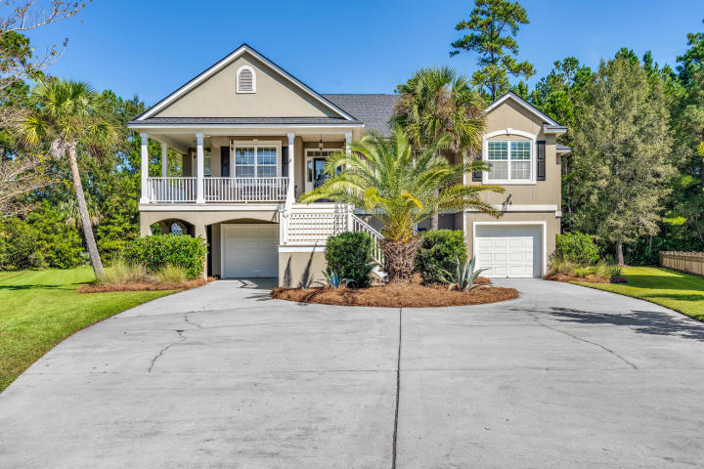
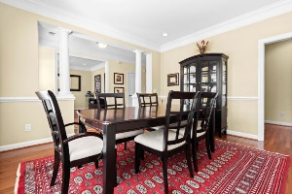
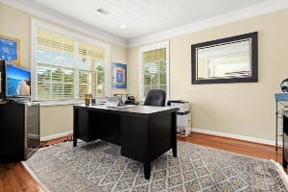
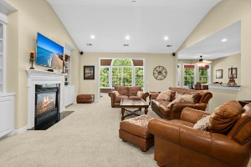
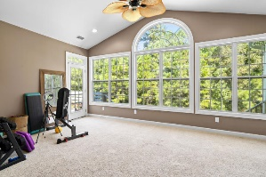
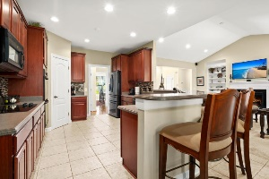
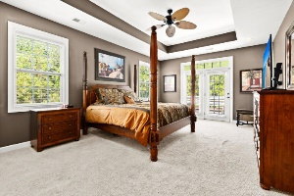
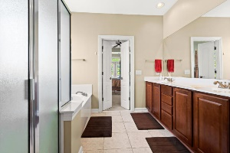

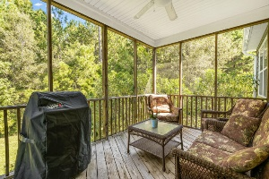
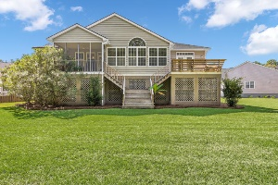

Price Improved! Elevated One Story Home
2704 Sarazen Drive
Rivertowne | Mount Pleasant, SC 29466 | MLS# 20027998 | $610,000
Welcome home to 2704 Sarazen Drive in the beautiful Rivertowne Country Club subdivision. Located at the end of a cul-de-sac, this elevated home has plenty of storage in the garage area! The roof was replaced in 2020 and HVAC was replaced in 2017! As you walk in the home you have a study/office on the left and a formal dining room on the right. Open concept kitchen and family room with tons of light spilling in from the windows in the back sitting room which are overlooking your private backyard. On the left side of the home you will find the master suite and the right side of the home you have three bedrooms, 2 full bathrooms, and your laundry room. Don't miss this opportunity, this home will not last long!
Marthe Teixeira (917) 325-8033
marthet@carolinaone.com
Scott Fulton 843-324-8845
ScottandMarthe@gmail.com
fultonteixeirahomes.com
Carolina One Real Estate | 2713 Highway 17 North | Mt. Pleasant, SC 29466

