Slide 1
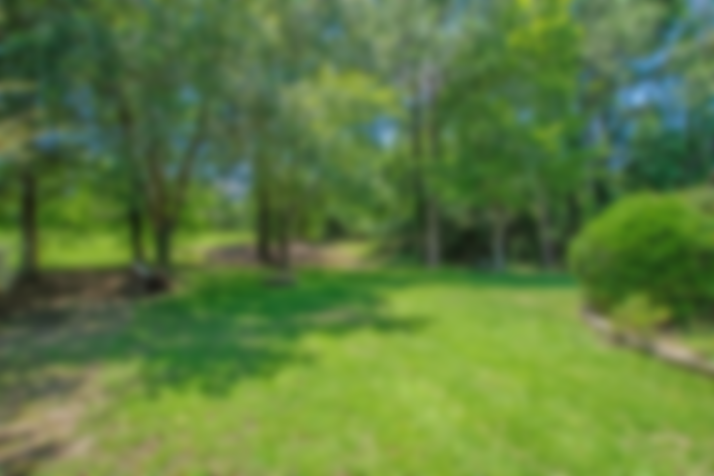
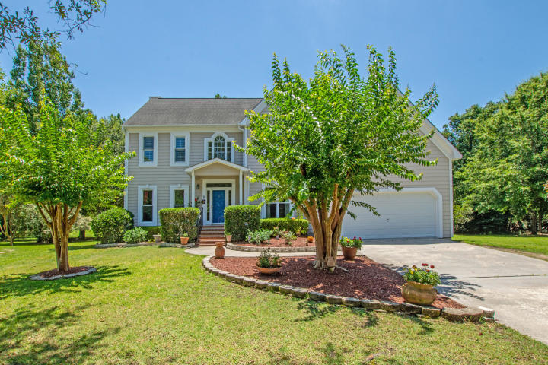
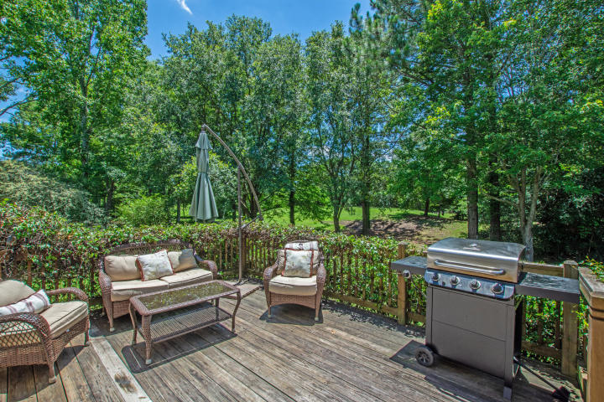
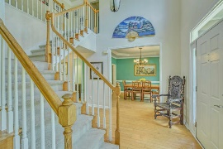
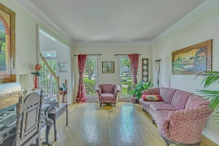
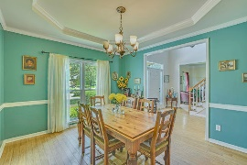
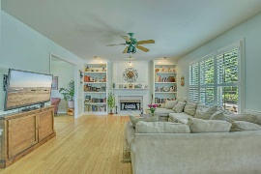
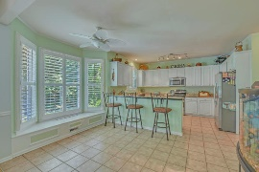
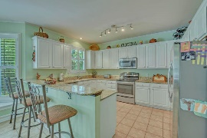
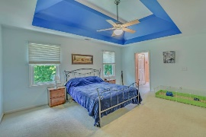
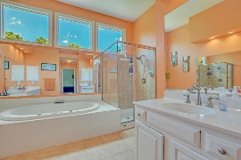
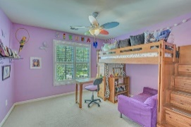
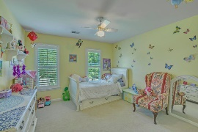
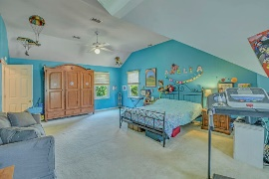
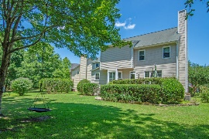

Brickyard - Private Backyard on Cul-de-Sac
4 Bedrooms + 2½ Baths + Quiet Cul-de-sac
2705 Gaston Gate
Brickyard Plantation | Mount Pleasant, SC 29466 | MLS# 19019765 | $565,000
This wonderful home resides on a beautifully landscaped yard in The Retreat on a cul-de-sac with plenty of space indoors and outdoors to enjoy and entertain. Traditional style home offers a spacious open floor plan with lots of natural light. The amazing updated kitchen with tile flooring, granite countertops and stainless steal appliances! The family room has fireplace with built in bookcases on both sides and lots of natural light, The dining room and den is conveniently located off the eat-in kitchen. High efficiency bamboo flooring through the first floor and high efficiency windows throughout the house. Second floor has 4 Br's with the Master that has tray ceiling, 2 large walk in closets and separate tub and shower with large 18 inch tiles. Nice size bedrooms and an over sized FROG being used as a 4th bedroom with deep closet. HVAC has been updated to include a split zone so the FROG has its own thermostat Enjoy the large deck with private backyard one of the best lots in The Retreat. Invisible dog fence for your pup to enjoy the large backyard!
The neighborhood has it all for year-round enjoyment: Boat ramp onto Horlbeck Creek, boat storage area, Olympic size swimming pool, and two smaller pools, play park, soccer field, and basketball court, 5 lighted tennis courts and club house. Enjoy the open spaces, including walk and bike paths and great ponds for fishing.
Marthe Teixeira
(917) 325-8033
marthe@agentownedrealty.com
AgentOwned Preferred Group
824 Johnnie Dodds Blvd
Mt Pleasant, SC 29464

