Slide 1
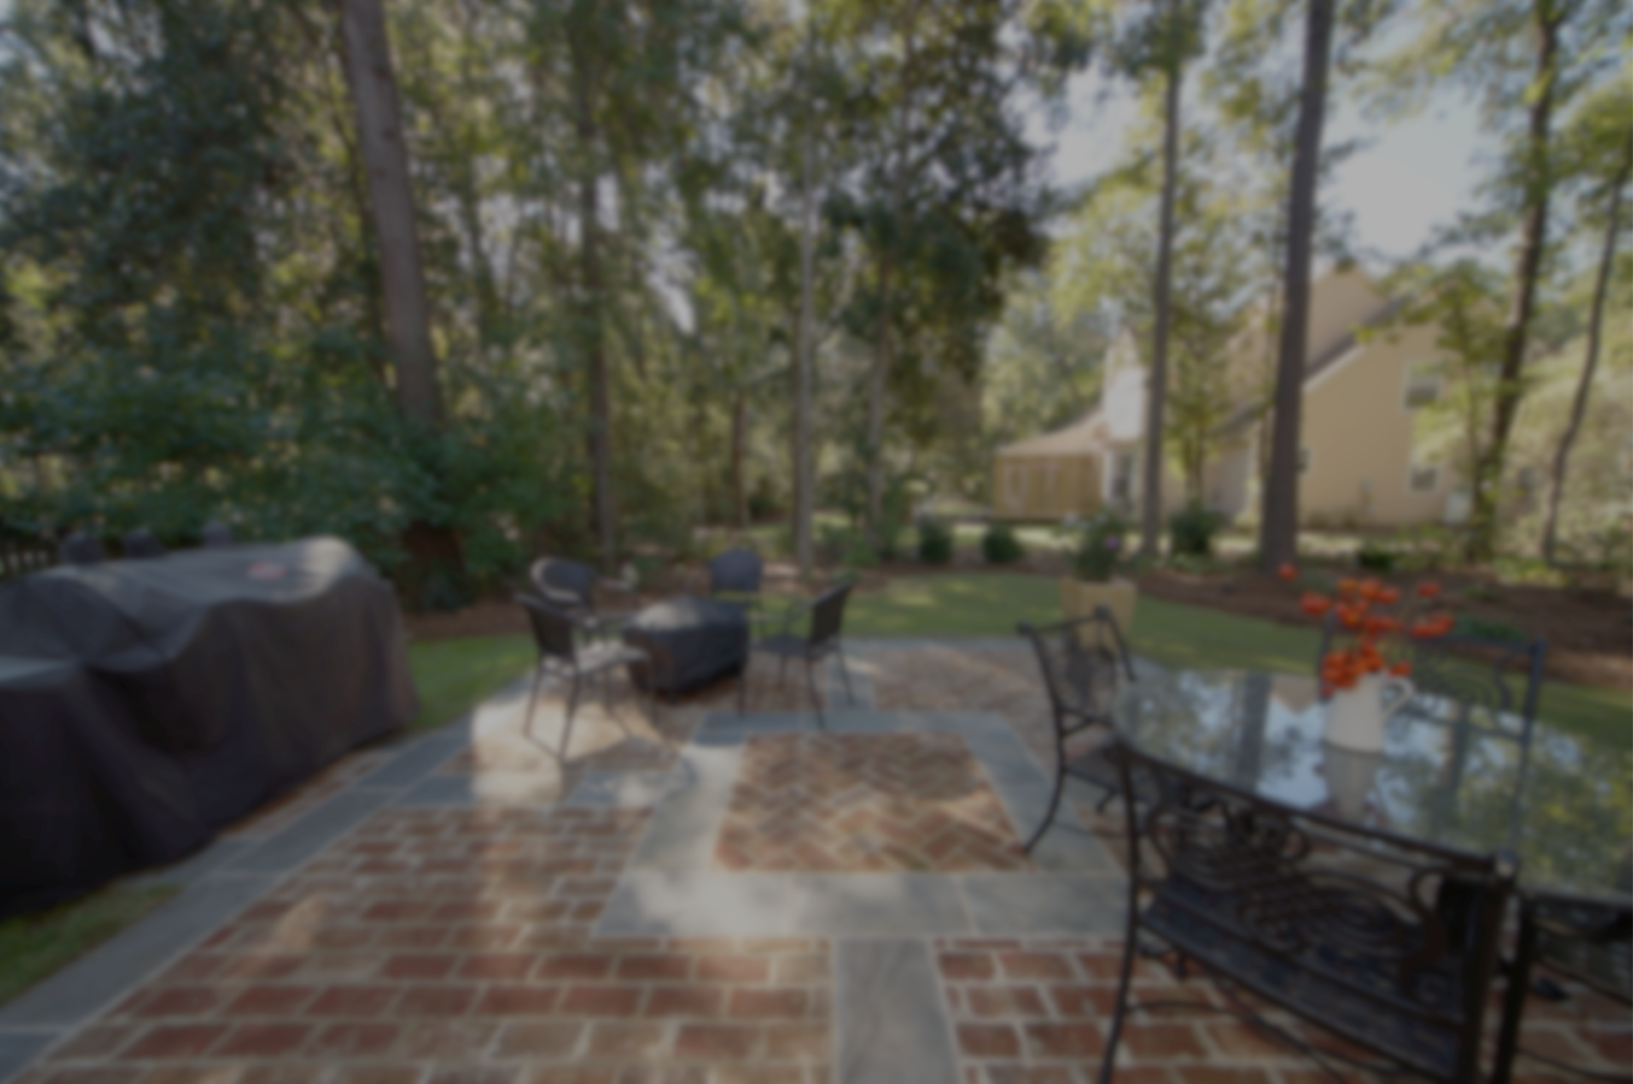
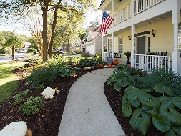
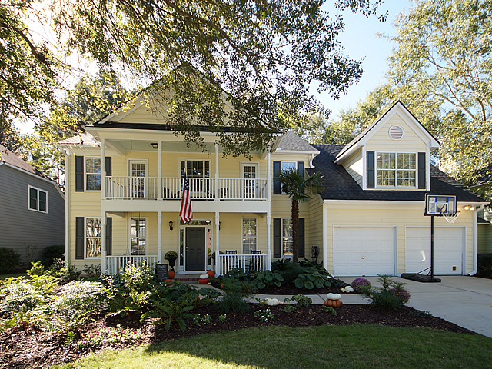
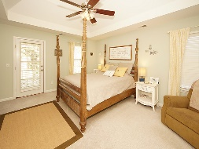
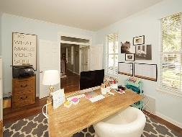
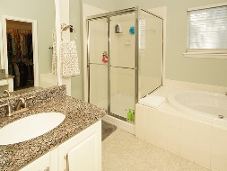
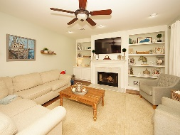
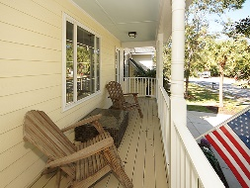
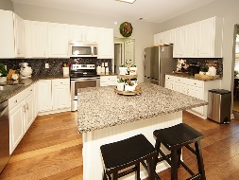
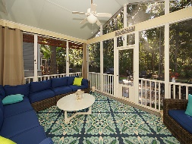
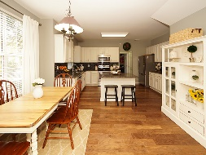
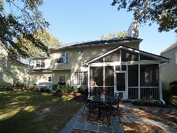

2706 Seastrand Lane
Brickyard Plantation
Mount Pleasant, SC 29466
MLS# 17029386 ~ $474,000
4 Bedrooms in the heart of Mt. Pleasant
Over 2,600sf for under 475k!
Reduced Another $50,000!
Must Sell By Year’s End!
2706 Seastrand lane is a gorgeous, 4 bedroom, 2.5 bath home in the highly desired Colonnade section of Brickyard Plantation. The home feature lovely tray ceilings, a huge master bedroom and master bath, walk-in closets a bonus room and a front first level room that may be used as a home office or a sitting room. The kitchen and baths have granite countertops and the floorplan is open, with an eat in kitchen space, plus a formal dining room. The home has been professionally landscaped and has a screen porch and custom patio for cooking out or just evening relaxation. This home is near the end of Seastrand, so there is no through traffic. The garage is attached and holds two automobiles. Shopping, schools and nightlife are all conveniently located. Come take a look!
Carolina One Real Estate
2713 Highway 17 North
Mt. Pleasant, SC 29466
Terry Hamlin
(843) 830-3946
terry@thamlinproperties.com

