Slide 1
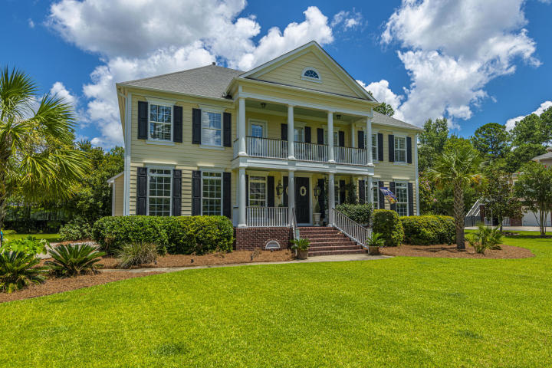
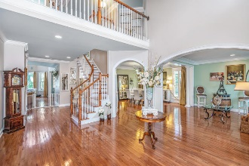
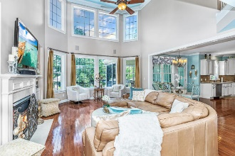
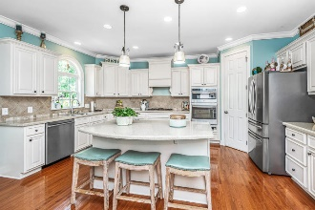
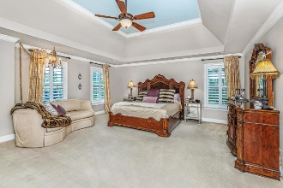
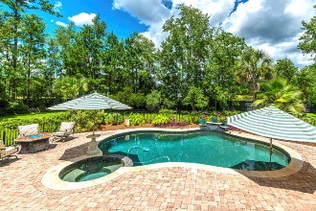
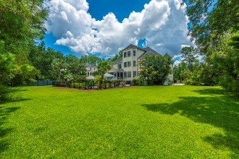


Welcome Home!
2708 Oak Manor Drive
Dunes West ~ Mount Pleasant, SC 29466 ~ MLS# 20019051 ~ $989,900
Style and sophistication describes 2708 Oak Manor Dr. This meticulously maintained 5 bedroom, 5 bathroom with 3rd floor bonus room is situated on .69 acres located in the highly sought after privacy gated Dunes West community. A luxurious in-ground pool 4'-7' deep with whirlpool and waterfall and even an out door shower awaits you. This stunning home offers an abundance of living space great for family & entertaining. You are greeted by fantastic double front porches with gas lanterns on the Jasmine draped front porch with your personal swing. Step inside to your grand open foyer. Off the foyer is lovely a sitting area that naturally flows to your spacious formal dining room. Large kitchen with abundance of cabinets for storage, gas cooktop, and more.
Kitchen opens to the 2 story great room; great for entertaining. There's a gas fireplace nestled between beautiful built in shelving and cabinets. A wall of windows that provide beautiful panoramic views overlooking your backyard retreat. Cozy screened porch is a serene place to unwind at night. Sit quietly just listening to the crickets chirping. Enjoy a cool evening in the backyard around your built-in fire pit with family and friends. Take a dip in your own private in-ground pool then rinse off in your outdoor shower.
There is plenty of room for an office for those who work from home or just like to have that special place. Home is well appointed with crown molding and hardwood floors.
There is a bedroom on the first floor off the great room; convenient for guests, office, etc.
Large master suite is located on the second floor along with the other 3 roomy bedrooms. Off the master bath is an incredible bonus retreat which currently serves as a private dressing room. Head on up to the 3rd floor bonus room which is large enough for a pool table, movie time and workout center.
There are so many more upgrades and special features. Must see to truly appreciate the beauty in this exquisite home.
Dunes West offers Resort style amenities, pools, tennis, golf, boat ramp, storage, jogging trails and much more. Your dream home is conveniently located close to award winning schools, recreation center, beaches, great shopping, Historic Downtown Charleston, Charleston airport.
Virtual Tour: https://my.matterport.com/show/?m=yQi8AzBsLEZ
Sue Hensch
843-324-6939
sue@suehensch.com | www.suehensch.com
Carolina One Real Estate | 195 W Coleman Blvd | Mt Pleasant, SC 29464-3495

