Slide 1
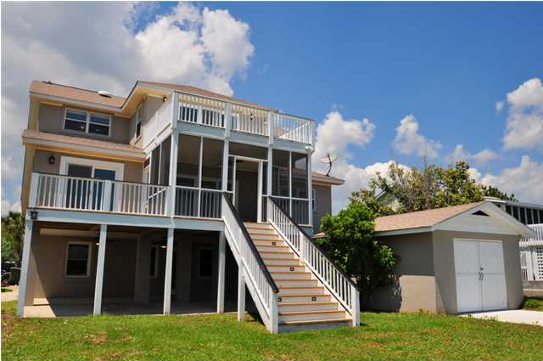
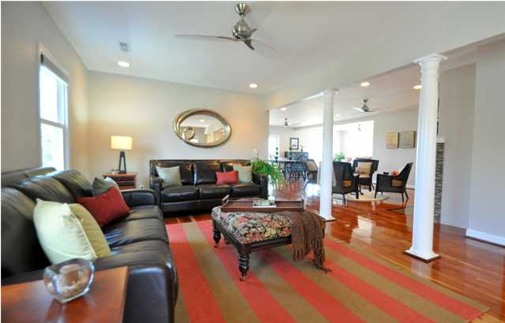
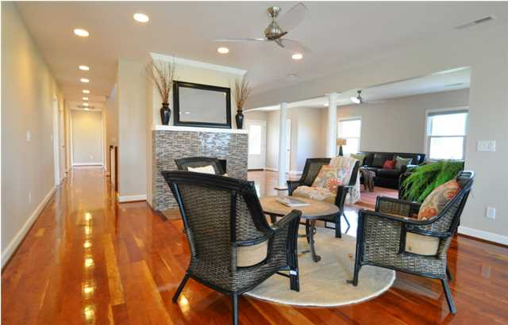
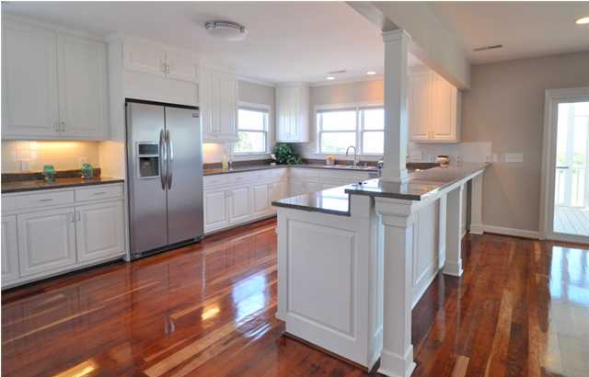
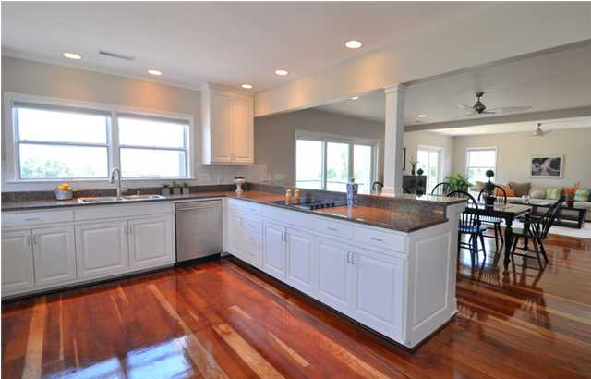
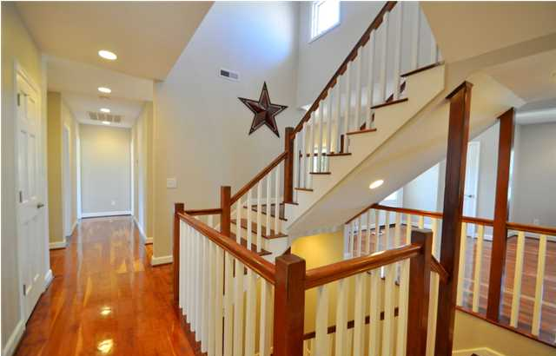
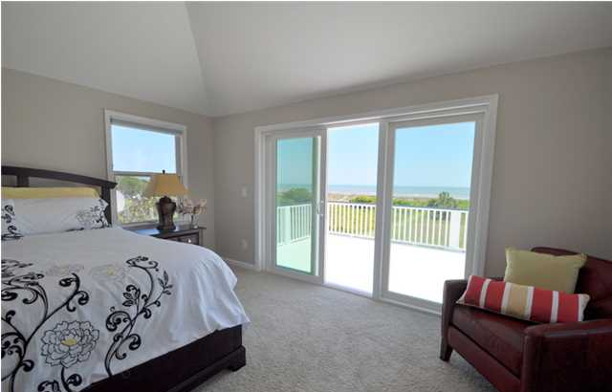
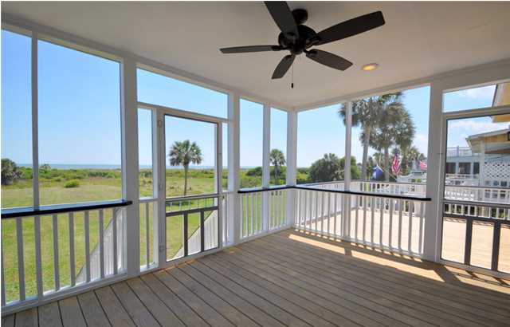
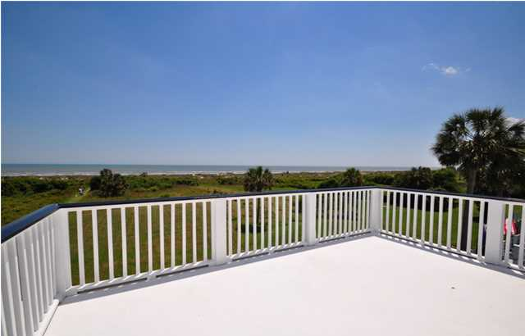
2708 Palm Blvd, Isle of Palms, SC Please join us for an "Evening on the Beach" August 14th from 3-8
The Seller is offering a $20,000 AGENT BONUS to Buyers’ Agent at closing with acceptable offer (subject to Broker approval).
Hor d'oeuvres & Dessert Served by Wild Thyme Catering
Wine Sampling
Acoustic Guitar performance by Local Musician, Justin Hoke
MLS# 1312185 $2,399,900
Listed By
John Vance
843-814-0039
jcvance29483@yahoo.com
Premier Properties of Charleston
Sponsored by
Haynes Johnson & Kris Olson
843-216-3611
kolson@peopleshomeequity.com
People’s Home Equity, Inc
NMLS 166463, 63371, 1193498

