Slide 1

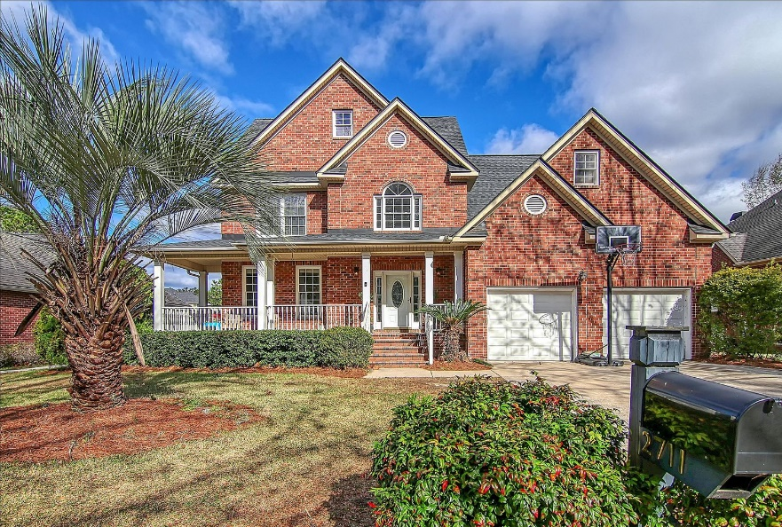
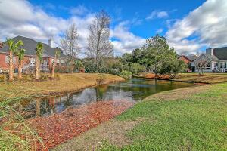
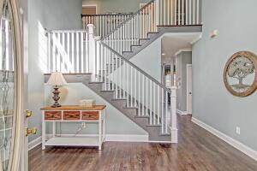
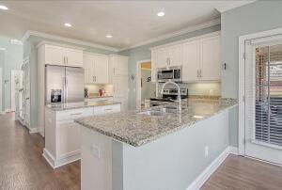
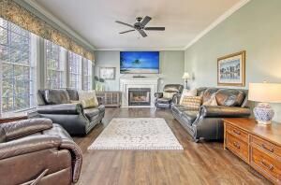
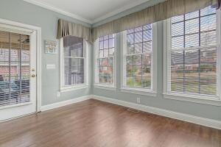
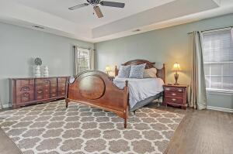

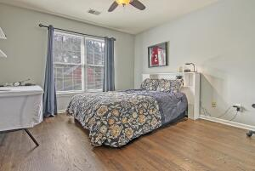
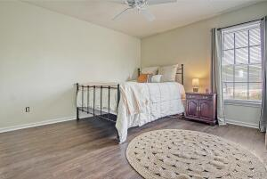
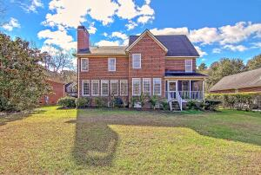
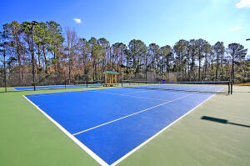
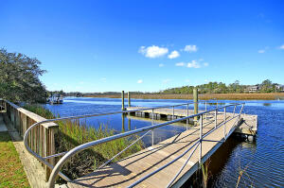
Back on the Market!
Debbie Cromer
ABR, RSPS, REALTOR, CRS
(843) 437-6342
debbie@debbiecromer.com
www.debbiecromer.com/
2711 Waterpointe Circle
Brickyard Plantation | Mount Pleasant, SC 29466 | MLS# 22000229 | $775,000
Beautifully renovated Brickyard home on one of the best pond lots in the Landing. Site finished hardwood floors just installed throughout living areas and bedrooms. The staircase updated with new rails and paint. The spacious master bedroom is upstairs and features a stunning master bath with a wet room (amazing shower and tub), new vanity and beautiful tile floor. Three additional bedrooms and a full bath with a beautiful new tiled shower, vanity and tile floor are also upstairs. Kitchen was renovated a few years ago with new cabinetry, beautiful granite countertops and stainless appliances. The half bath has a new vanity and tile floors. The garage features an amazing storage loft. Amenities including boat ramp, boat storage, pool, tennis and walking trails. Flood ins. not required. Conveniently located close to shopping, restaurants, the beach and downtown.
Video Tour: http://www.vimeo.com/662145426
Century 21 Properties Plus | 1090 Park West Blvd; Ste 103 | Mount Pleasant, SC 29466

