Slide 1



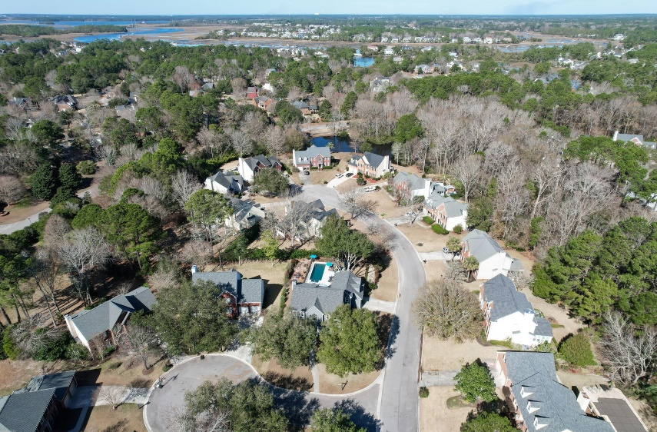
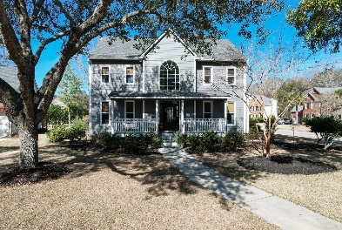
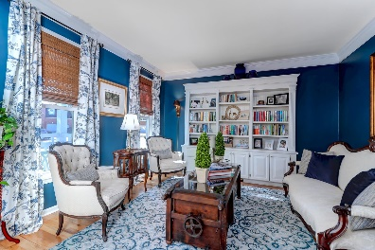
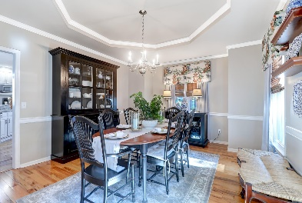
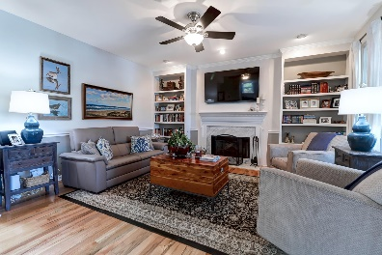
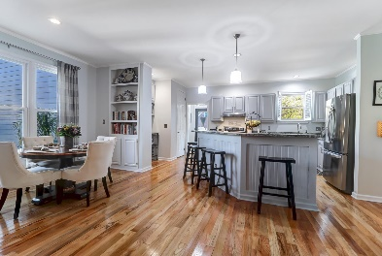
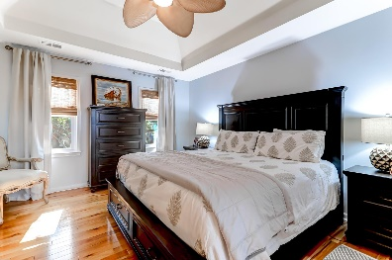
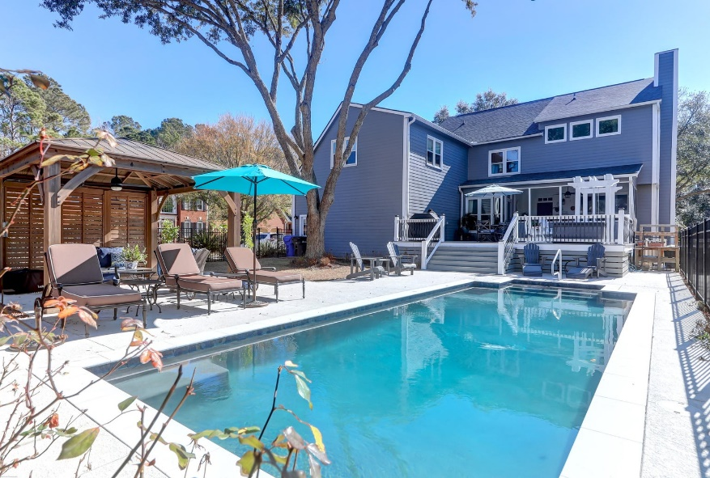
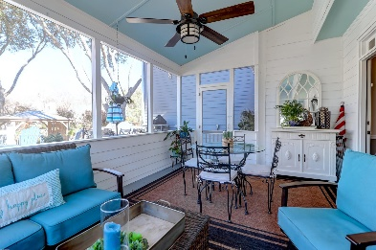
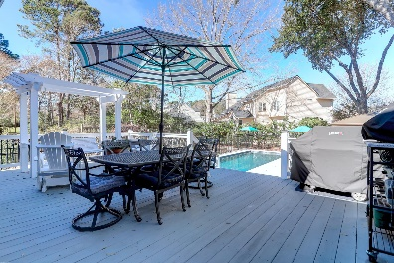
Leesa Northrup
Carolina One Real Estate 628 Long Point Road Mount Pleasant SC 29464 Office: 843.884.1622
Mobile: 843.442.0987
Fax: 843.746.4994
lnorthrup@carolinaone.com
2715 Coddell Court
Brickyard Plantation | Mount Pleasant, SC 29466
Welcome to your dream home in the desirable and centrally located Brickyard Plantation neighborhood. This elegant residence is situated on a coveted corner lot and a cul de sac. Step inside and be greeted by a true foyer, with the formal dining and living rooms providing the perfect setting for entertaining guests or hosting elegant dinner parties. The heart of the home is the spacious kitchen, complete with granite countertops, an eat-in area and a lovely great room; all open to each other. There is even a convenient drop zone at the side door. Hardwood floors grace the main living areas, adding warmth and sophistication to the home's aesthetic. Multiple built-in bookshelves provide a touch of character and functionality. Storage is huge plus in this home, as it offers an abundance of closets and storage spaces throughout. Retreat to the updated master bathroom, a luxurious oasis where you can unwind and rejuvenate. With modern fixtures and shiplap, it offers a spa-like experience in the comfort of your own home. The fourth bedroom is the finished room over the garage which boasts a huge closet and offers incredible flexible space. As you step outside, you'll be captivated by the backyard, which resembles a private resort. A gunite pool awaits, equipped with a heater for year-round enjoyment and a chiller to keep you cool during the summer months along with a flexible mesh cover. Imagine spending lazy afternoons lounging by the pool or hosting memorable gatherings with friends and family. For those seeking shade and tranquility, a lovely gazebo provides the perfect spot to relax and block the sun's rays. Additionally, a large deck and a screened-in porch overlook the pool, offering additional space for outdoor dining, entertaining, or simply enjoying the beautiful surroundings. Brickyard Plantation is known for its incredible amenities, including a boat ramp, two pools, a playground, multiple tennis courts, a basketball court and a lovely clubhouse.
Now Offering at $1,100,000
MLS 24002464
Bedrooms: 4
Bathrooms: 2.5
Square Feet: 3,194

