Slide 1

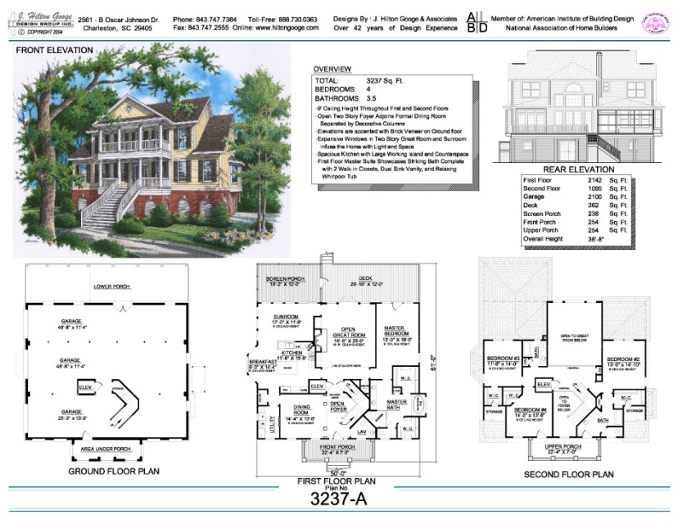
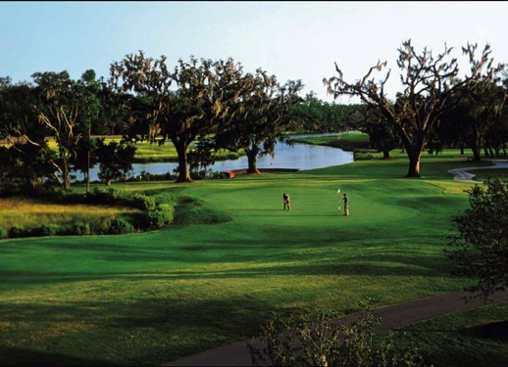
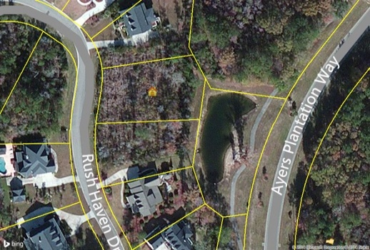
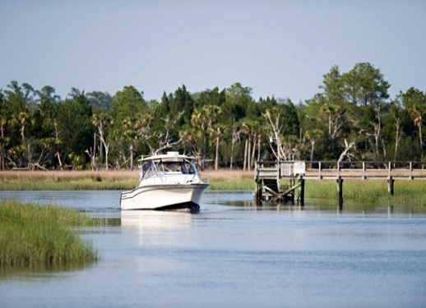



In the Spotlight…
2716 Rush Haven Drive-The Harbour
Build Your Dream Home – $689,000 - Dunes West
Close On Building Lot/House Loan within 45 Days of HOA approval
Home Features-MLS #14028752
½ Acre Plus Lot
3,237 Square Feet
4 Bedroom, 3.5 Bath
Double Front Porches
9’ Ceilings on 1st floor
1st Floor Master Bedroom Suite
Gourmet Kitchen with Granite
Elevator Shaft
Rear Deck & Screened In Porch
Screened In Porch
Private street with Custom Homes
Beautiful established street with custom built homes situated close to the Wando River situated in the gated community of Dunes West. Dunes West has something for everyone. Amenities for members include 18 hole Arthur Hills golf course, beautiful Southern style golf Clubhouse overlooking Wagner Creek, 9 Lighted Tennis courts with tennis shop and pro, state of the art Fitness Center and aerobics room, resort style pool with zero entry and water slide, as well as another lap style pool, children's playground, walking trails, crabbing dock, boat storage and boat launch. You can purchase the lot on its own at $174,700 (MLS #1422523)
Margaret Hekker
BIC, Owner
Lighthouse Realty Group, LLC
Cell-843-296-7520
mhekkerrealestate@gmail.com
Builder Will Meet With Buyer At The Lot – Call For Details / Specs

