Slide 1
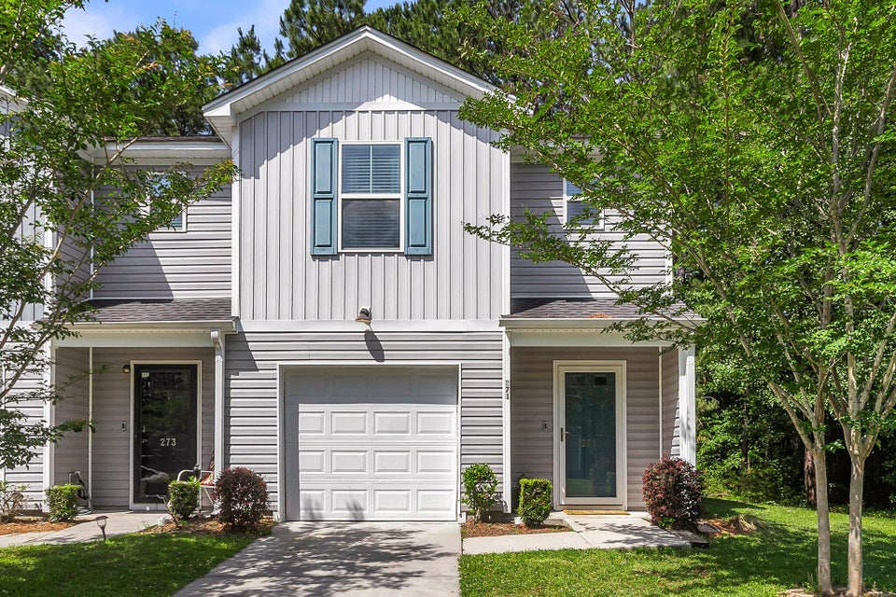
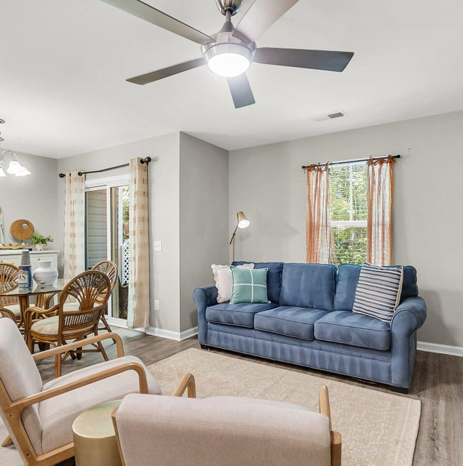
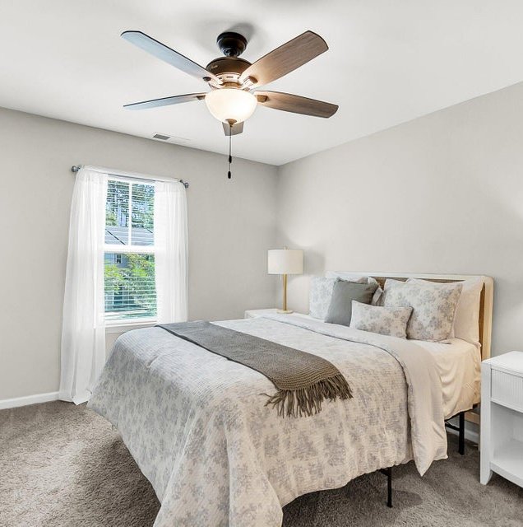

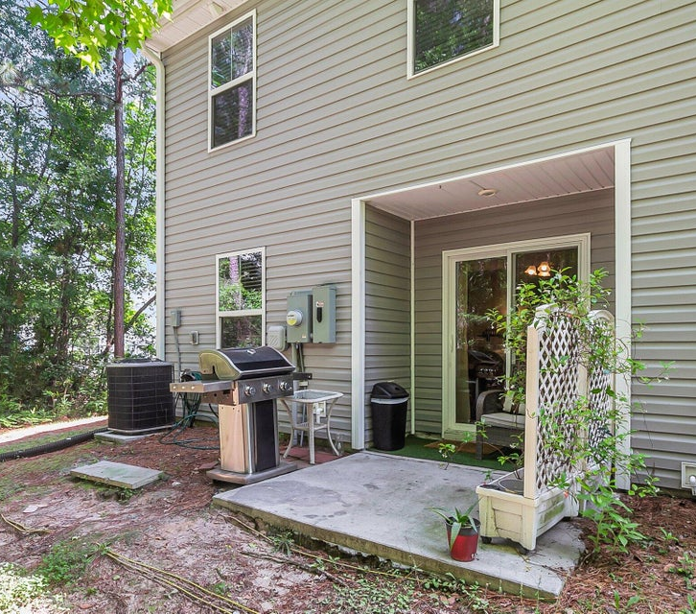
LISTED AT $265,000
271 Jackson Street
Lakeview Commons
MLS# 25013685
Don't Miss This Beautiful Like New End Unit.
Recent Price Improvement!
All Staging Furniture Is New And Available For Separate Purchase!
®
PROPERTY FEATURES
listed exclusively by:
CHRISSY STRICKLAND
843-906-5553
chrissychsrealtor@gmail.com https://residerealestatellc.com/
3 Bedrooms
2.5 Bathrooms
1,280 Sq ft

