Slide 1
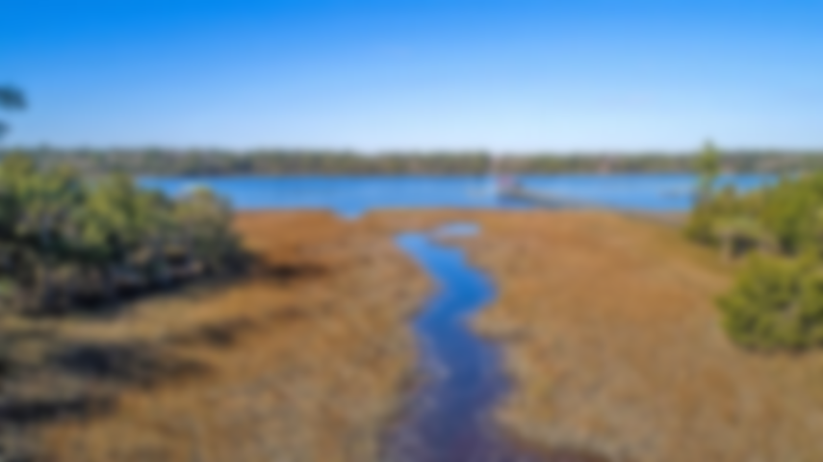
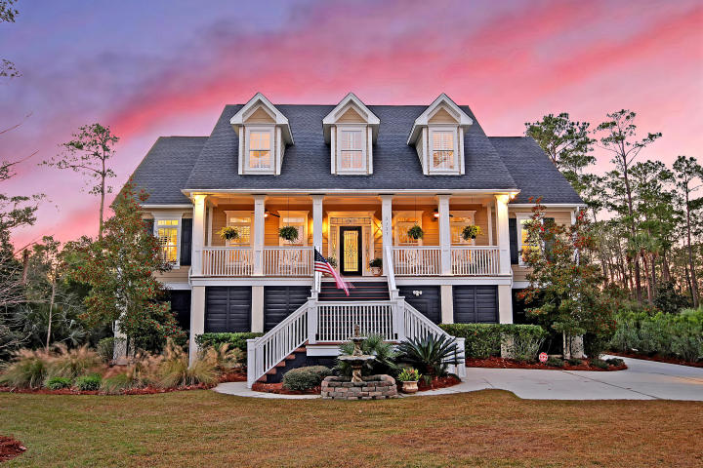
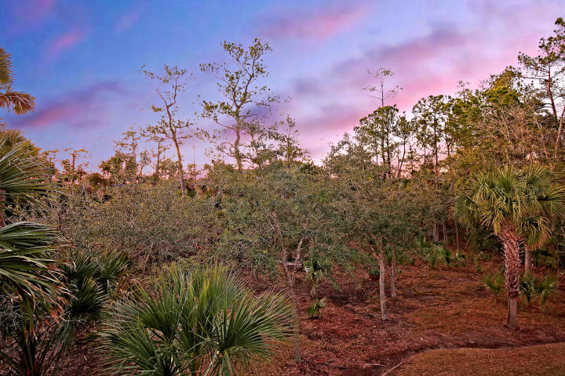
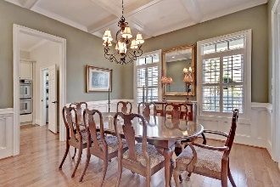
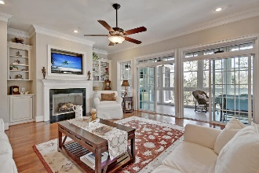
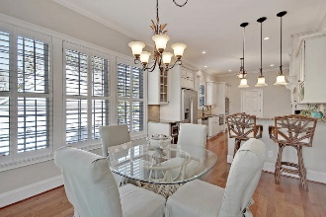
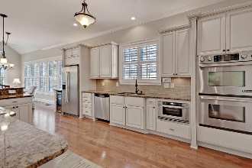
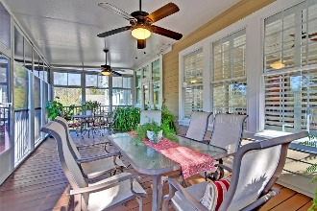
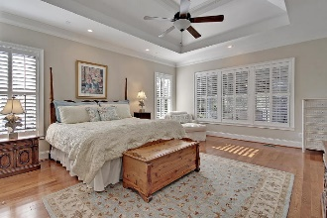
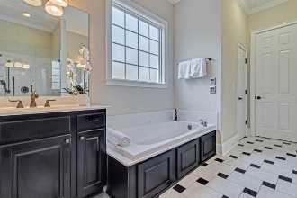
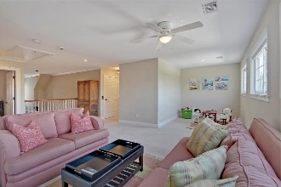
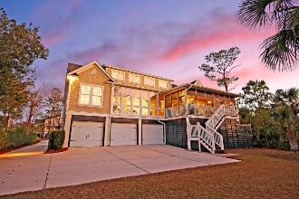
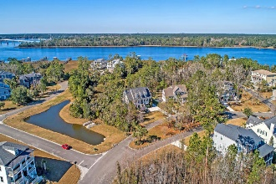


REDUCED TO SELL! BRING ALL OFFERS!
2721 Fountainhead Way
Dunes West | Mount Pleasant, SC 29466 | MLS# 19001788 | $850,000
PRICE REDUCED * APPRAISAL IN HAND FOR $950,000 * IMMACULATE CUSTOM-BUILT HOME WITH PRIVACY AND VIEWS OF THE POND, MARSH AND WANDO RIVER *
This upgraded home is located in the desirable gated community of Dunes West and offers gorgeous wetland, marsh and pond views from the 1st story, and breathtaking views of the Wando River from the 2nd story. With no neighbors on one side and a marshfront lot this home offers privacy and connection with natural surroundings.
Notable features of this home include: 2 tankless water heaters, seven-inch baseboards throughout, a 2,550 sq. feet 3-car garage that can actually accommodate 4 total cars as well as a system wired for network, cable, telephone & audio. Dunes West amenities include community pool, play park, boat ramp, boat storage, club and golf memberships available, + more! Book your showing today!
Brian Beatty Mobile - (843) 345-1273 | Office - (843) 416-2000
lowcountryhomesales@gmail.com
www.listingsincharleston.com
Keller Williams Realty Charleston | 496 Bramson Ct Ste 200 | Mt. Pleasant, SC 29464

