Slide 1



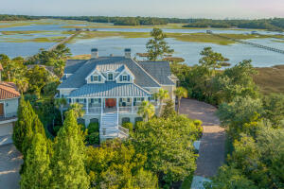
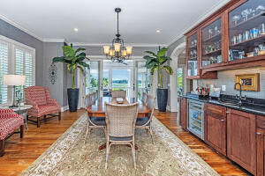
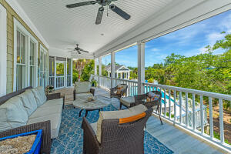



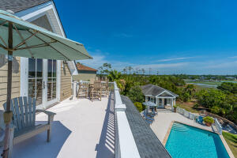
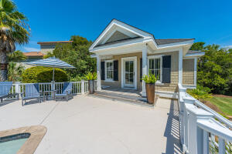

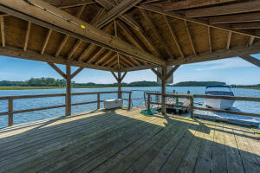
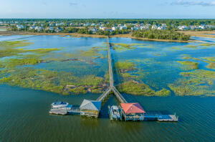


2721 Parkers Landing Road Rivertowne Country Club Mount Pleasant, SC 29466 MLS# 22017397 | $3,050,000
Deepwater Estate
Wind your way down Rivertowne Country Club Drive, past the rolling fairways, the stately homes, and the grand club house into the exclusive enclave of Parkers Landing. Arguably the most desirable lot within this prestigious neighborhood, 2721 Parkers Landing Road is a custom masterpiece nestled into an almost acre lot secluded from view of the street. Tucked into the lush and plentiful Lowcountry landscape, the home is bordered by privacy hedges, marsh, and Horlbeck Creek. Sweeping views of the creek and marshes will dazzle you at nearly every turn. The exterior of the home is impressive, from the bricked drive, to the crushed tabby skirt, it is evident that this home was built in a timeless fashion and designed with a classically elegant flare that will transcend trends and fads.
A shared walkway leads to your private dock with covered pier head, floater and drive on boat dock. Truly deepwater, you'll be able to hop on your boat and be cruising the Wando River within minutes of leaving your dock. Additional features of the home include a three-stop elevator to access all floors (installed in 2021), a whole home generator (installed 2021), updated HVAC units, a humidity controlled workshop within the garage, security system, and integrated speakers throughout. All of this and located in the prestigious Rivertowne Country Club. Enjoy golf at Rivertowne Country Club's Arnold Palmer Signature Course then meet friends at the club for dinner. Additional amenities include neighborhood pool, tennis courts, walking trails and play park all conveniently located to beaches and the world class dining and shopping of historic downtown Charleston.
Tour: https://my.matterport.com/show/?m=fdpTwYonRia
Don Dawson 843-514-0452 ddawson@carolinaone.com Carolina One Real Estate • 2713 Highway 17 North • Mount Pleasant, SC 29466
www.TeamDawsonSC.com

