Slide 1
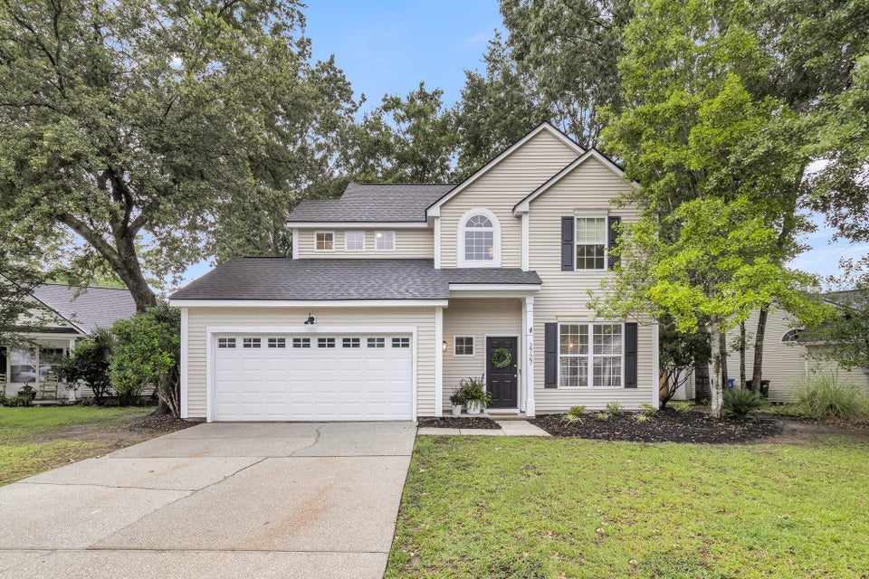
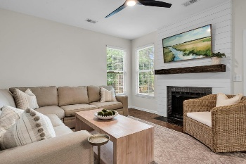
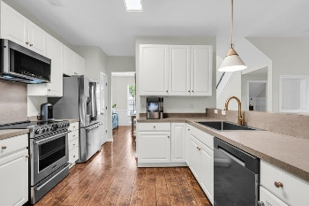
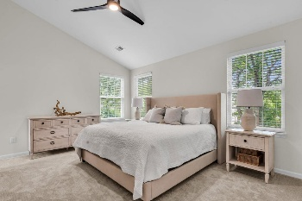
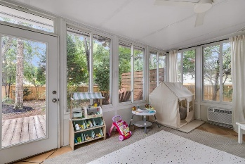
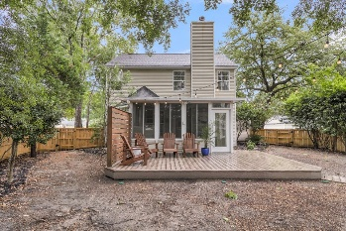

2727 4 Winds Place Planters Pointe · Mount Pleasant, SC 29466 · MLS# 25016134 · $675,000
Coming Soon In Planters Pointe, Mount Pleasant!
Stunning Updated Home with Shiplap & Gold Accents in Sought-After Planters Pointe! Welcome to this beautifully updated 3-bedroom, 2.5-bath home located in the highly desirable Planters Pointe subdivision of Mount Pleasant, SC. With exceptional curb appeal and thoughtfully designed interiors, this home offers a perfect blend of style, comfort, and function. Step inside to soaring ceilings, rich flooring, gold-accented custom light fixtures, and abundant natural light. Tasteful shiplap walls in key living areas add warmth and coastal character throughout the home. To your right, a formal dining room features elegant wainscoting, —creating a stylish space for entertaining, with convenient back access to the kitchen. At the heart of the home is a chef-inspired kitchen featuring crisp white cabinetry, a deep single-bowl sink with an updated gold-tone faucet, stainless steel appliances, and a charming eat-in area. The kitchen opens seamlessly to a cozy family room centered around a welcoming fireplace, flanked by shiplap accents for a clean, modern touch. Just off the family room is a serene three-season sunroom - your perfect second living space for relaxing or entertaining - while enjoying views of the fully fenced backyard. Upstairs, the primary suite is a true retreat with a spa-like ensuite bath that includes a soaking tub, separate shower, dual-sink vanity, striking gold accented light fixture, and a generous walk-in closet. Two additional well-sized bedrooms and a full bath complete the upper level. Enjoy outdoor living in the private, fenced backyard featuring a spacious deck ideal for grilling, gathering, or simply soaking in the Lowcountry charm. To make your move seamless, all appliances convey - including the kitchen refrigerator, washer, and dryer. Planters Pointe offers resort-style amenities including a clubhouse, swimming pool, playground, pickleball and tennis courts, basketball court, and scenic walking/jogging trails. Conveniently located near top-rated Mount Pleasant schools, shopping, dining, medical facilities, and just a short drive to the beaches and Charleston International Airport. Don't miss this incredible opportunity to own a move-in ready home full of charm and designer details in one of Mount Pleasant's premier communities!
Stan Huff
843-670-2835 stan.huff@agentowned.com
Jill Marcacci
843-297-5590 jill@agentowned.com
www.agentownedrealty.com
AgentOwned Realty Co. Preferred Group, Inc. | 824 Johnnie Dodds Blvd | Mt Pleasant, SC 29464

