Slide 1
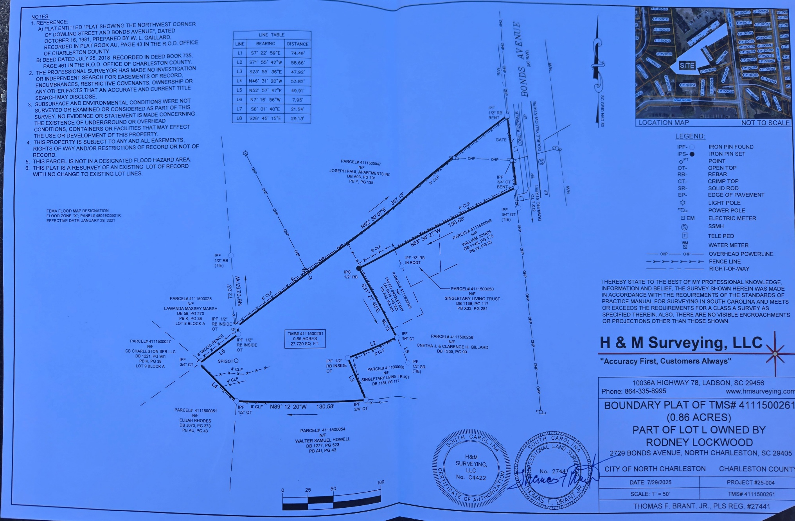
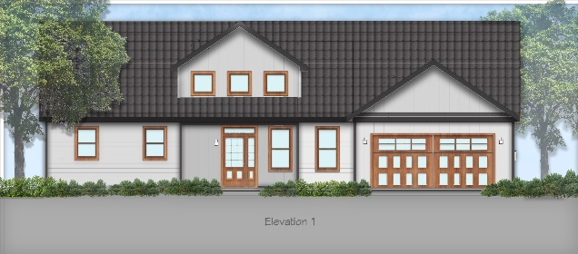
Sample Construction
4 Shovel Ready Lots
2728 Bonds Avenue
North Charleston, SC 29405
Opportunity Zone (Tax Advantage)
Multiple Family Usage
Great For 1031 Exchange
Rare Find
.85 Acres
$300,000
Rodney Lockwood | sweetlock63@gmail.com | (843) 860-7325

