Slide 1
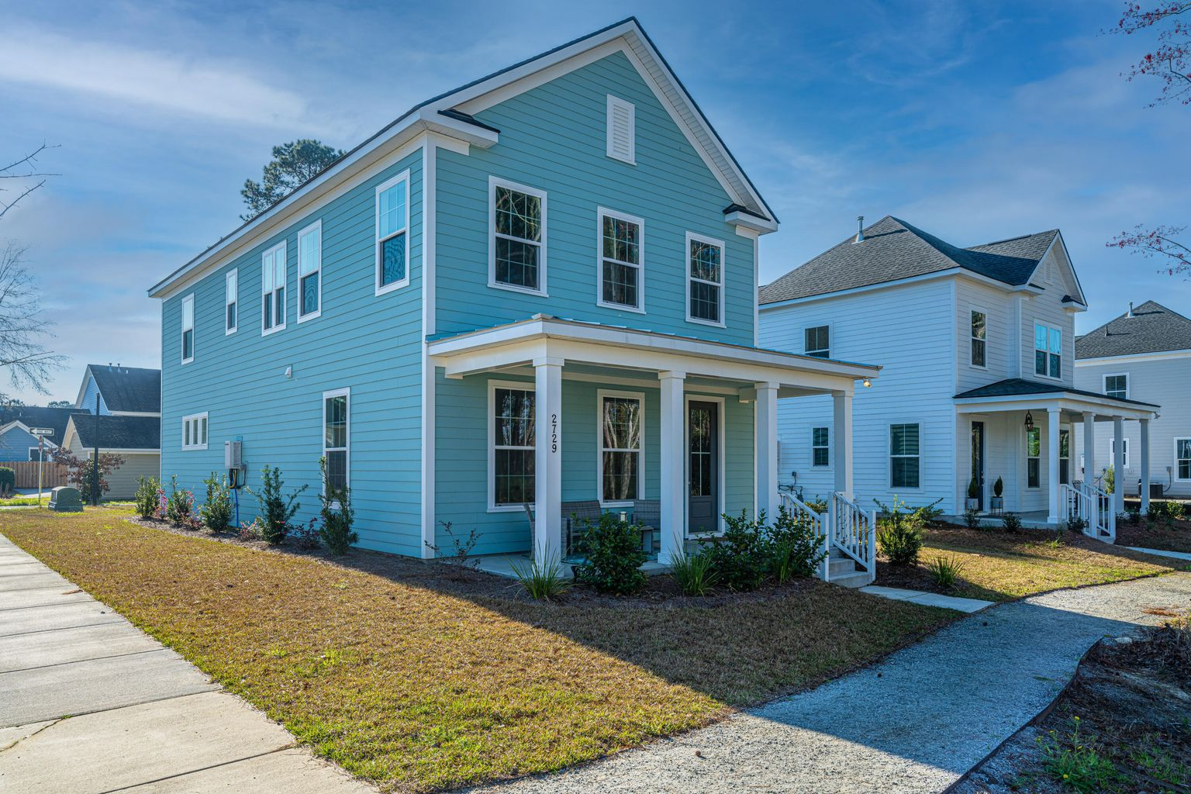
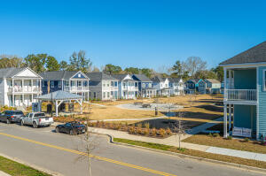
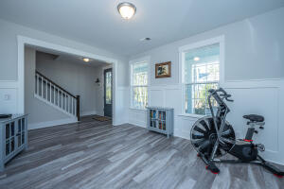




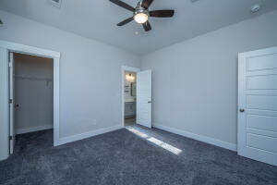
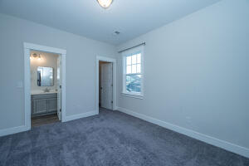

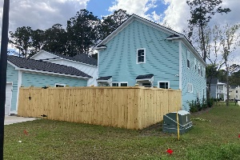
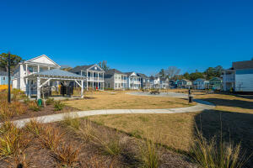

2729 Calico Bass Lane Whitney Lake Johns Island, SC 29455 MLS# 22005683 $585,000
Back on the Market!
BACK ON MARKET DUE TO FINANCING. Every detail was covered in this fully upgraded 2021 Hayward model. Home remains covered under original Builder warranty. Ideally located corner lot, across from park and protected wetland in front. One car garage with additional parking pad leads to sunroom or drop off area. Open floor plan with LVT covering on first floor and upgraded carpet second floor. Upgraded cabinets trim, appliances (gas stove, refrigerator and tankless water heater, the thermostat is in laundry room). Master Bath has dual sinks, upgraded tile shower with bench, tub and private water closet. Jack and Jill bath adjoin the secondary bedrooms. Numerous upgrades include builders 'craftsmen package', nickel hardware in all baths. Privacy fence defines both back and side yards.
Mary Warren ABR, RSPS, REALTOR
Mobile - (843) 224-6272
mwarren@carolinaoneplus.com
Carolina One Real Estate | 1265 Folly Rd | Charleston, SC 29412

