Slide 1
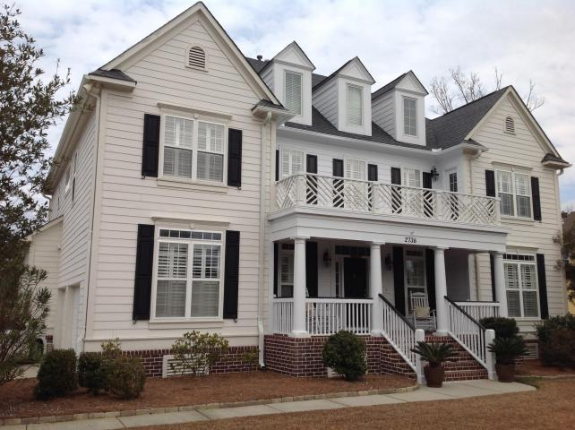
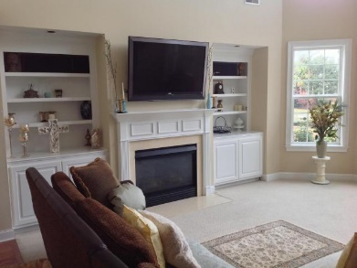
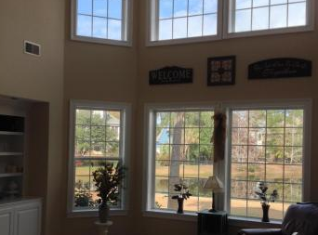
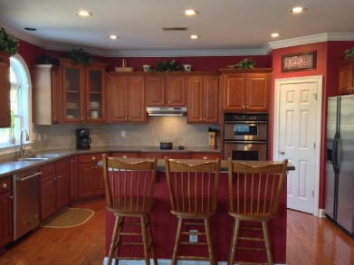
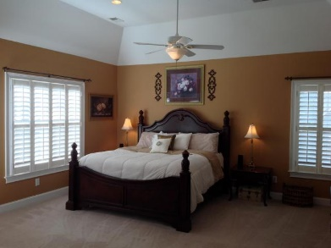
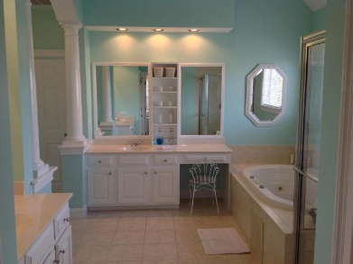

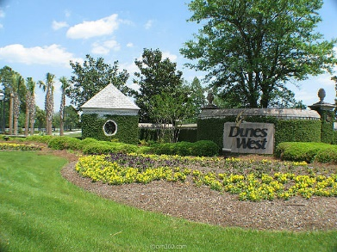

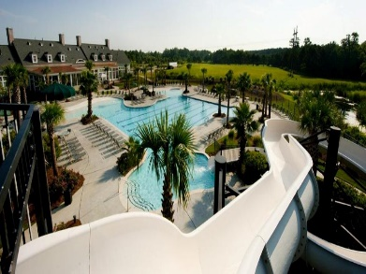


Gorgeous Water Views Out Of Almost Every Window! 2736 Oak Manor Drive Dunes West - Mount Pleasant - MLS# 16001722
~ 2736 Oak Manor Drive is located within the high demand subsection of Richmond Cove in the prestigious gated subdivision of Dunes West ~ Graceful southern charm is evidenced by an open floor plan, large rooms, six bedrooms, five full baths (including one Jack and Jill), high ceilings, double front piazzas, panoramic view of pond, architectural moldings and built-ins, huge kitchen with eat-in breakfast area, center island with breakfast bar, large kitchen pantry, stainless steel appliances including double wall ovens, hardwood floors, plantation shutters, and gas fireplace with mantle ~
All of this situated on .40 of an acre of land which can be viewed out of the abundance of oversized windows ~
The floor plan of this gorgeous home also includes a huge attached frog with full bath, which opens to a separate media/ game room and a bedroom, providing ultimate spaciousness and privacy ~ There are outdoor balconies directly off the master suite and guest room, jetted waterfall tub in the master bath, along with his and her vanities and closets, and many options for an office throughout the home (including a separate room within the master suite) ~
This majestic executive home includes most custom upgrades, such as historic paint colors, designer lighting and fans, security and irrigation systems, plentiful attics/ extra storage space, personal planning center in the kitchen, multiple walk-in closets, and a mother-in-law suite on the first floor ~
Recent additions/ renovations include hardwood floors added to the foyer and dining room, painting, additional 6th bedroom and 5th bathroom, new dishwasher, and a custom master closet ~
Dunes West is known for having some of the finest amenities, including a full tennis facility, work out club with classes, two club houses, gate & security guard, play park, three pools (one with a super slide), boat landing and storage, golf, dining, and walking and jogging trails â€“ all within one of the top school districts within the Charleston area ~
Just Listed at $748,000
Aviles Real Estate Brokerage
Susan Aviles
843-697-2383
Gil Aviles
843-697-5535
www.Aviles-RealEstate.com

