Slide 1
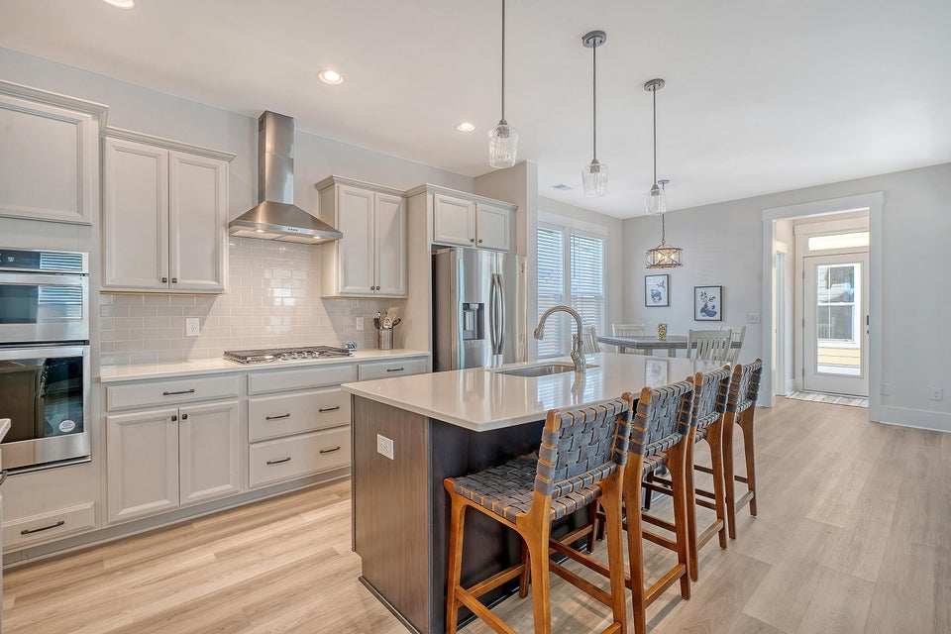
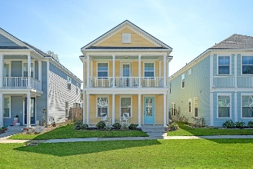
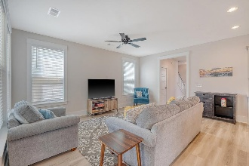
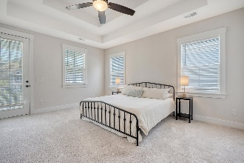
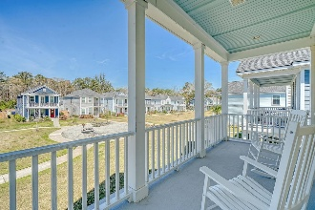
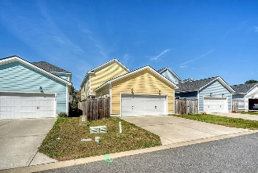

Turn Key Home on Johns Island
Hosted by Kathy Ware | 843-830-3804 | kathy.ware@carolinaone.com
2739 Calico Bass Lane
Whitney Lake | Johns Island, SC 29455 | MLS# 25007512 | $619,000
Charming well-maintained home conveniently located in Whitney Lakes! Upon entering the home, you will immediately notice the natural sunlight, 9 ft ceilings, LVP flooring and attention to detail. Spacious family room provides a wonderful spot to relax. Well-appointed kitchen with ample countertop space, cabinets and a large kitchen island will be the center of your home as you entertain friends and family. Eat-in breakfast area off the kitchen is a nice addition to this floorplan. Separate dining room that is connected to the kitchen through a butler's pantry. The butler's pantry provides a wonderful space for storage as well as additional countertop space. Large walk-in closet near the back door provides a good storage closet - or could work as a home office.
Drop zone with bench and storage space as you enter from the back door. Upstairs you will find an extra flex space and 3 bedrooms and two full bathrooms. The primary bedroom has a tray ceiling and is split from the other bedrooms. Providing nice privacy with an upstairs outside balcony. Primary bathroom has dual sinks, walk-in tiled shower, separate water closet. Walk-in closet in the primary bedroom. Two secondary bedrooms each with a spacious walk-in closet are a great size and share a full bathroom. Detached 2 car garage and a fenced in yard complete this home. The home is facing the neighborhood green space and provides a beautiful setting. Location is prime 20 mins to downtown and beaches. Restaurants and shopping close by. Whitney Lakes has a 25 acre lake, trails, and covered dock. Enjoy fishing, kayaking or paddle boarding in the lake.
VIDEO TOUR
Carolina One Real Estate
195 W Coleman Blvd
Mt Pleasant, SC 29464-3495
Jennie Hood Emerson (843) 327-0384
jennie@carolinaone.com
www.yourcharlestonhomes.com

