Slide 1
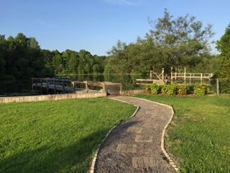
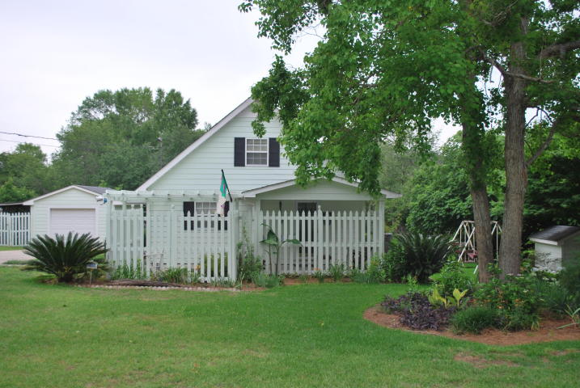
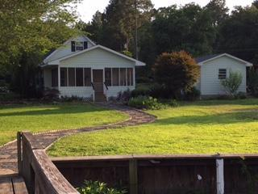
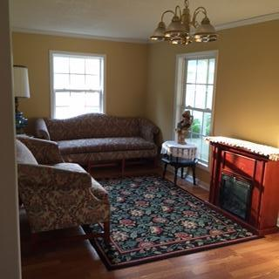
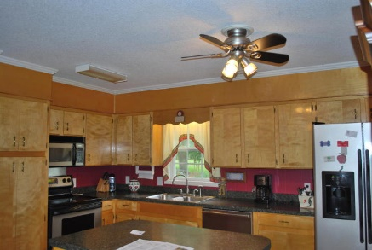
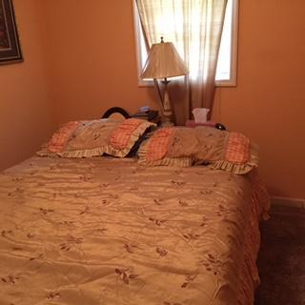
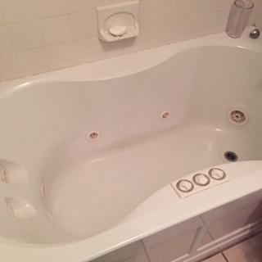
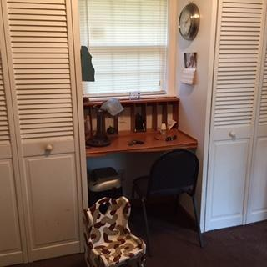
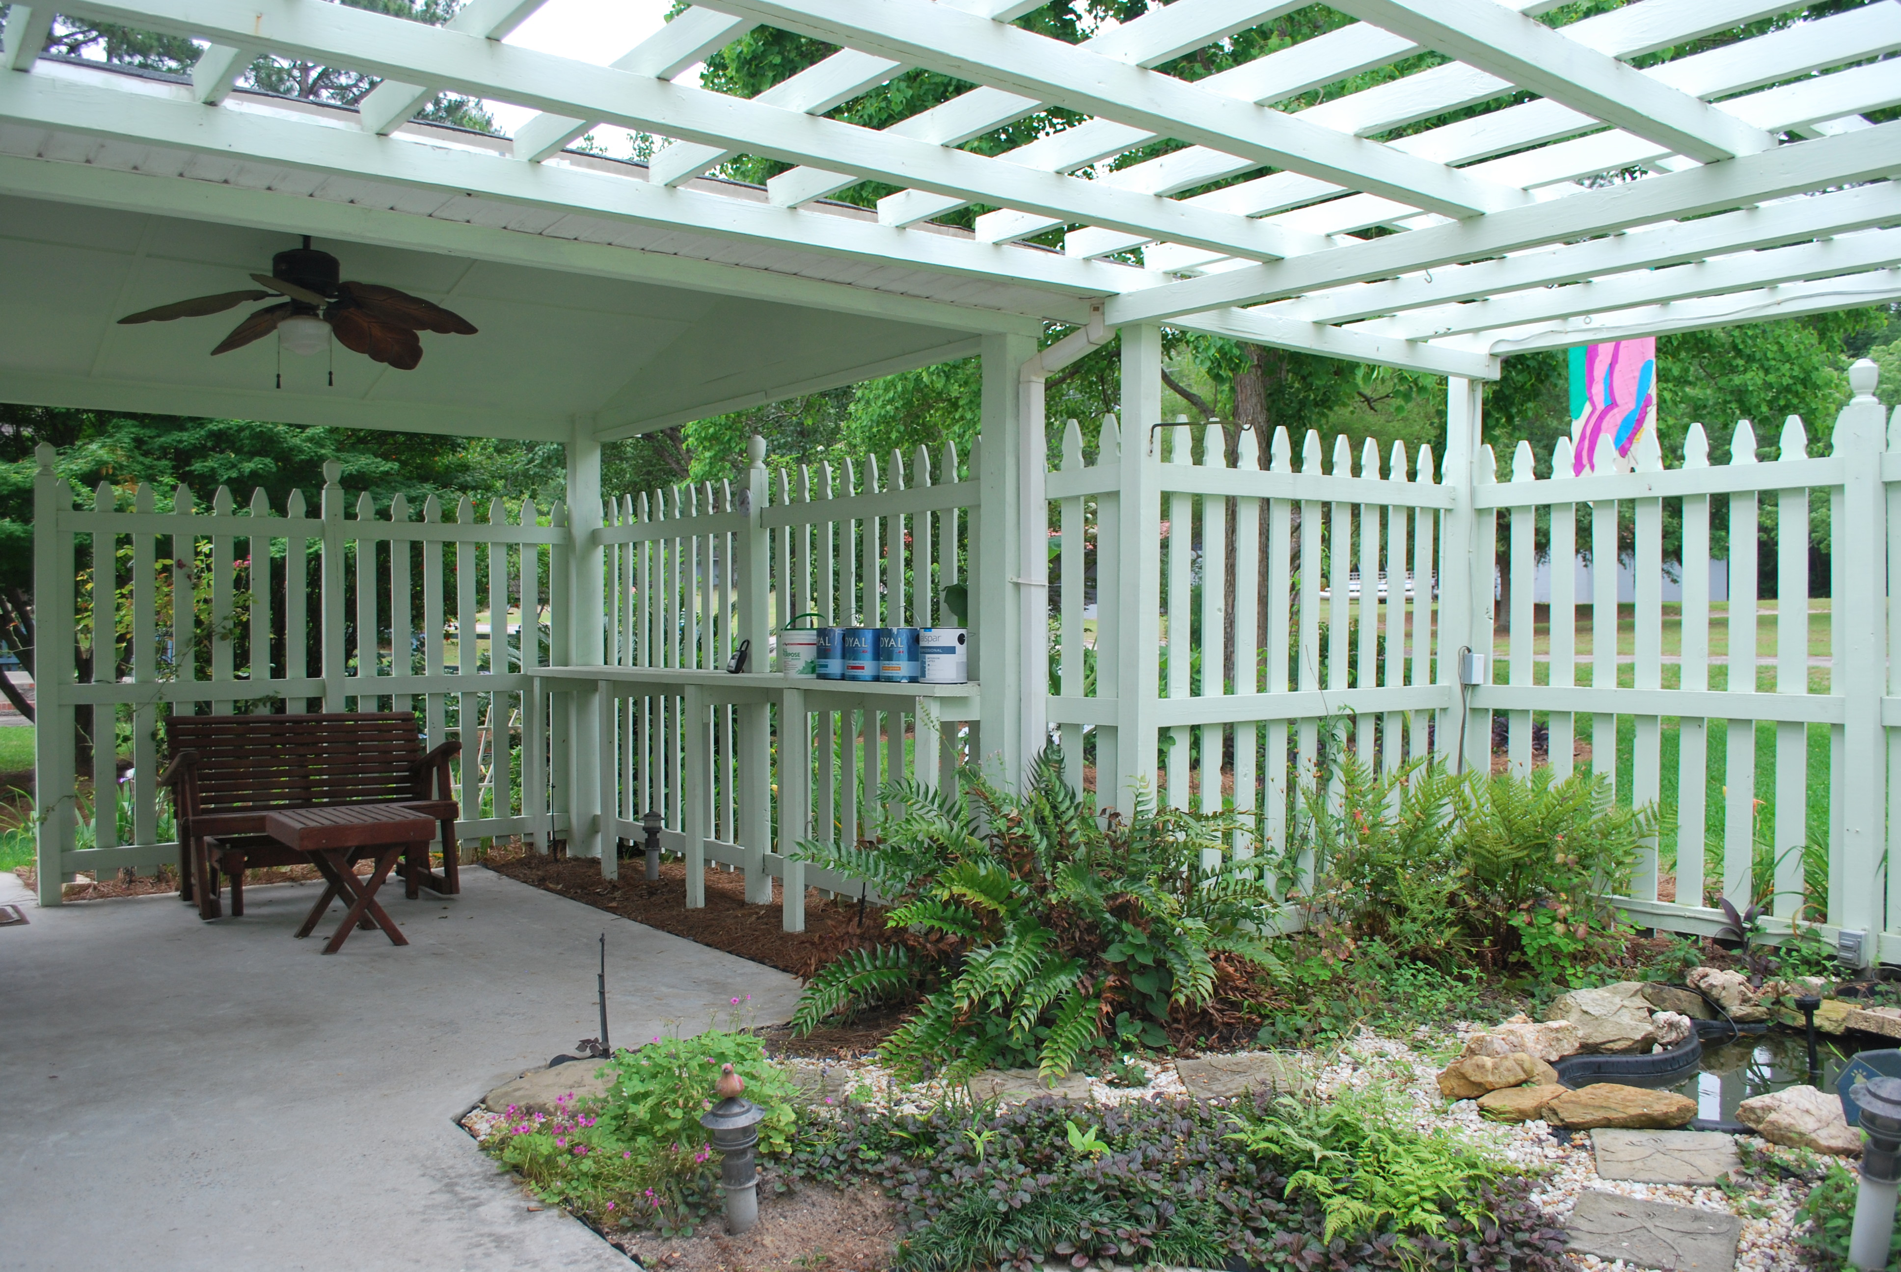
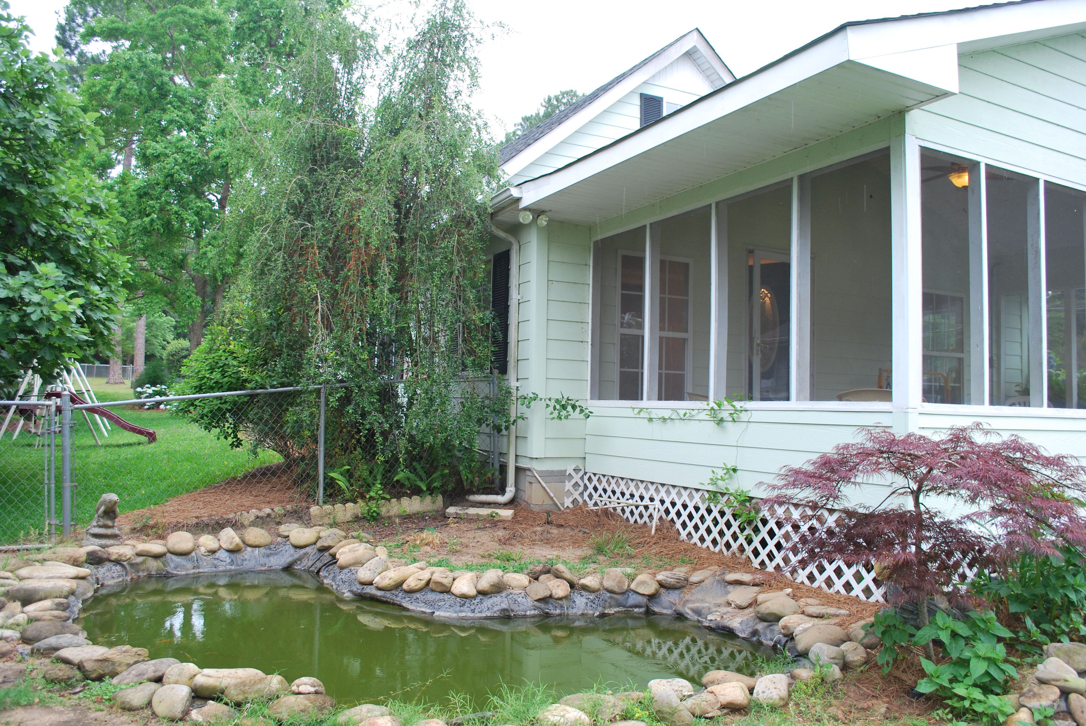
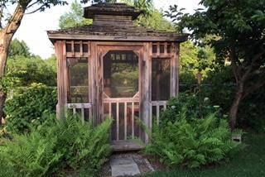
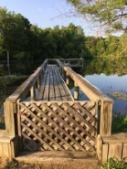
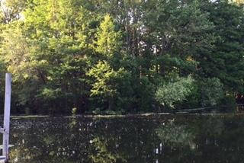
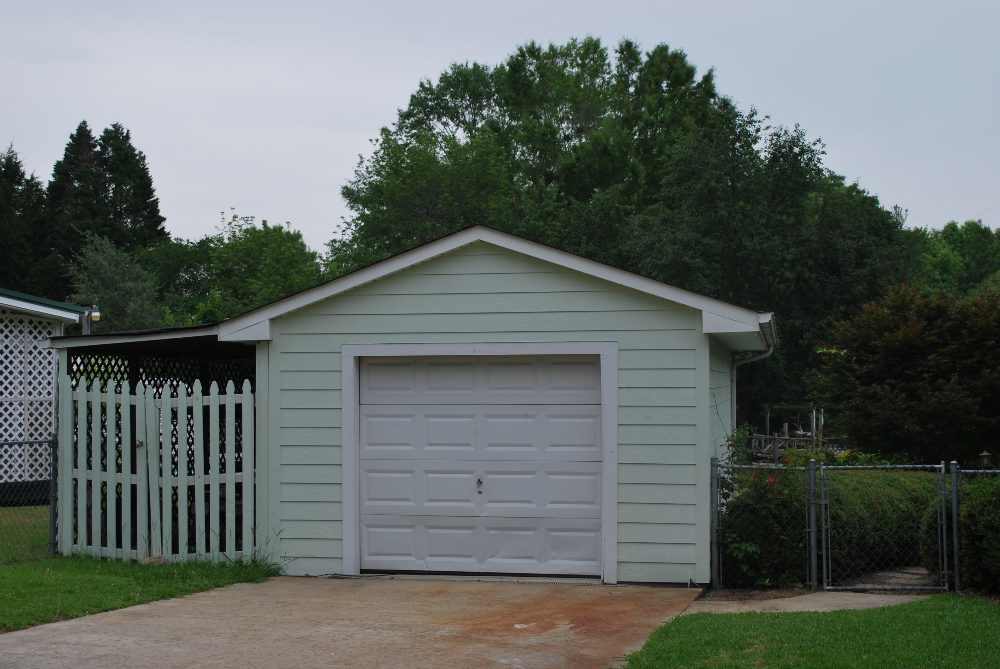

273 Belvedere Drive
Belvedere II - Eutawville
MLS# 16012796 | $265,000
This is your perfect WATERFRONT summer getaway! This is a well maintained property that is within five minutes of Big Cathead, which has public lake access, and is ideal for all of your summer dreams! This property has a new air conditioner, new front porch, the outside has recently been painted, a new irrigation system, a relatively new water heater, a termite bond in place and some of the inside has also been repainted! Within the last ten years the property has also had new gutters, had the kitchen remodeled, new roof and windows, laminate floors, septic tank and leach field, a new well pump, and new siding! This property is ready for you and your family to move in!
Carla C Davis
Mobile - (843) 437-4873
gaweber@tds.net
AgentOwned Premiere Group
141 A N. Main Street
Summerville, SC 29483

