Slide 1
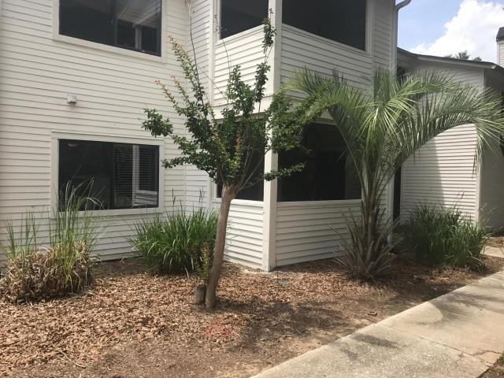
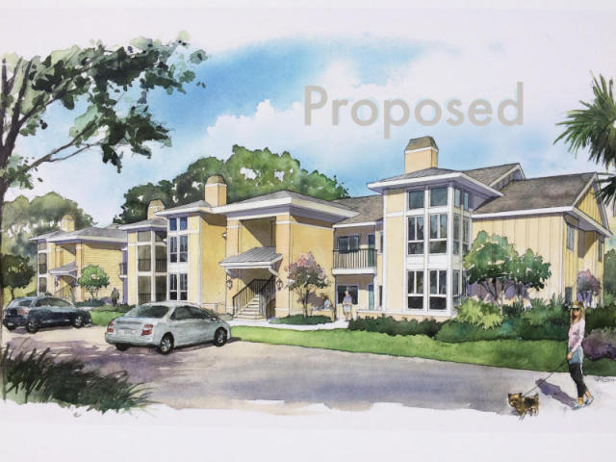
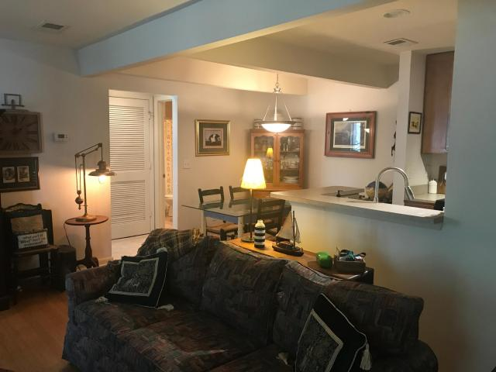
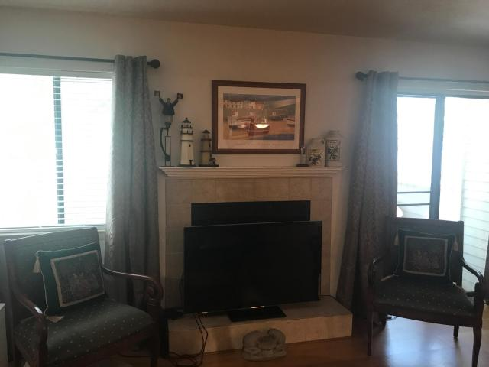
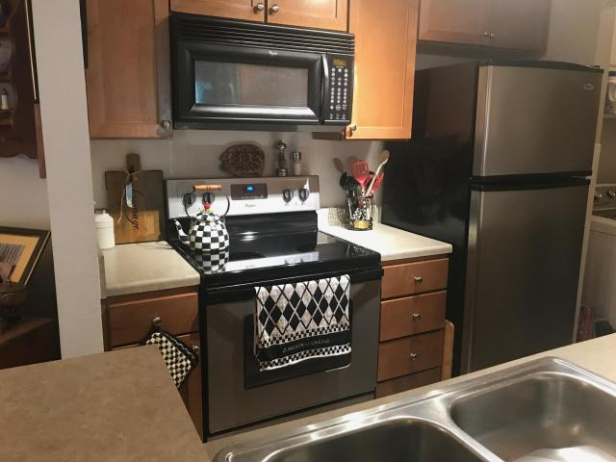
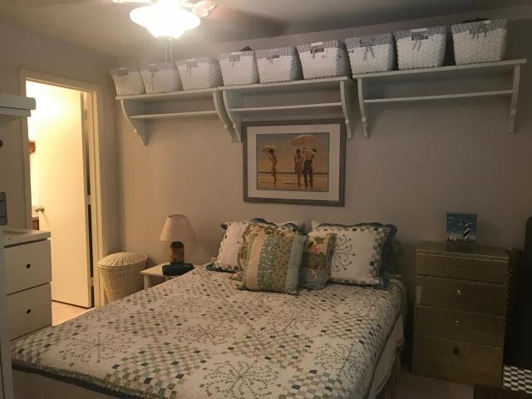
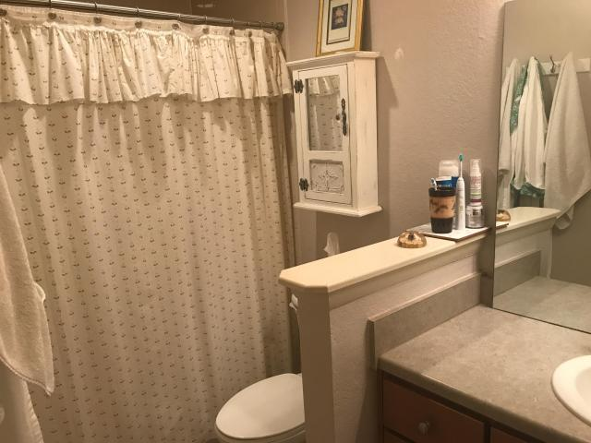
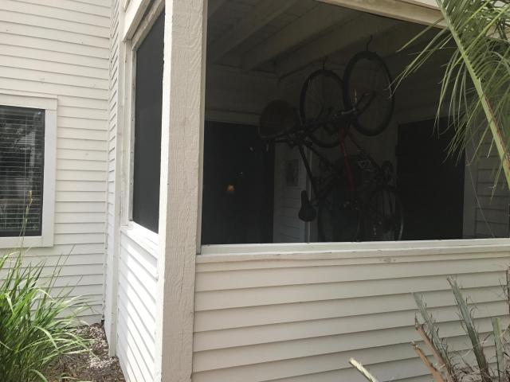
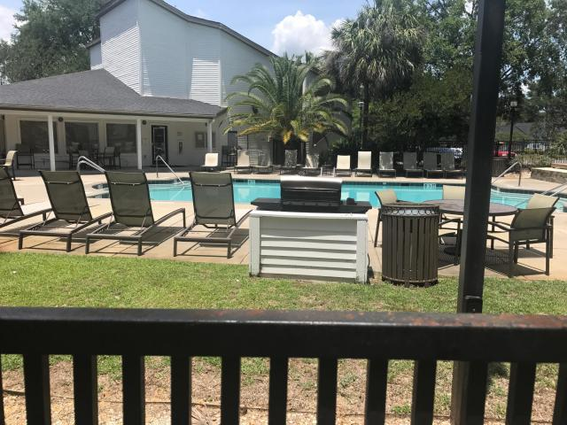
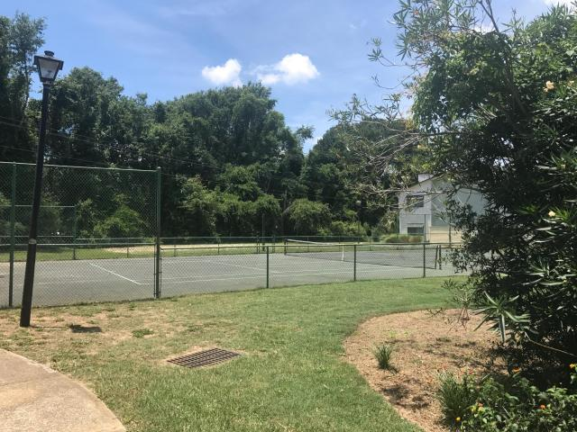

Best Bet in Popular East Bridge!
273 Alexandra Drive 13
East Bridge Town Lofts ~ Mount Pleasant, SC 29464
MLS# 17015595 ~ $220,000
Turn Key FIRST FLOOR two bedroom unit at East Bridge, with exterior renovations about to start! New cement fiber siding, new windows, new roof, reconfigured stairwells, and this seller opted to upgrade the porch to a finished sunroom! This is an AWESOME time to purchase as this unit will be the second building to be renovated! A BRAND NEW AC was installed last year in addition to a new range. This unit has bamboo floors throughout the main living areas and upgraded light fixtures as well. Amenities include a fitness center, pool, and tennis courts. UNBEATABLE LOCATION! Walk to Waterfront Park, a quick ride over the bridge to Historic Downtown Charleston, and close proximity to Starbucks, Whole Foods, Trader Joe's, and other favorite stores, restaurants and attractions The best value in East Bridge is ready for its new owner, so don't delay!
Ellen O'Neil
Broker/Owner
Ellen O'Neil Realty
ABR, e-PRO, CNE
Charleston Realtor of Distinction
(843)300-8530
http://EllenONeilRealty.com

