Slide 1

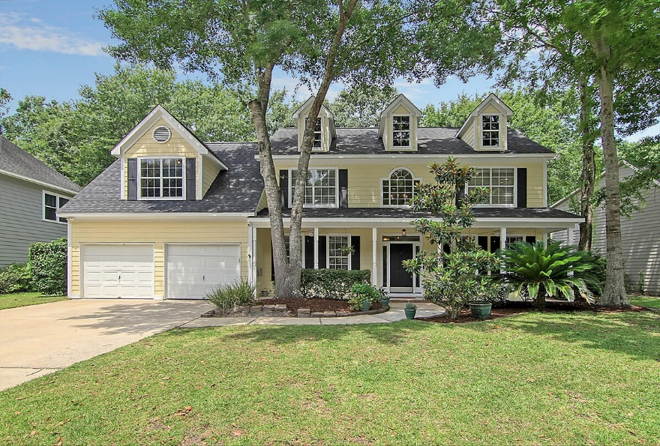
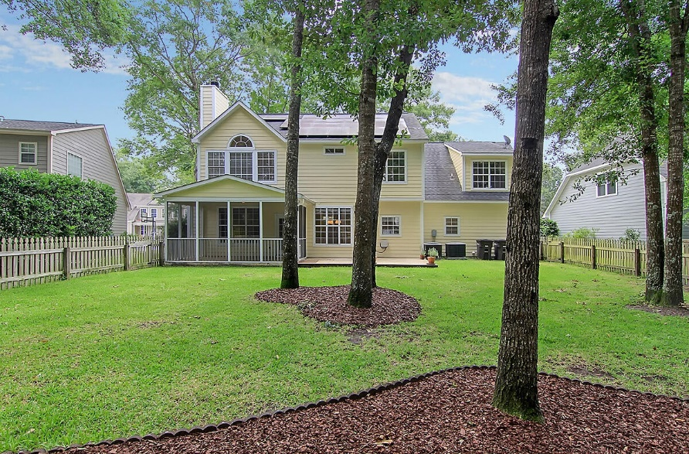
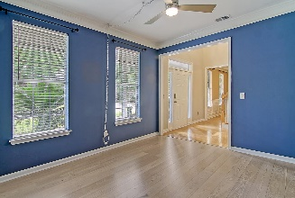
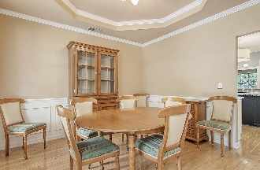
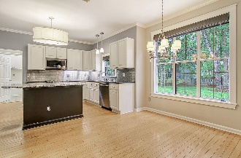
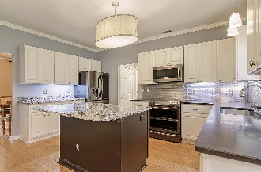
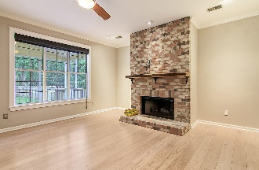

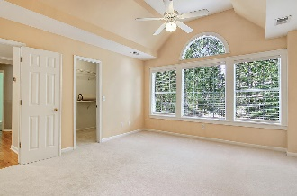
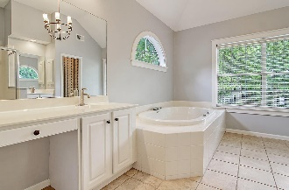
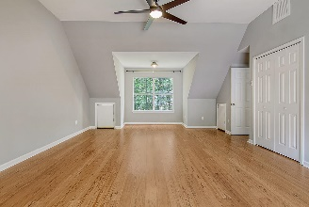
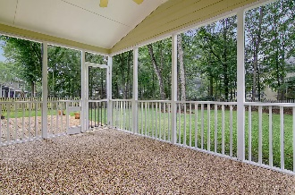
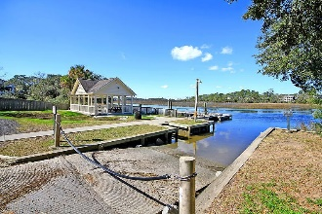
Price Improved ~
Beautiful Brickyard Home
Debbie Cromer
ABR, RSPS, REALTOR, CRS
(843) 437-6342
debbie@debbiecromer.com
www.debbiecromer.com/
2743 Seastrand Lane
Brickyard Plantation | Mount Pleasant, SC 29466 | MLS# 23013839 | $819,500
Price Improvement! Stunning two-story home, where modern updates meet classic charm. The heart of the home is the spacious eat-in kitchen, complete w/ honed black granite countertops & sleek black stainless appliances. The cozy breakfast area opens up to the inviting family room, featuring a wood-burning fireplace w/ a reclaimed wood mantle. With a separate dining room & study downstairs, there's no shortage of space for entertaining or working from home. Upstairs you'll find four bedrooms including the luxurious master suite. Enjoy morning coffee on the screen porch with its new pebble floor or host barbecues on the large deck overlooking the beautifully landscaped fully fenced yard which features in ground irrigation - all while basking in natural light that floods through every window. This home features many updates including eco-conscious and energy efficient solar panels that not only reduce your carbon footprint but also cut down on utility costs. Harnessing the power of the sun in style has never been easier!
Brickyard Plantation's comprehensive amenity package: 5 lighted tennis courts with full-time teaching pro, USTA league teams, community boat ramp & deepwater dock PLUS dry boat storage, soccer field, basketball court, Clubhouse, junior Olympic pool plus a 2nd smaller pool in the Colonnade! Walk & jogging trails throughout the community. Brickyard Boat Landing is in Old Brickyard section on Royal Trace Lane
Video Tour
Century 21 Properties Plus | 1090 Park West Blvd; Ste 103 | Mount Pleasant, SC 29466

