Slide 1
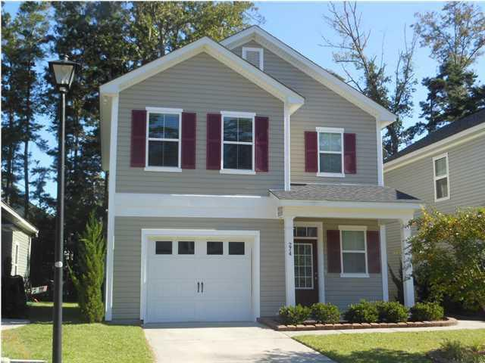
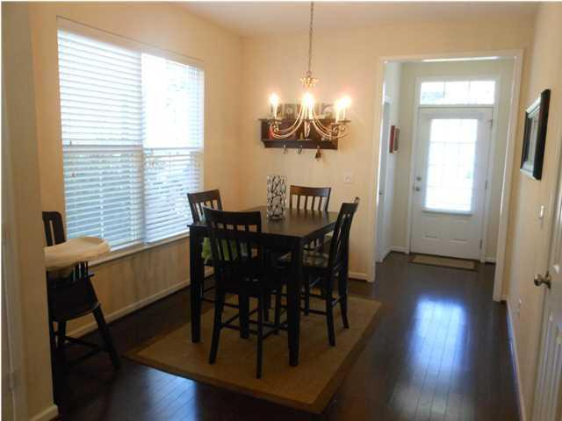
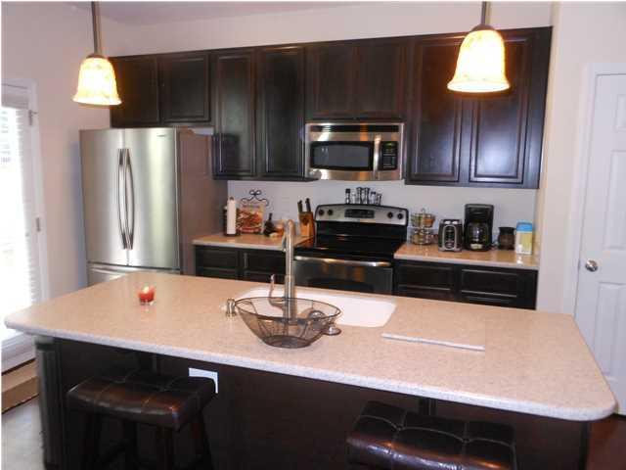
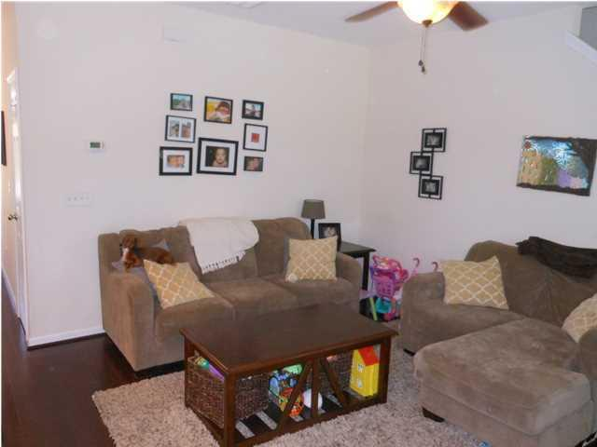
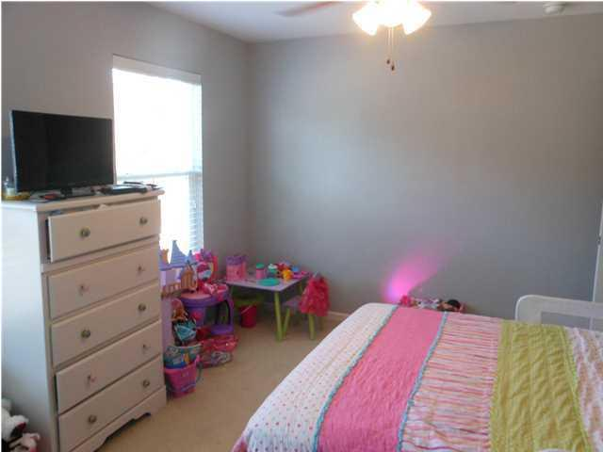
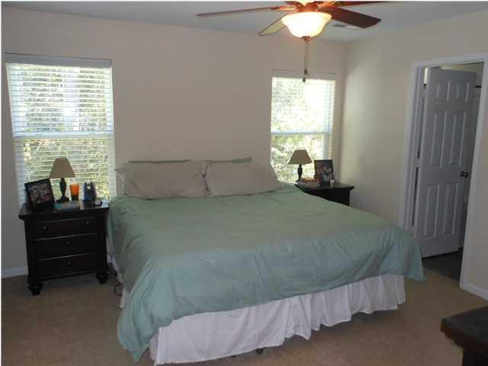
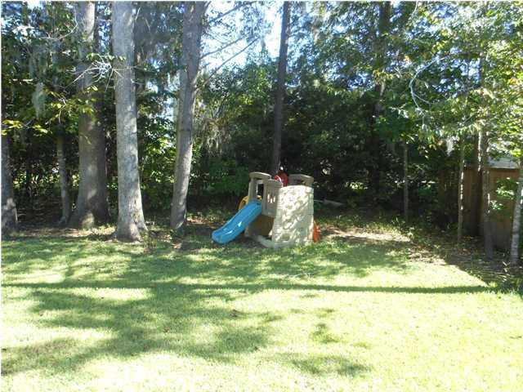

274 Chemistry Cir The Reserve at Eagle Run Ladson, SC MLS# 1426616 $154,900 1,429 Sq Ft - 3 Bedroom - 2½ Bath
Just Listed!
Well maintained 3 bedroom 2.5 bath home in great neighbor and Dorchester 2 schools. This home has beautiful hardwood floors throughout the first floor. The entrance hall with its beautiful hardwood floors has a powder room off to one side and continues on to a separate dining area adjoining the kitchen completing the open floor plan design. The kitchen with recessed can lighting boasts a stainless steel smooth top range, built in microwave, refrigerator, dishwasher and pantry. There are upgraded 42'' cabinets with Corian countertops, a center island with pendent lights overlooking the family room. There is also has an oversized garage with storage under the stairs. Upstairs are 2 nice sized secondary bedrooms joined by a Jack and Jill bath with upgraded cabinet. The master suite features a walk-in closet, private bath with dual sinks, and upgraded cabinets. A separate laundry room is conveniently located on the second floor. All blinds, ceiling fans and the washer and dryer convey with the home. Its move in ready. The back yard is bordered by a wooded buffer for privacy. The Reserve at Eagle Run is conveniently located in the Oakbrook area of Summerville. Dorchester II schools you are within walking distance to both Oakbrook Elementary and Middle School and a short drive to Fort Dorchester High School. The Reserve at Eagle Run is centrally located to the Air Force Base, Boeing, as well as the Naval Weapons Station and area interstates. Beaches, Historic Downtown Summerville and shopping are just a short drive. The extension of Parler Road to Ladson Road is under construction. This will make for even quicker access to I 26, Trident Hospital as well as the Naval Weapons Station. This is a must see home and is available for a quick close.
Bill Milo
Mobile: 843-412-0052
Bill@southernshoresre.com
Southern Shores Real Estate
1050 St. Andrews Blvd
Charleston, SC 29407

