Slide 1
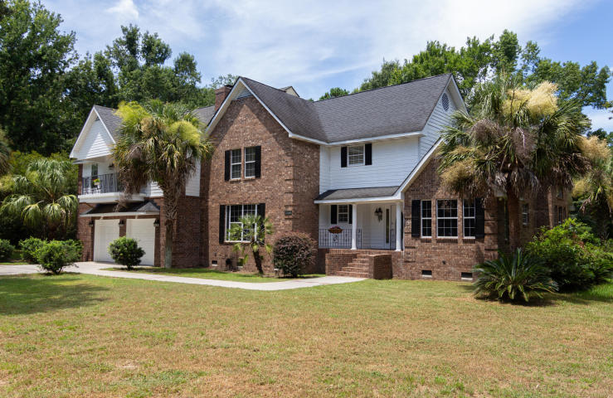
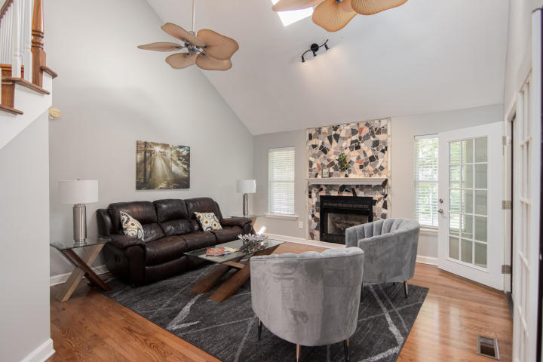
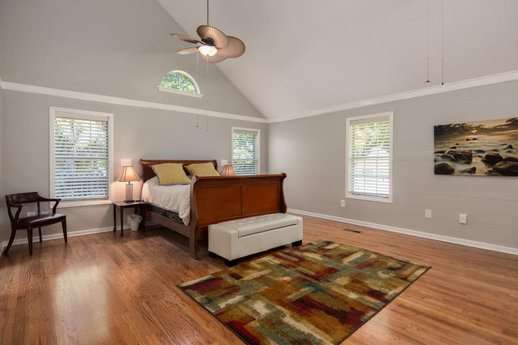
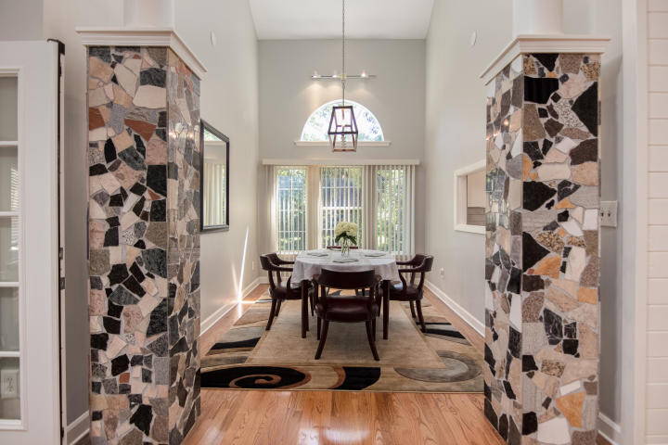
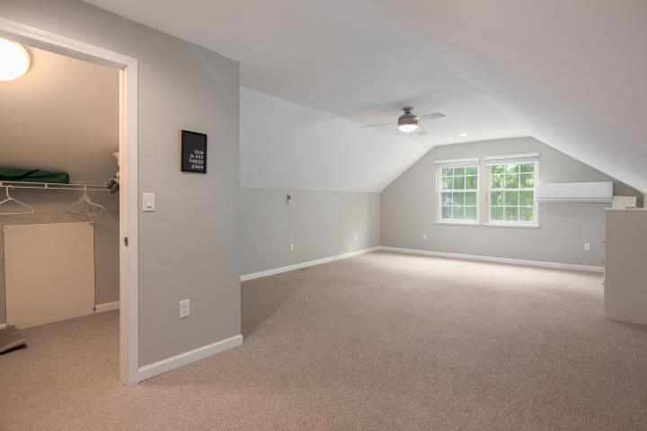
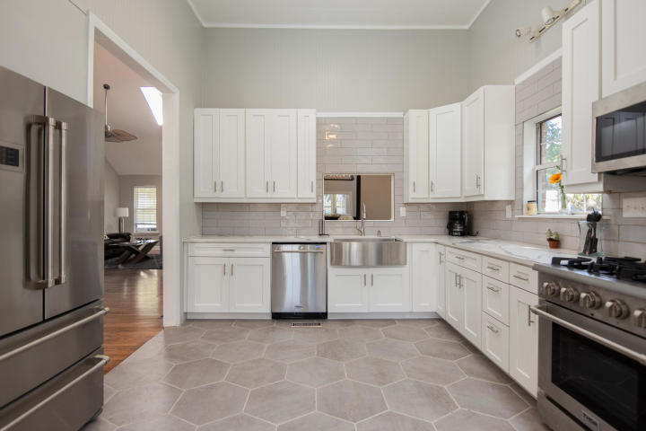
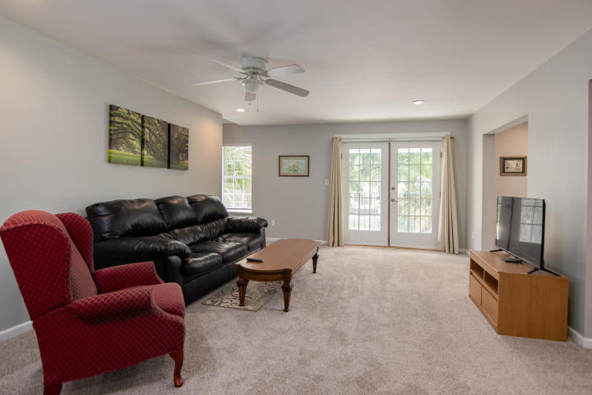
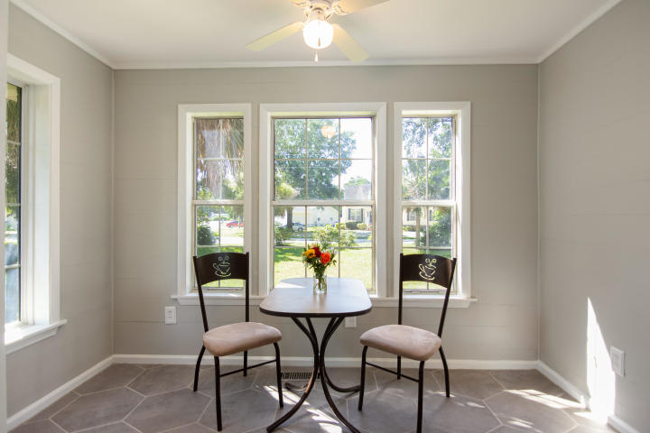
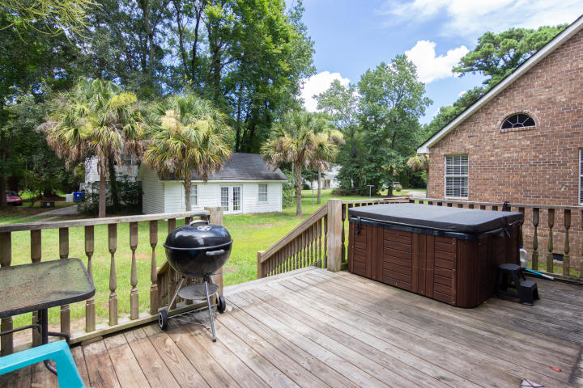
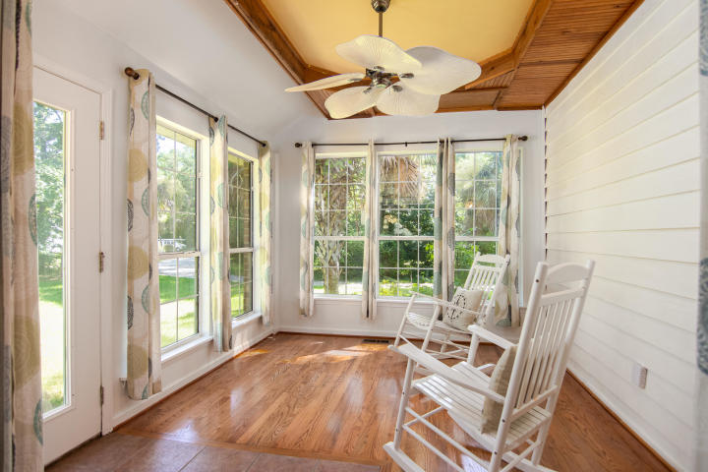
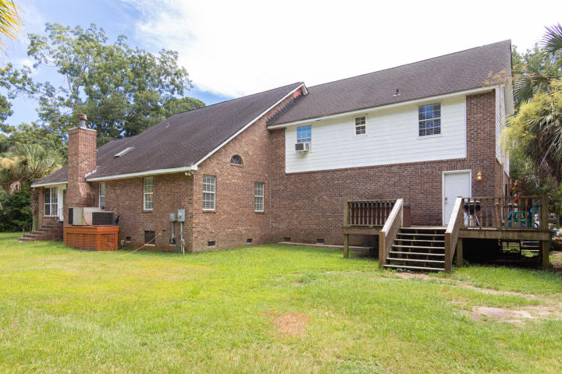


Want A $676,000 Home
That Pays For Itself?
Agent Open House
Wednesday from 11-1
2750 Rifle Range Road
Mount Pleasant, SC 29466 ~ MLS# 20022231 ~ $676,000
Tired of paying for HOA fees that you never use? Enjoy this fully renovated 5 Bedroom, 3 full bathrooms and 3 half bathroom home with a downstairs master on a .5 acre lot . Has a separate in law unit perfect for visiting friends and family or vacation rentals (call for detailed information). Home has been totally renovated in 2020 with new kitchen, upgraded appliances, gorgeous quartz countertops, new tile flooring, and custom white cabinetry. Main floor showcases an enormous master bedroom retreat with soaring ceiling, his and her large walk in closets, marble bath featuring oversized shower with double shower heads, soaker tub, and dual sinks. Main level has a fresh feel with shiplap throughout, newly finished hardwood floors, palatial dining room, formal living room with fireplace, skylight, soaring ceilings, sunroom, giant family room with another brick fireplace. Separate driveway for anyone wanting a boat which opens up to an amazing backyard with a workshop/shed.
Jason Newhauser
(843) 534-6564
jasonsellscharleston@gmail.com
www.jasonnewhauser.com
Coldwell Banker Residential Brokerage
1127 Queensborough Blvd. 103
Mt Pleasant, SC 29464

