Slide 1
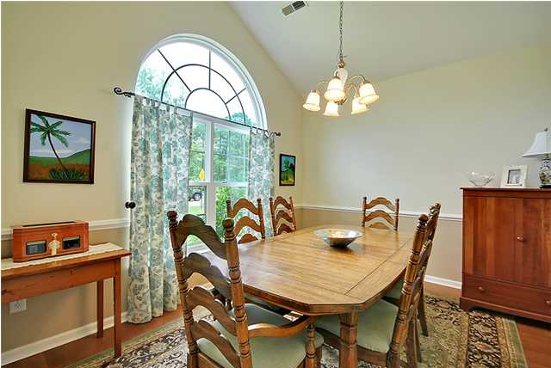
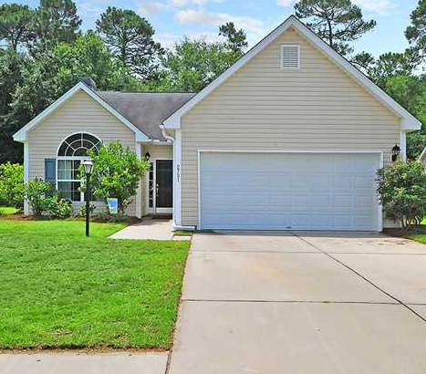
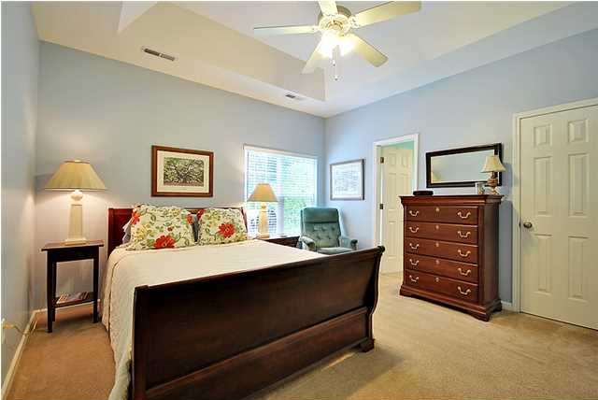
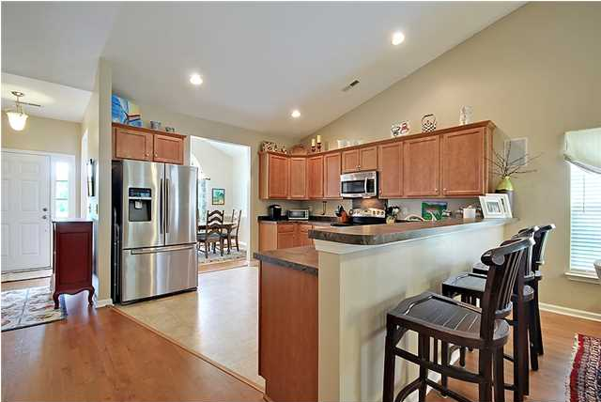
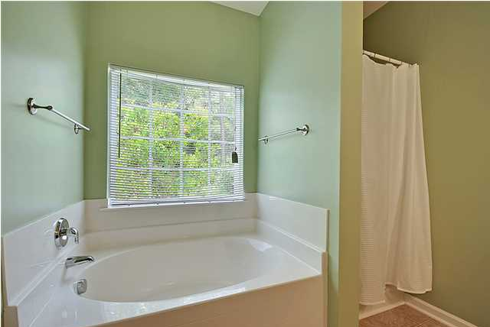
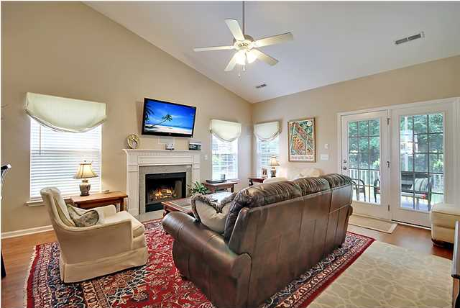
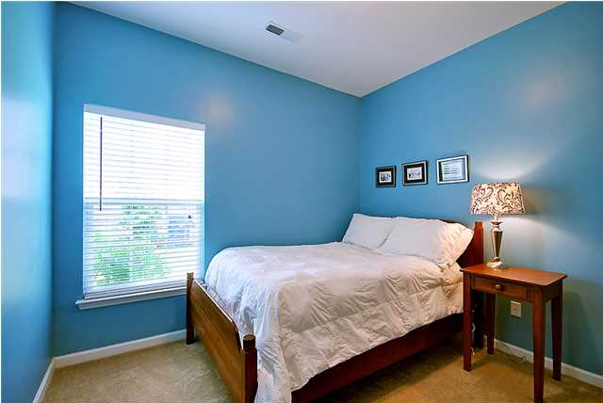
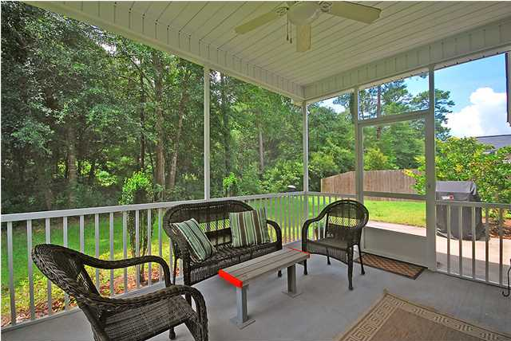
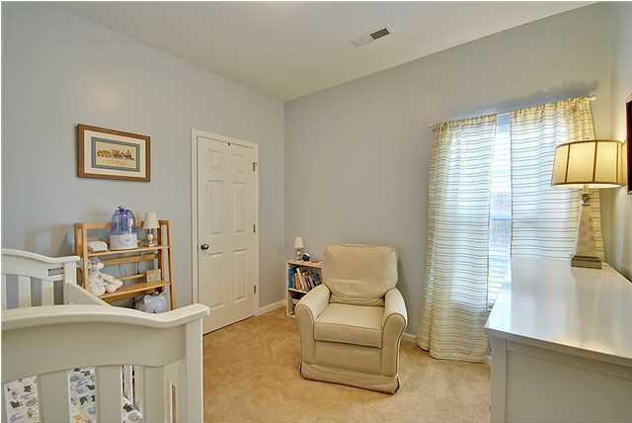


BEST DEAL ON JOHNS ISLAND!
2751 Summertrees Blvd
Summertrees – Charleston – MLS# 1419163 - $204,000
Prefect opportunity to purchase a turn key home in the heart of Johns Island just minutes to Downtown Charleston, Kiawah Island and all of greater Charleston. As you enter this amazing home you will find wood floors throughout the foyer, dining room and living room, the formal dining room just to the left upon entry, perfect for entertaining guests and meals with the family. The huge chef's kitchen flows perfectly into the living room, complete with grand vaulted ceilings and a fireplace. There is ample counter space as well as 42 inch cabinets, in addition too GE stainless steel appliances! The living room leads you out to the ultra private screened in porch where you can grill out or relax. The two guest bedrooms are very spacious and offer plenty of closet space as well as a full bath to share. The master bedroom boasts a deep tray ceiling, large walk in, dual vanity, soaking garden tub and stand up shower. This home also features distributed audio surround sound in the living room and screened in porch. This is an energy star rated home as well. The outdoor areas are ideal and private, the garage has plenty of room for cars, storage and/or a workshop, there is also an irrigation system. This home is priced to sell, don't miss this house!
Dan Lorentz, Realtor
ERA Agent of the Year
843-532-4653
dan@danlorentz.com
www.danlorentz.com
ERA Wilder Realty, 125-F Wappoo Creek Dr, Charleston, SC 29412

