Slide 1
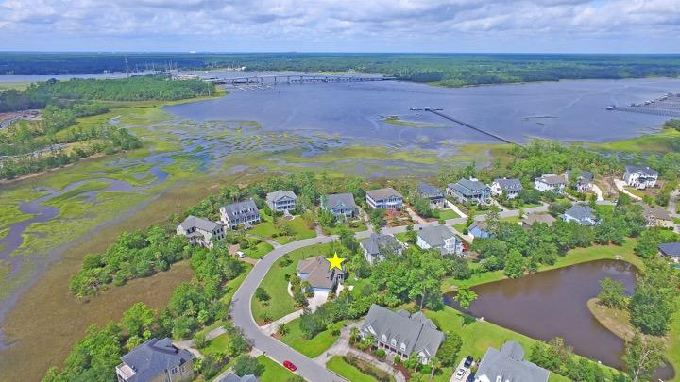
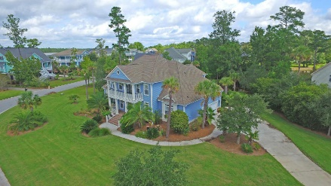
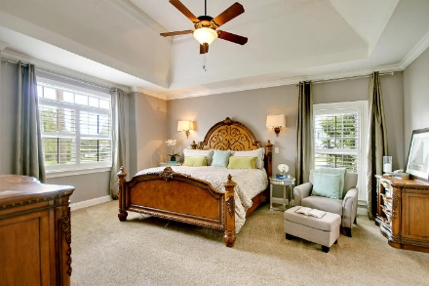
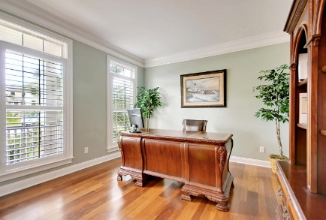
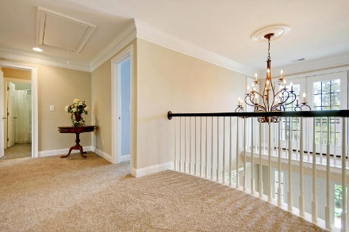
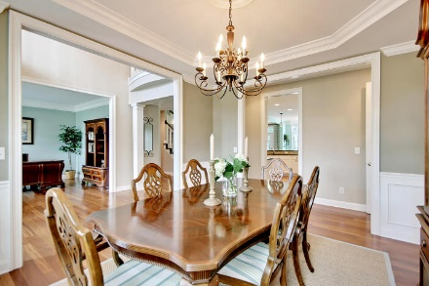
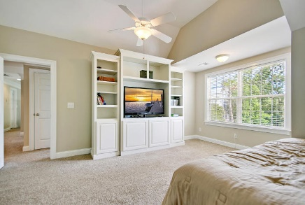
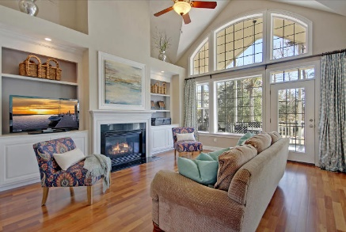
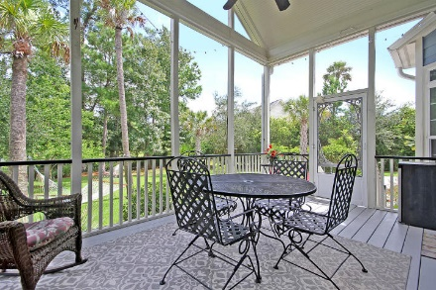
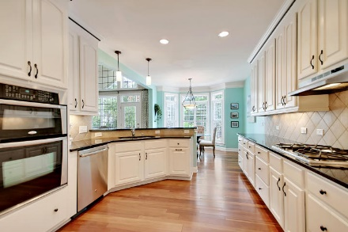
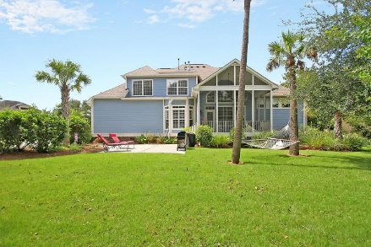
Price Reduced!
Seller Offering $5,000 Agent Bonus For Closing By 5/1/18
2752 Oak Manor Drive
Dunes West ~ Mount Pleasant, SC 29466 ~ MLS# 17025865 ~ $624,999
This beautiful, move-in-ready home features a grand lot with a private feel. It has a large curved shaped front lawn and a long driveway and it sits across the street from wooded marsh. The spacious back yard is on a pond and is buffered from other homes by mature landscaping. The home's floor plan is ideal for everyday living and entertaining. It features a downstairs master ensuite, a two story living room with fireplace and built-ins, a screened porch with cathedral ceiling, a two story entry and a flex loft space. It boast Brazilian teak floors, formal dining room with tray ceiling, eat in kitchen with bay window and a huge mud room. Exterior painted in 2015. Dunes West has amazing amenities: golf, tennis, play park, pool, fitness center, boat ramp/storage, walking/biking trails.
Additional features include:
Upstairs are three bedrooms, two full baths, access to the balcony and a loft area
Exterior painted in 2015.
Dunes West has amazing amenities: golf, tennis, play park, pool, fitness center, boat ramp/storage, walking/biking trails.
Book your showing today!
Lisa Quick lisa@mattoneillteam.com 843-452-6688

