Slide 1
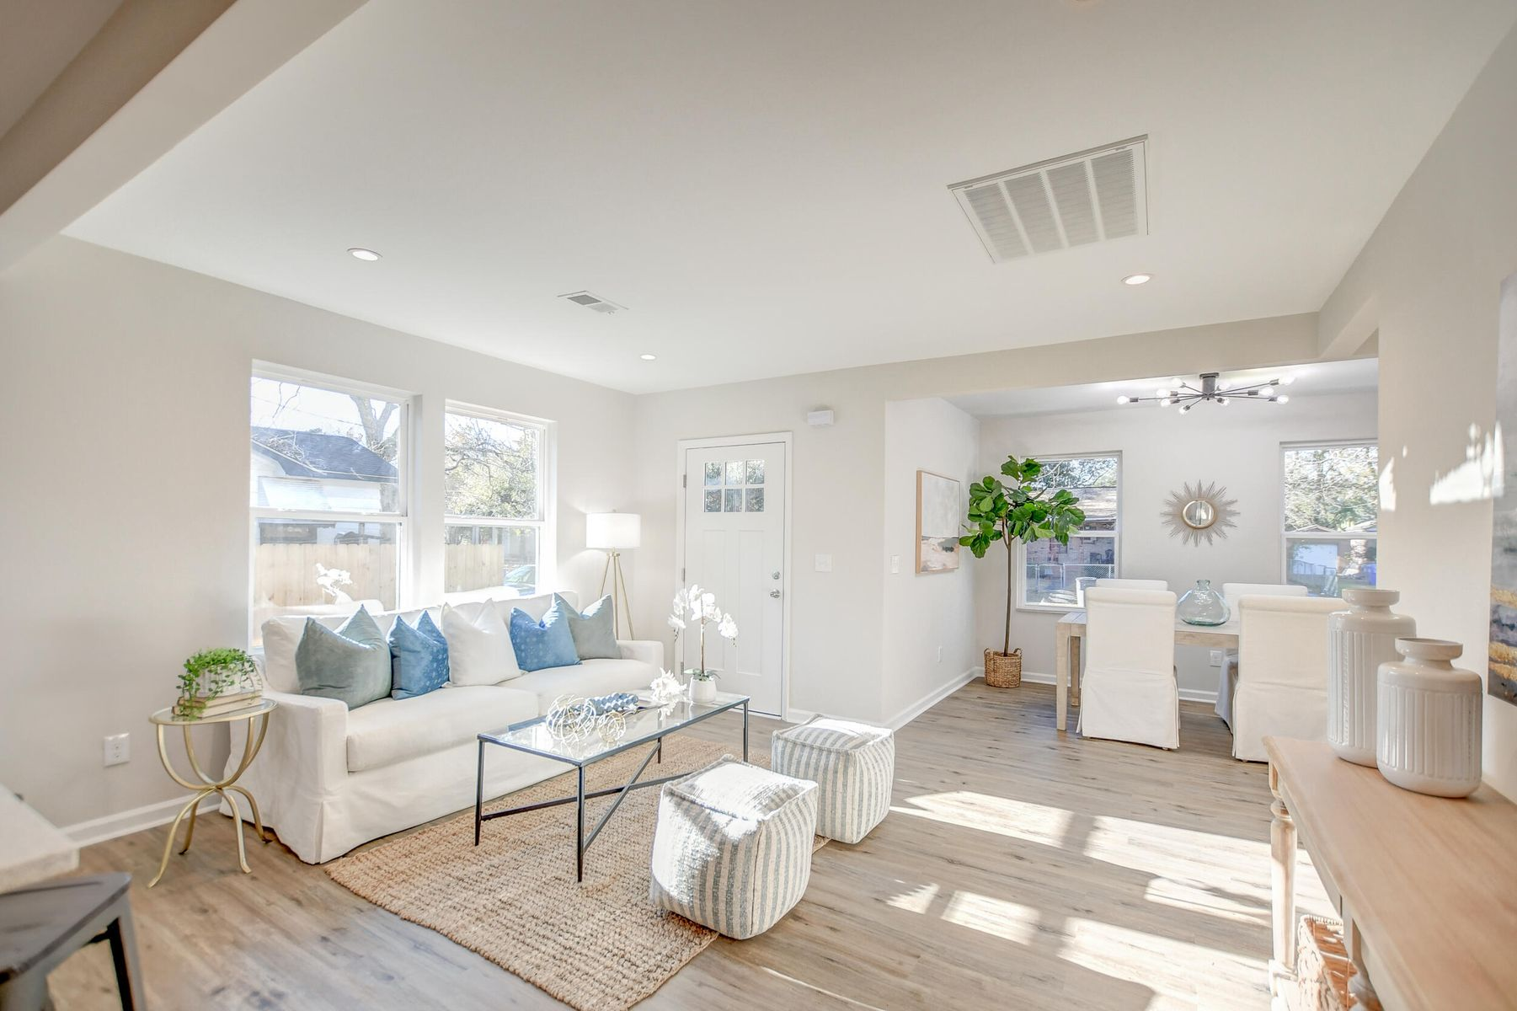

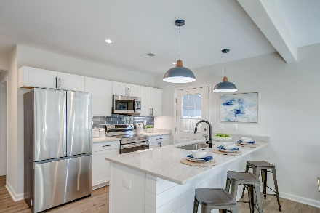
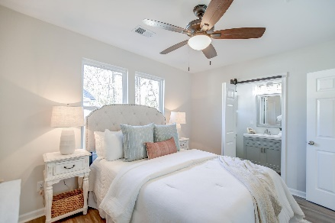
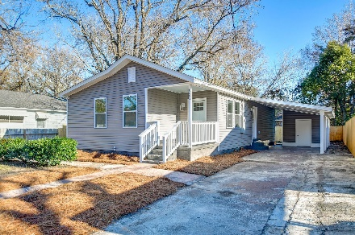
Price Refreshed
OPEN HOUSE
SATURDAY 12-3
Open House Saturday 12-3
2753 Ranger Drive
Waylyn ~ North Charleston, SC 29405 ~ MLS# 24002141 ~ $335,000
Why You'll Love This Home:
Completely Renovated: Experience the blend of artistry and modernity in this meticulously updated residence.
Elegant Interiors: Enjoy luxury vinyl plank flooring throughout, a spacious open floor plan, and a designated dining area ideal for entertaining.
Gourmet Kitchen: Delight in the stylish kitchen with white cabinets, stainless steel appliances, granite countertops, and a chic navy tile backsplash.
Owner's Suite: Relax in comfort with dual walk-in closets and an ensuite bath featuring a custom tile step-in shower.
Outdoor Oasis: Discover a spacious backyard with a new extended privacy fence and an enclosed courtyard, perfect for serene mornings or social gatherings.
Additional Features: Benefit from a new roof, updated HVAC system, tankless hot water heater, and the potential for short-term rental use.
This move-in-ready home epitomizes modern living, offering a harmonious blend of contemporary aesthetics, thoughtful design, and practical functionality. Don't miss this opportunity to make this renovated haven your own. Schedule a showing today and envision your future in this turnkey masterpiece at a new, more accessible price.
We look forward to assisting you in your home-buying journey.
Book your showing today!
Stacy Danosky sdanosky@mattoneillteam.com 843-860-8048

