Slide 1
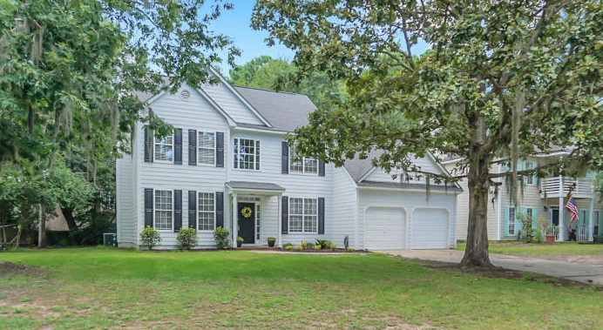
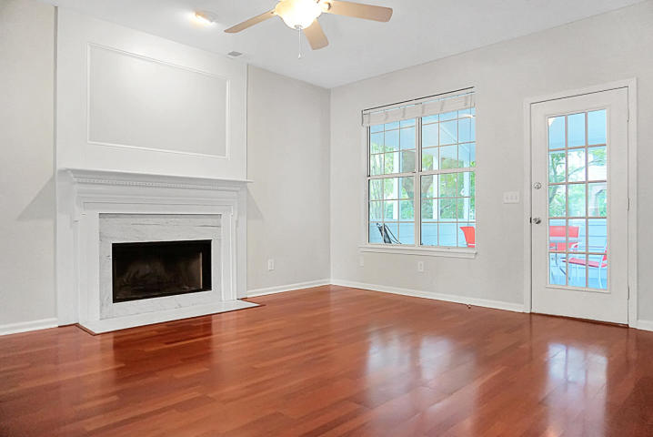
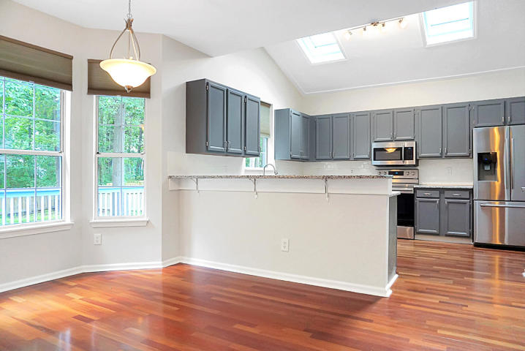
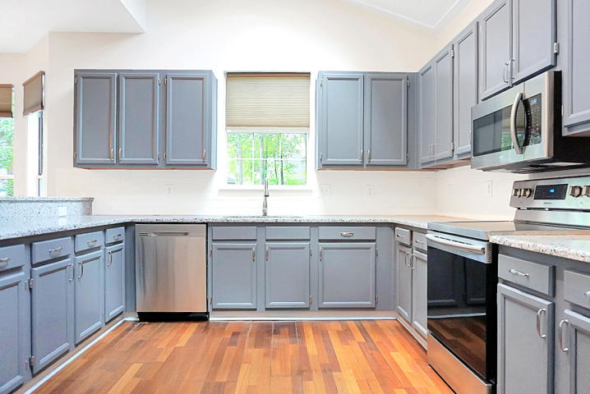
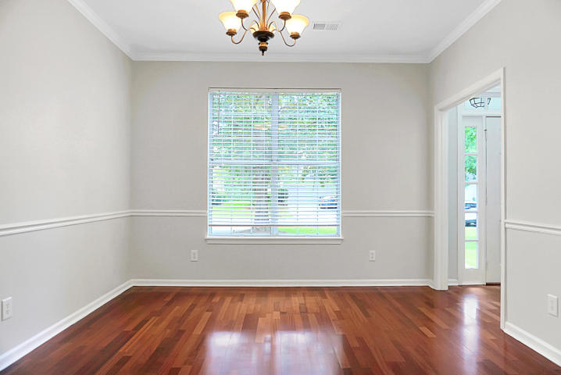
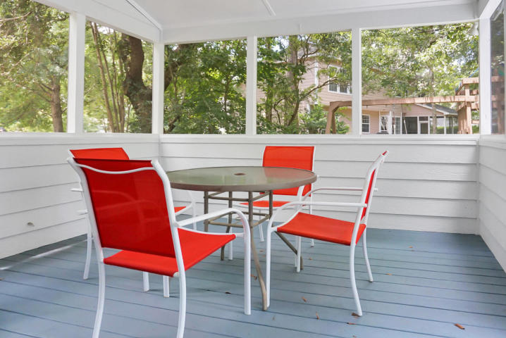
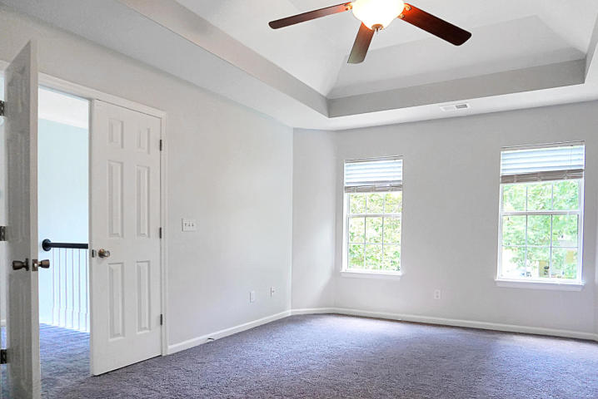
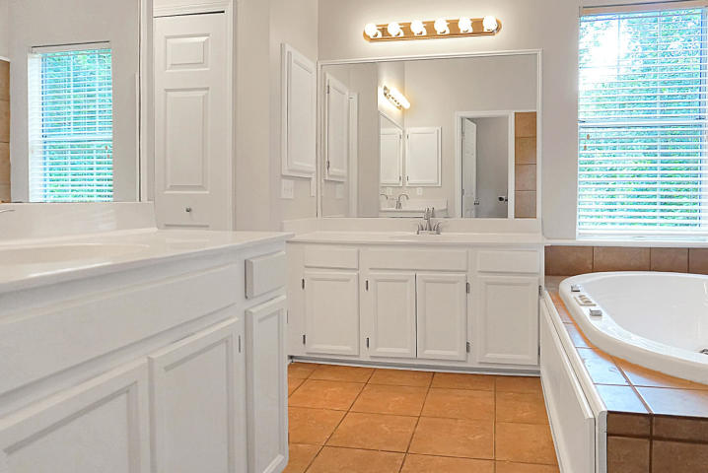
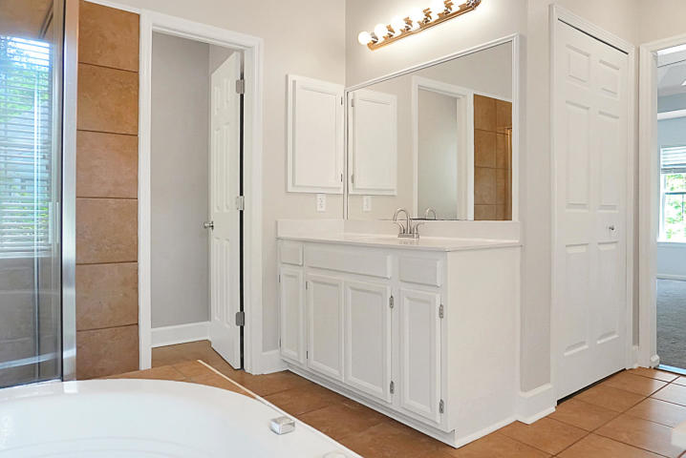
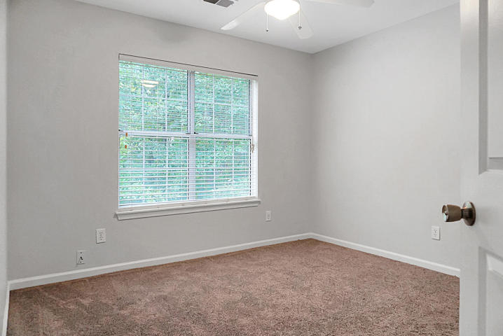
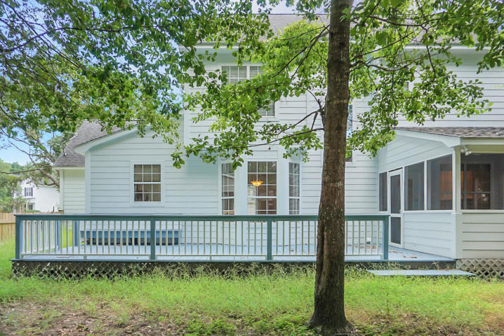


Great Home!
Great Price!
2755 Stamby Place
Brickyard Plantation ~ Mt Pleasant ~ MLS# 19021417 ~ $445,000
Beautiful, recently updated 3 Bedroom ready for move-in! This spectacular home has been freshly painted completely inside and outside, and features Brazilian hardwood floors on the 1st floor, and Brand new carpet throughout the entire 2nd floor. The large and open kitchen has grey cabinetry with beautiful new granite and subway tile backsplash, perfect for cooking and entertaining. All new stainless steel appliances with 2 sky lights above! This open floor plan has a fireplace encased with molding located in the living room, as well as crown molding and wainscoting in the dining room. Upstairs there is a large master bedroom with Jacuzzi tub and shower. The guest bath has a new vanity, new floors and beadboard on walls. There is a nice screened porch with a large deck and fenced shaded backyard. Brickyard is just minutes from the beach, and has lots of great amenities in the community, with 2 pools, new tennis courts, playground, very nice boat dock and storage parking for boats.
Marilyn Stewart, Realtor
Realtor of Distinction
843-297-4098 M
843-416-2200 F
marilyn@charlestonsells.com
Keller Williams Realty
496 Bramson Ct Ste 200
Mt. Pleasant, SC 29464

