Slide 1
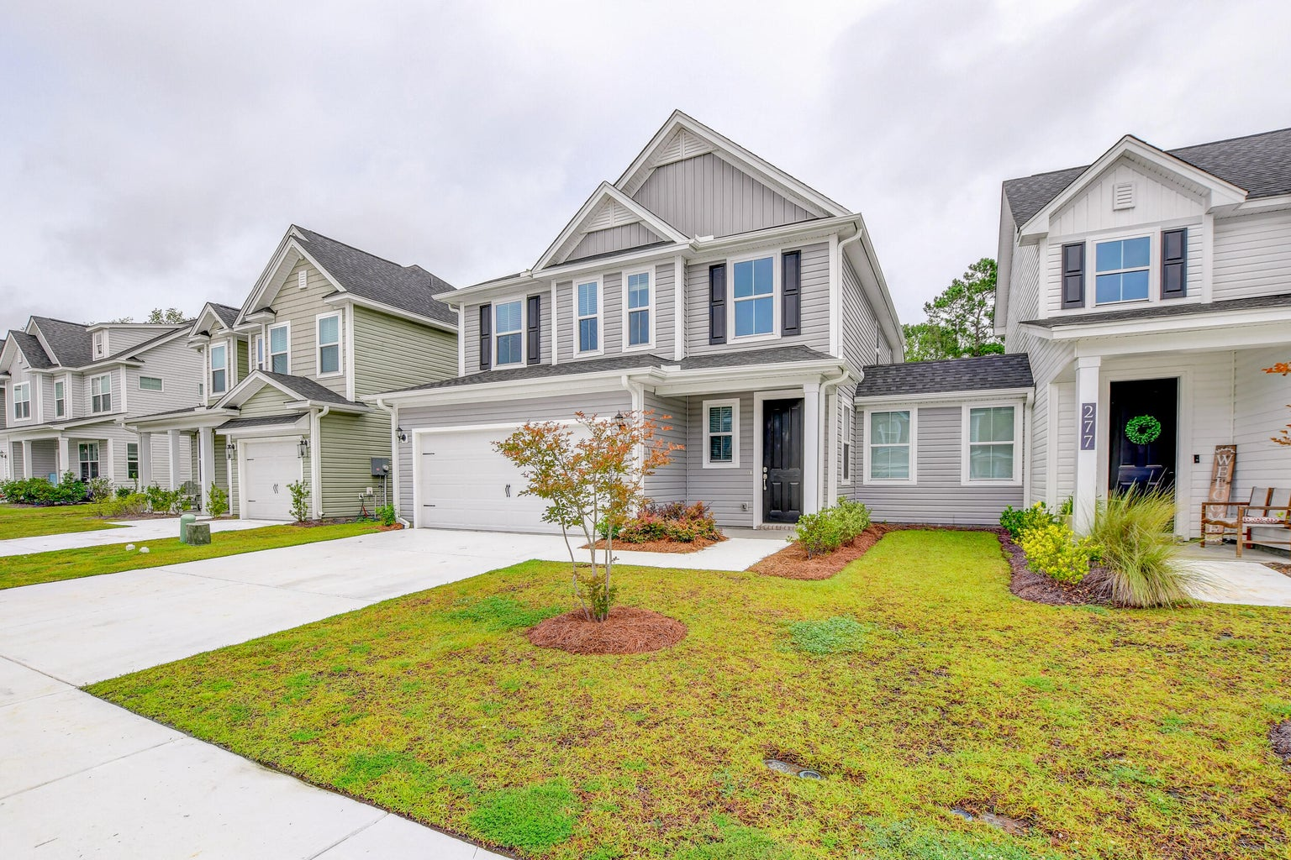

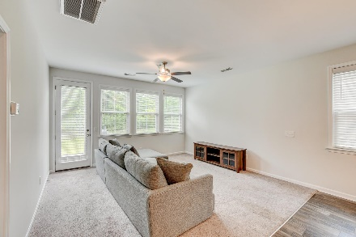
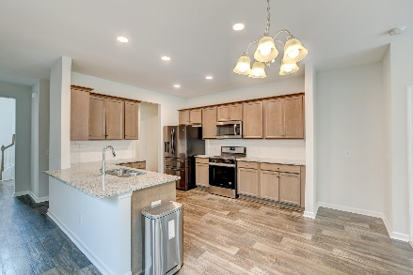
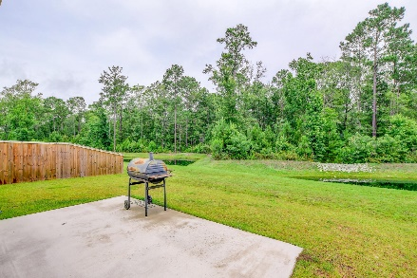
Serenity & Privacy
OPEN HOUSE
SATURDAY 12-3
Open House Saturday 12-3
275 Mcclellan Way
Hampton Woods | Summerville, SC 29483 | MLS# 23014165 | $350,000
This delightful Single Family Attached offers the perfect blend of convenience and privacy. Step inside and experience a living space that feels much more like a detached home than traditional row house designs. With its optimal layout, this home provides all the features you desire for comfortable and functional living. As you enter, you'll be greeted by a spacious living room and a well-appointed kitchen that is sure to impress. The kitchen boasts granite countertops, a breakfast bar, plenty of cabinets and counterspace, and stainless steel appliances. Also on the first floor, you'll find a large primary suite that offers a serene retreat. French doors lead you to the luxurious bathroom, complete with a double vanity, a soaking tub, and a separate shower.
Additionally, there is a convenient laundry room and a half bath on this level, ensuring utmost convenience for your daily routines. Upstairs, you'll discover a generous bonus/flex space landing that can be utilized as a second living area or a home office setup. Imagine the possibilities for creating your own personalized space to relax, work, or indulge in hobbies. Two additional bedrooms and a full bathroom complete this level, providing ample space for family members or guests. Step outside to the backyard oasis, where you'll find a patio perfect for outdoor gatherings and a grassy lawn that leads to a tranquil pond. Beyond the pond, mature woods create a picturesque backdrop, offering a sense of serenity and privacy.
This property is located 2.7 miles from Food Lion, 4.5 miles from downtown Summerville, 5 miles from Nexton restaurants and shops, 16.9 miles from Givhans Ferry State Park, and 21.4 miles from Charleston International Airport.
Book your showing today!
Jeremiah Brown jbrown@mattoneillteam.com 803-730-1715

