Slide 1

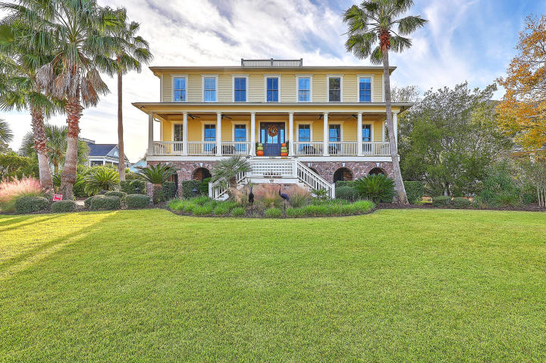
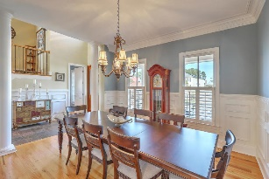
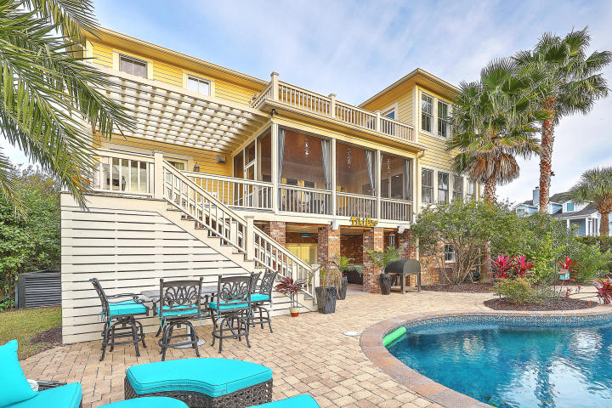
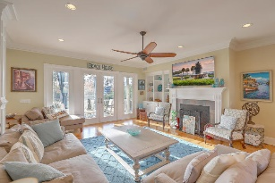
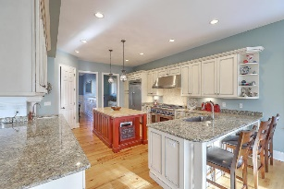
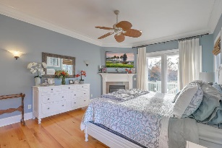
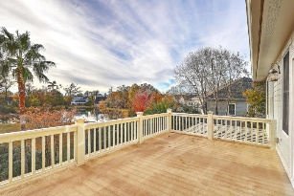
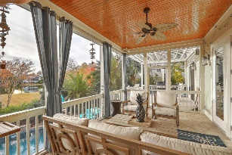
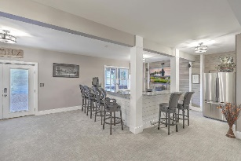
Owners Motivated ~ $20,000 Price Drop
Open House Saturday from 1-3
2760 Fountainhead Way
Dunes West ~ Mount Pleasant, SC 29466 ~ MLS# 20000374 ~ $928,900
This Lowcountry gem is located in the premier Harbour subsection of sought-after Dunes West Plantation. The brick paved driveway welcomes you home to the .366 acre pond front lot. The custom-built home contains gorgeous crown molding, distressed oak wood floors and 10’ first and 9’ second floor ceilings. The home is an entertainer's dream both inside and out. The inside offers an open floor plan with chef's kitchen and elevator access to all three floors. Outdoors, features a custom built saltwater pool complete with LED underwater lighting and a full outdoor kitchen! The southern style full width front porch has antiqued copper gas lamps, clear stained bead board wood ceiling and 4 ceiling fans.
Dunes West is a golf course community with amenities galore. This home, listed under current appraised value, is an opportunity that buyers should not ignore!
Kenneth Nix
kenneth@landsouthofcharleston.com
M (843) 222-2582 | O (843) 577-5263
Land South of Charleston, LLC | 180 E Bay St Ste 300 | Charleston, SC 29401

